Slide 1
Unit 6 Topic3
Which is the way to the hospital?
Section C
WWW.PPT818.COM

Slide 2
Review
Say the meaning of each traffic sign.
Turn right
No left turn
Turn left
No right turn

Slide 3
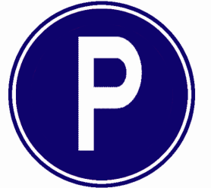
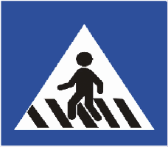
Say the meaning of each traffic sign.
Danger
Parking
No parking
= Don't park here.
Crosswalk

Slide 4
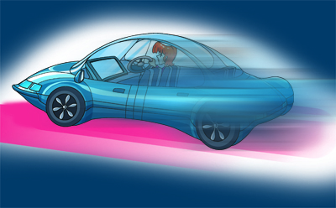
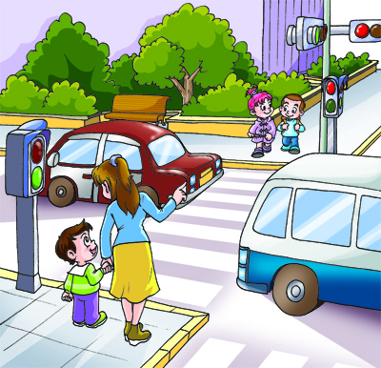
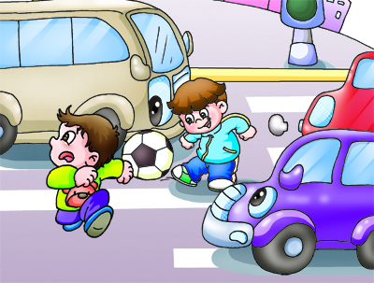
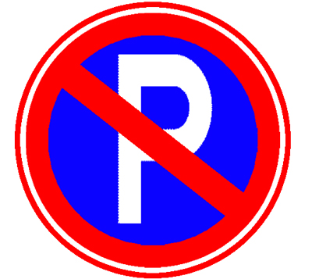
Match the following sentences with the pictures.
A. Don't drive too fast.
B. Stop when the light is red.
C. Turn right.
D. Don't park here.
E. Be careful!
F. Don't play on the
street.
A
E
D
C
B
F

Slide 5
祈使句
祈使句表示请求、命令、建议，句子通常不带主语，谓语动词用原形。肯定形式一般以动词原形开头，其否定形式是在谓语动词前加do not或don’t。
A. Don't drive too fast.
B. Stop when the light is red.
C. Turn right.
D. Don't park here.
E. Be careful!
F. Don't play on the street.

Slide 6
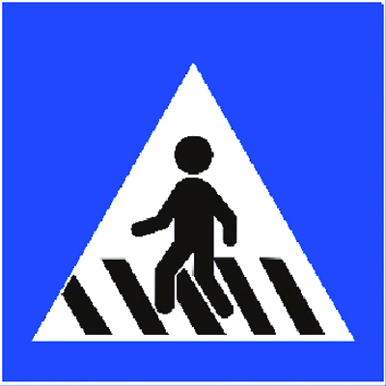
Work in groups. Discuss and write more traffic rules.
Don't drive after drinking.
Don't ride on the sidewalk.
Cross ...
...

Slide 7
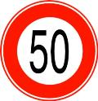
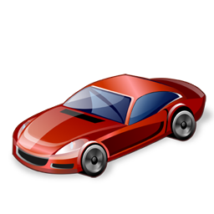
1. If you drive too fast, the policeman will give you a ticket for speeding.

Slide 8
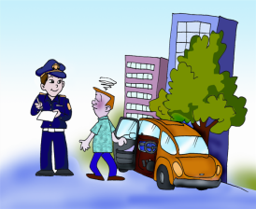
Look at the pictures and match them with the sentences.
醉驾
2. a ticket for drunk-driving
3. a ticket for parking in the wrong
places
4. a ticket for making a wrong turn
3
2
4

Slide 9
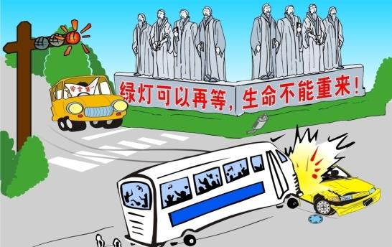
a traffic accident 交通事故
get hurt 受伤
lose one’s life 丧生

Slide 10
Look at the title of the passage and guess what the passage is about.
Keeping Safe on the Street
How can we keep safe when we are walking on the street?

Slide 11
Read 1a and mark T for true or F for false.
( ) 1. We must not cross when we see
the green “walk” sign.
( ) 2. We must stop and look both ways
before we cross the street.
( ) 3. We must not ride skateboards on
the street.
( ) 4. It’s not good to help children
cross the street.

Slide 12
( ) 1. We must not cross when we see
the green “walk” sign.
( ) 2. We must stop and look both ways
before we cross the street.
( ) 3. We must not ride skateboards on
the street.
( ) 4. It’s not good to help children
cross the street.
F
T
T
F

Slide 13
Read 1a and fill in the blanks.
How can we keep safe when we are walking on the street?
First | We must __________ the traffic rules. We must cross when we see the ________ "walk" sign.
Second | We must _________ and ________ both ways.
Third | We must never ________ on the street.
Last | We should help __________ and ________ _________ cross the street.
All of us should be very careful when we are walking on the street.
obey
green
stop
look
play
children
old
people

Slide 14
The words, first, second, third, and last are useful. They will help you understand the passage better.
Tip

Slide 15
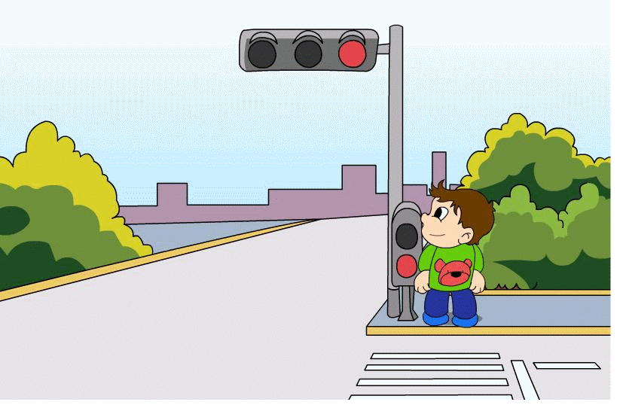
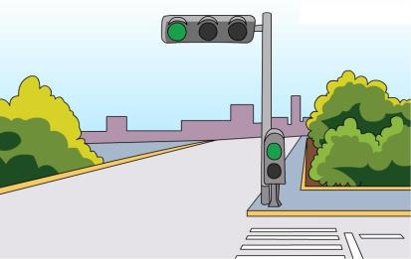
Key points
look left/right 向左/右看
cross the street 过街

Slide 16
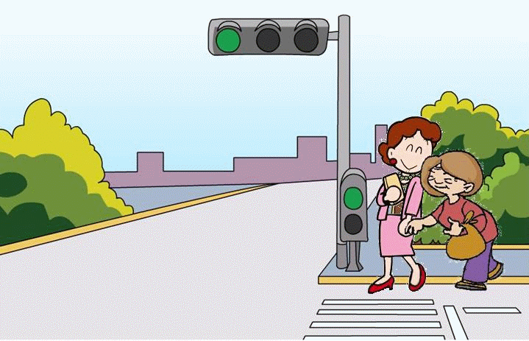
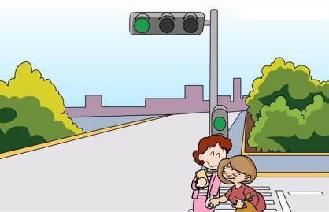
...it’s good to help children and old people cross the street.
It’s good to do sth. 做(某事)是好的
E.g. It’s good to help parents do the housework.

Slide 17
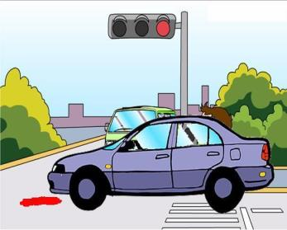
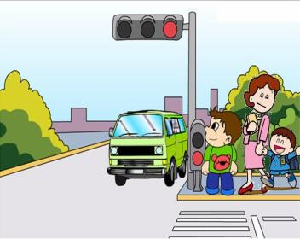
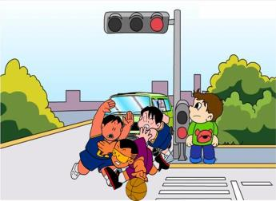
Retell the passage based on the following pictures and the table in 1b.

Slide 18
Listen and complete each sentence with the correct word.
1. Jim, please be _________ (quiet, quick).
2. Now I can eat like a ______ (horse, cow).
3. _______ (Dove, Love) me, love my dog.
4. There are _________ (fourteen, forty) children and _________ (forty, four) jackets in the classroom.
quiet
cow
Love
fourteen
forty

Slide 19
Listen and read the chant aloud, paying attention to the sound /V/.
'Mom, 'mom, 'mom.
Your 'son has 'come.
'Come, 'come, 'come.
'Here comes 'mom.

Slide 20
Summary
1. Imperatives.
No parking. =Don’t park here.
Don’t play on the street. 否定形式
Be careful! 肯定形式
2. Key words and phrases:
traffic accident
get hurt
lose one’s life
obey the traffic rules
cross the street
It’s good to…

Slide 21
Homework
1. Write down as many traffic rules as you can, using imperative sentences.
2. Preview Section C.

