Slide 1
Unit 2 Lesson 9
Eat More Vegetables and Fruit!
WWW.PPT818.COM

Slide 2
Warm-up
I like vegetables. I often eat vegetables.
What about you? How often do you eat them?

Slide 3
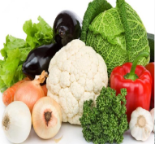
Let’s talk
How often does Danny eat vegetables?
Twice a week.

Slide 4
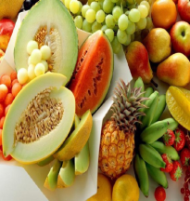
Let’s talk
How often does Danny eat fruit?
Three times a week.

Slide 5
Let’s talk
How often does Danny eat donuts?
Twice a day.

Slide 6
Let’s talk
I think I need to eat more vegetables and fruit. An apple a day keeps the doctor away!

Slide 7
Circle the key words you learn.
donut keep
often away
teacher twice

Slide 8
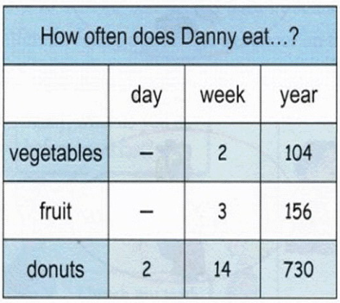
Let’s act
Look at the table, then role in play.
A: Danny, how often do you eat…?
B: I…

Slide 9
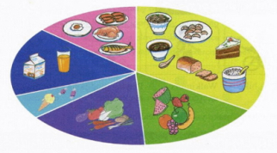
Talk and write
A: What do you like to eat?
B: I like to eat vegetables and fish.
A: What's your favourite food?
B: Vegetables are my favourite.
A: How often do you eat vegetables?
B: I eat vegetables every day.

Slide 10
Make a survey
How often do you eat?
vegetables
fruit
meat
…
me
my friend
…

Slide 11
Make a survey
How often do you watch TV?
I watch TV three times a week.
What’s your favourite program?
Animal world.

Slide 12
Summary and Evaluation
What have you learned in this class?
A excellent B good C adequate D need improvement
内容 | 学生自评 | 小组互评
我能认真听老师讲课，听同学发言
遇到我会回答的问题主动举手了
活动中坚持使用英语来交际
我能积极参与小组讨论活动，能与他人合作。

Slide 13
Homework
1. Copy the key words three times.
2. Recite some key sentences.

