Slide 1
Unit 5 MUSIC
Section Ⅴ Listening and Talking
WWW.PPT818.COM

Slide 2
1.Translate the following words and phrases.
①set sth up __________________ ②equipment n. ________________
③try out ____________________ ④talent n. __________________
⑤piano n. ________________ ⑥assume vt. ________________
⑦addition n. ____________________⑧in addition (to sb/sth) ________________
安装好(设备或机器)
设备；装备
参加……选拔(或比赛)
天才；天资；天赋
钢琴
以为；假设
添加；加法；增加物
除……以外(还)

Slide 3
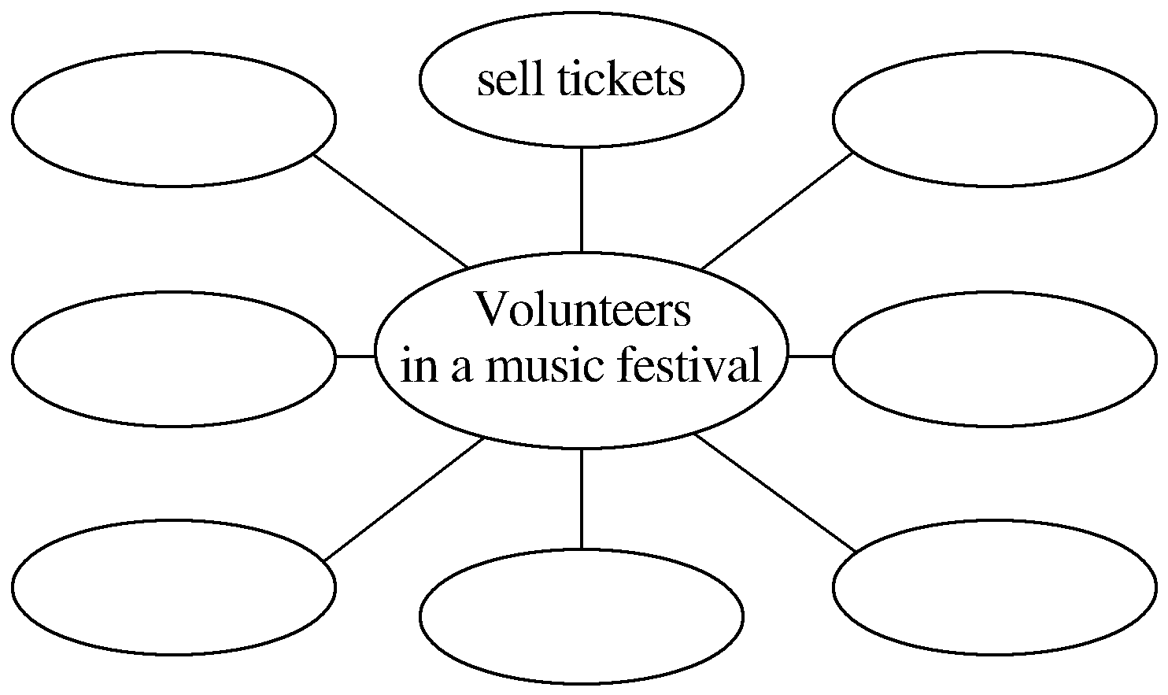
2.Brainstorming：What can volunteers do during the music festival?
The answer is open.

Slide 4
Finish Ex.1 & Ex.2 on Page 55.
Talking—Finish Ex.3&Ex.4 on Page 55.

Slide 5
语言知识积累
表示“偏爱”的常用表达
1.What would you prefer to do?
What would you rather do?
你愿意做点什么？
2.Would you rather stay at home or travel with your friends in the summer vacations?
暑假中，你是愿意待在家中还是和朋友一起旅游？
3.The reason why I prefer the classical music is that it always reminds me of the splendid Chinese traditional cultures.
我之所以喜欢古典音乐，是因为它总是让我想起灿烂的中国传统文化。

Slide 6
4.After all, all kids prefer to be praised rather than be scolded.
→After all, all kids prefer being praised to being scolded.
→After all, all kids would be praised rather than be scolded.
→After all, all kids would rather be praised than be scolded.
毕竟，所有的孩子都喜欢表扬而不是批评。

Slide 7
1.talent n.天才；天资；天赋 talented adj.有才能的，聪颖的
What can those who think they do not have musical talent do? (教材P₅₅)
那些自认为没有音乐天赋的人能够做些什么？
[合作探究] 体会talent及其派生词的用法和意义
My brother showed a talent for music when he was very young.
我弟弟在很小的时候就表现出音乐才能。
He has a talent for singing at an early age.很小的时候，他就有唱歌的天赋。
She is a talented artist as well as a photographer.
她不但是位摄影师，还是位天才艺术家。

Slide 8
[自主发现]
①________________ 对……有天赋；拥有……天赋
②________________ 表现出……才能
[名师提醒]
talent的同义词是gift; talented的同义词是gifted。
have a talent for
show a talent for

Slide 9
[巩固内化]
(1)单句语法填空
①Writing poems is one of his many ____________ (talent).
②He realized he was ____________ (talent) for playing football.
(2)补全句子
③Jane _____________________________ because she did well in all her subjects and _____________________________ singing, dancing and drawing.
詹妮是个有天赋的小女孩，她所有的功课都做得很好，也有唱歌、跳舞和绘画的天赋。
talents
talented
was a talented girl
had a talent for

Slide 10
2.assume vt.以为；假设 assumption n.假定；设想
So can I assume that the aim of the festival is to raise money? (教材P₅₅)
那么我能否认为这个音乐节的目的是筹集善款？
[合作探究] 体会assume的用法和意义
We assumed him to be the best writer of our time.
我们认为他是我们这个时代最好的作家。
It is assumed that this is the best possible translation.据认为这可能是最佳译文。
Assuming (that) the weather is favourable, farmers will have a bumper harvest.
假如风调雨顺，今年农民将获丰收。

Slide 11
[自主发现]
①__________________ 假定/假设某人/某事为
②It is assumed that... ____________
③________________ 假定……；设想……
assume sb/sth to be
据认为……
assuming (that)...

Slide 12
[巩固内化]
(1)单句语法填空
①A lot of people make the ____________ (assume) that poverty only exists in the third world.
(2)补全句子
②_________________________________ global warming and climate change could cause even more disasters in the future.
据认为全球变暖和气候改变在将来会引起更多的灾难。
assumption
It is assumed that

Slide 13
3.addition n.添加；加法；增加物
How else could you help in addition? (教材P₅₅)
除此之外，你还可以用什么方式给予帮助？
[合作探究] 体会addition的用法和意义
In addition, passive smoking causes great concern in recent years.
另外，被动吸烟在近几年引起了极大的关注。
She can speak French and German in addition to English.
除了英语，她还会说法语和德语。

Slide 14
[自主发现]
①____________ “另外”，相当于副词
②____________ “除……以外(还)”，用作介词短语
in addition
in addition to

Slide 15
[巩固内化]
选词填空(in addition/in addition to)
①____________ creating lifelong memories with my family, another wonderful thing happened as a result of this bike trip.
②The products are nice.____________， the price is low.
In addition to
In addition

Slide 16
4.set sth up安装好(设备或机器)；建立；设立；创办
people to set up equipment(教材P₅₅)安装设备的人
①They want to set up their own workshops.他们想创办自己的工作室。
[短语记牢] 记牢下列短语
set down 写下；记下
set aside 搁置；把……放在一边
set off 出发；使爆炸
set out 出发；动身
set out to do sth 开始做某事
set about doing sth 开始做某事

Slide 17
②The old man set off down the path towards the river.
老人开始沿着小路向河边走去。
③Do you know how to set about going on with this work?
＝Do you know how to set out to go on with this work?
你知道怎样着手继续这项工作吗？

Slide 18
[巩固内化] 单句语法填空
①For all these years I have been working for others.I’m hoping I’ll set ____________ my own business some day.
②You had better set ____________ what your teacher said.
③The moment he arrived home, he set out ____________ (read) the book.
④Since these cameras are of such poor quality, they need to be set ____________ and taken back to the shop.
⑤He reminded me that it was time we should set ____________ for the railway station.
up
down
to read
aside
off/out

Slide 19
5.try out参加……选拔(或试演)；测试；试验；试用
Who can try out as a performer? (教材P₅₅)谁会参加表演者的选拔赛？
①Try out the new medicine for a year and we’ll see how well it works.
这种新药试用一年，我们就会知道它的效用有多大。
[短语记牢] 记牢下列短语
try one’s best 尽最大努力
try on 试穿
try out for 参加……的选拔

Slide 20
②These teams are going to try out for the Olympic Games.
这些队伍要参加奥林匹克运动会的选拔赛。
③I’d like to try on that blue wool coat.我想试穿那件蓝色的羊毛外衣。

Slide 21
[巩固内化]
(1)单句语法填空
①The government is trying ____________ a new way to solve the air pollution.
②Try ____________ that one and decide which one to buy.
③Trying out ____________ the music festival is really a struggle for her.
(2)补全句子
④He _______________________________________ the task before deadline.
他尽最大努力在截止日期前完成这项任务。
out
on
for
tried his best to finish

