Slide 1
Unit 4 Christmas
Lesson 24 Maddy’s Christmas
WWW.PPT818.COM

Slide 2
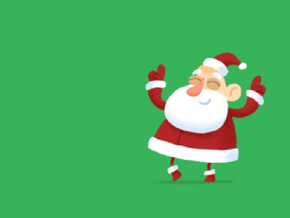
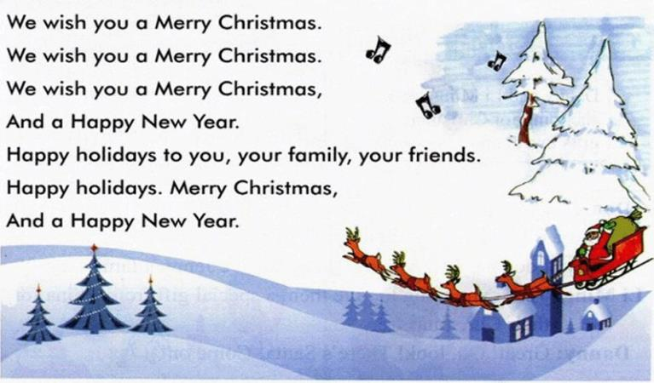
Warming up
1.Let’s sing a song

Slide 3
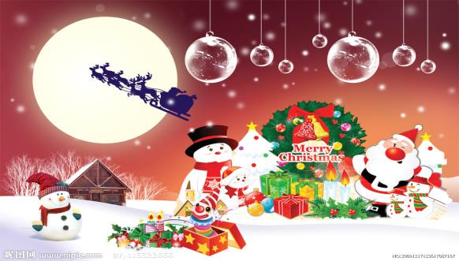
Warming up
2.Free talk
Are you ready for Christmas?
What would you like for Christmas?
What are you going to give your family for Christmas?

Slide 4
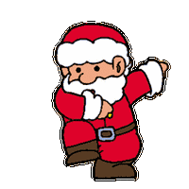
Warming up
3.I am Santa.
I have many gifts for you. Please tell me, what would you like for Christmas?
What would your parents like for Christmas?
How about preparing something for them?

Slide 5
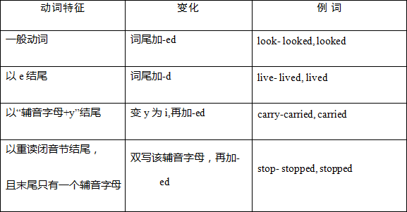
Presentation
动词过去式
buy –bought
bring—brought
is–was
find—found

Slide 6
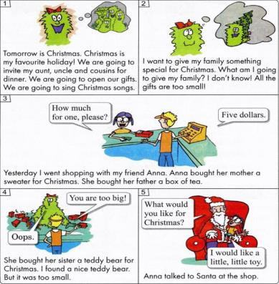
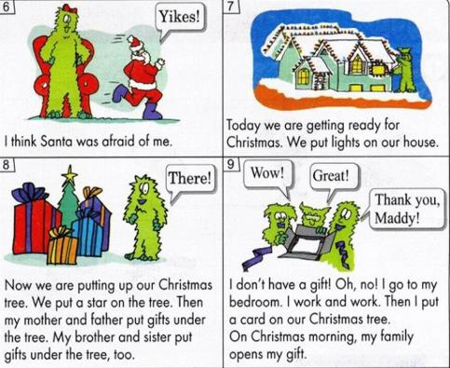
Presentation
Listen and answer.
What did Anna buy for her mother?
What would Anna like for Christmas?
Did Maddy buy anything?

Slide 7
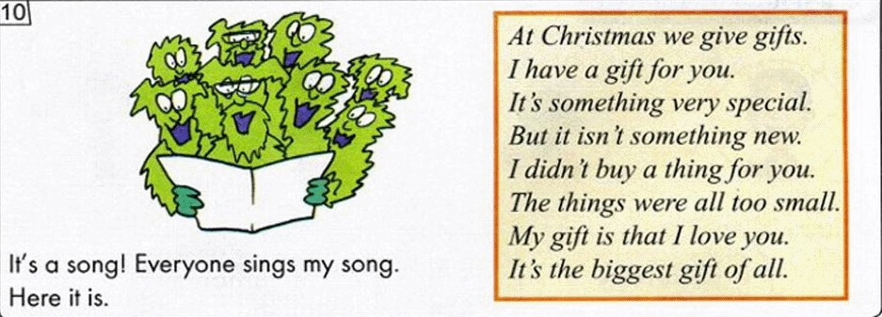
Presentation
Listen and answer.
What does Maddy give his family at last?
Are Maddy’s family happy when they see the gift from him?

Slide 8
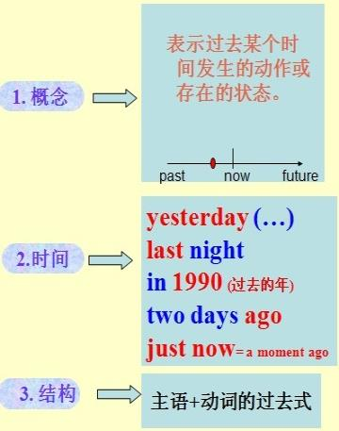
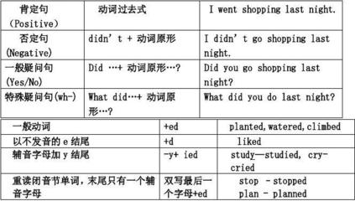
Presentation
一般过去时态

Slide 9
Practice
Transform the sentences into the past tense.
1.I talk to my father.
__________________________________
2.I buy some fruit for you.
__________________________________
3.What do you do on the playground?
__________________________________
4.I think Santa is afraid of me.
__________________________________
I talked to my father.
I bought some fruit for you.
What did you do on the playground?
I thought Santa was afraid of me.

Slide 10
Consolidation
1.用一般过去时态复述故事
2.试想自己作为Maddy的家人，收到Maddy的贺卡后会对他说些什么？

Slide 11
Summing up
1.动词过去式变化规则:
（1）规则动词加ed: talked; visited; walked; watched
（2）不规则动词：bring—brought; buy—bought,
is—was; find—found
2. 时态例句:
I buy…for…
I bought…for…yesterday.
I am going to buy…for…
3.
这节课我的收获是：_____________
这节课我的不足是：_____________

Slide 12
Homework
1.听录音，朗读本课的第一部分
2.完成相关习题
3.复述本课小故事，并结合本课学习内容创编一个新的故事，并将其表演出来。

