Slide 1
Unit 8 It must belong to Carla.
Section B Period 3 1a-2e
WWW.PPT818.COM
Notes:
1
1

Slide 2
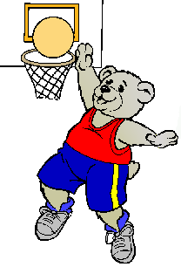
What is the bear
doing?
It might /could be
_______________.
playing basketball

Slide 3
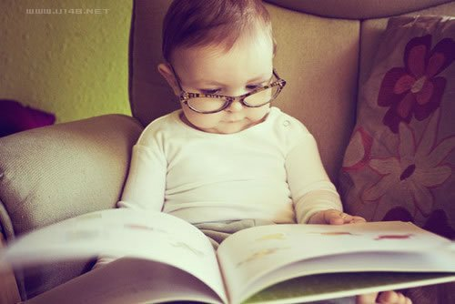
What is he doing?
He might /could be_______________.
reading a book

Slide 4
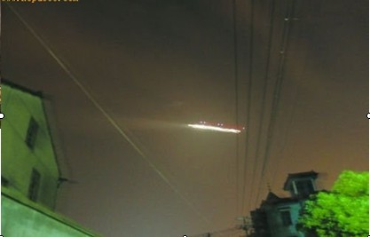
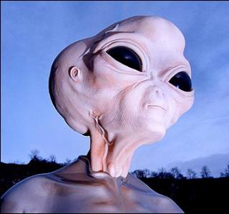
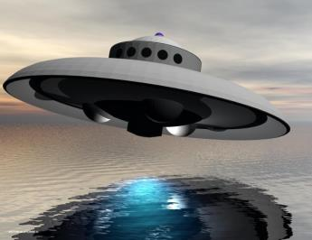
Do you believe they are true or not?
UFO
alien

Slide 5
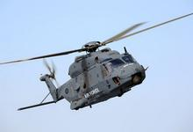
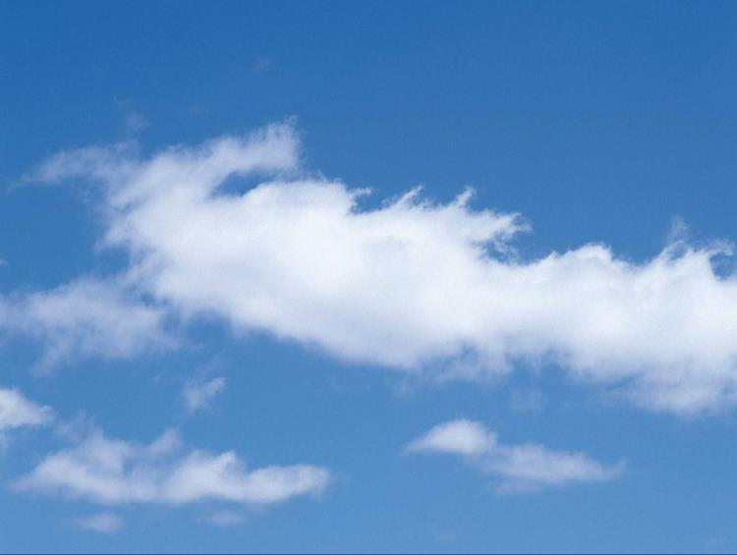
helicopter
sky
天空中有架直升机正在飞。
helicopter
flying
There is a ________ _________
in the ________.
sky

Slide 6
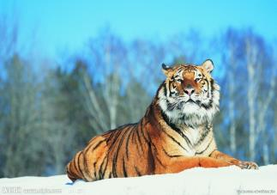
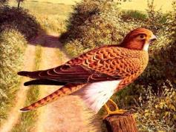
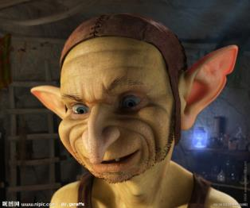
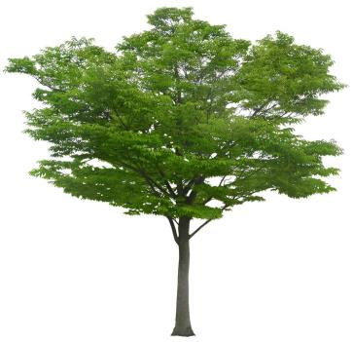
alien
外星人
an
Animals ,plants, people and other strange
living things. They are all __________.
creatures

Slide 7
Words
sky
helicopter
creature
catch
n. 天; 天空
n. 直升机
n. 生物; 动物
v. 赶上(车船等); 捕获

Slide 8
Look at the pictures. Then use the words in the box to write a sentence about each picture.
1a
v. 着陆，降落
land man UFO run alien
run after
追逐；追赶

Slide 9
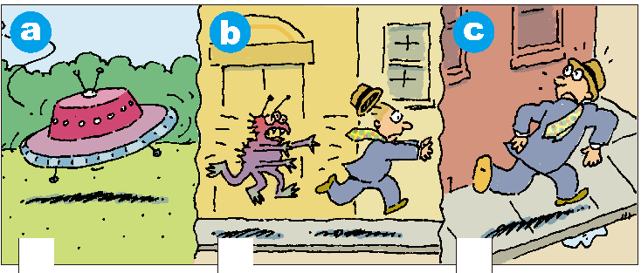
land man UFO run alien run after
在……后面跑、追
类似的短语还有：
read after 跟着读
a. A UFO is landing.
b. The alien is running after the man.
c. The man is running down the street.

Slide 10
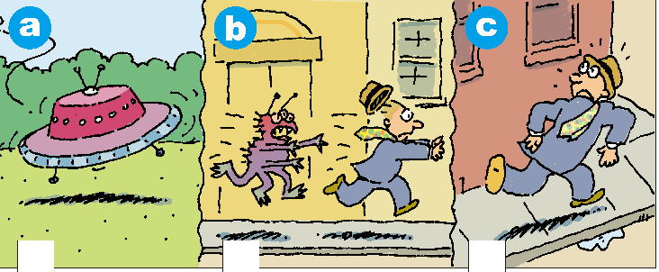
Why do you think the man is running?
Listen and number the pictures [1-3] in 1a.
Then write two or three sentences to finish the story.
1b
2
3
1
1. A woman is filming with a camera.
2. They are making a movie.
______________________________________________________________________________

Slide 11
1c
Listen again. Complete the sentences.
They see... | The man says...
1. a man running | he might be ____________
2. something in the sky | it could be _____________
3. something strange | it must be ______________
4. a woman with a camera | she could be ________________
late for work
英语里表达“有，没有”，
可以用there be 句型， 动
词have，还可用介词with, without
作伴随状语。
a plane
an alien
from the TV news

Slide 12
They see... | The woman says...
1. a man running | he could be ________________
2. something in the sky | it must be _________
3. something strange | I must be __________
4. a woman with a camera | they must be _______________
running for exercise
a UFO
dreaming
making a movie

Slide 13
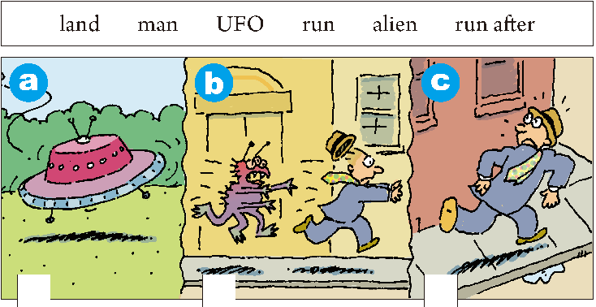
Pair work
catch作动词，意为
“赶上；捕获”。过去式、
过去分词均为caught，
catch a bus意为
“赶上公共汽车”。
Role-play the conversation
between the man and the woman.
1d
A: Why do you think the man is running?
B: He could be running for exercise.
A: No, he’s wearing a suit. He might be
running to catch a bus to work.
…

Slide 14
Match each linking word or phrase with its purpose.
2a
Linking word or phrase | Purpose of linking word or phrase
so | expressing a difference
as, because, since | giving a choice
but, however, though | expressing a result
not only... but also ... | expressing two things happening at the same time
or | giving reasons
when, while | adding information
express v. 表示，表达

Slide 15
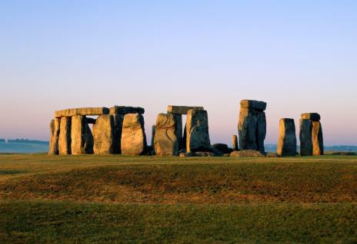
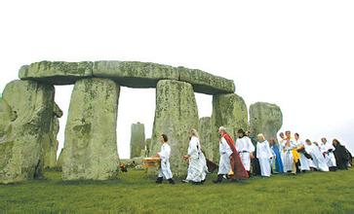
Free Talk
2b
Have you ever heard of Stonehenge?
Where is it?
Why is it famous?

Slide 16
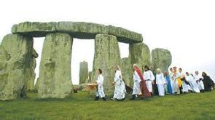
Read the article and answer the questions.
Where is the Stonehenge?
2. How many people visit Stonehenge every year?
3. Who is Paul Stocker?
4.Does anyone know who built the Stonehenge ?
In Britain.
More than 750,000 visitors.
He is a historian.
No.

Slide 17
Can you put the passage into these three parts?
The introduction(介绍） of Stonehenge.
（ paragraph 1 )
2. What was Stonehenge used for ?
（ paragraph 2-3 )
3.Who built the Stonehenge?
（ paragraph 4 )

Slide 18
Stonehenge--Can Anyone Explain Why It Is There?
Stonehenge, a rock circle, is not only one of
n. 圆圈
Britain’s most famous historical places but also
大不列颠
one of its greatest mysteries. Every year it
n. 奥秘，神秘事物
receives more than 750,000 visitors. People like to
v. 接受，收到
go to this place especially in June as they want to see the sun rising on the longest day of the year.

Slide 19
For many years, historians believed Stonehenge
n. 历史学家，历史工作者
was a temple where ancient leaders tried to
n. 领导，领袖
communicate with the gods. However, historian Paul Stoker thinks this can’t be true because Stonehenge was built so many centuries ago. “The leaders arrived in England much later,” he points out.

Slide 20
Another popular idea is that Stonehenge might be a kind of calendar. The large stones were put together in a certain way. On midsummer’s
n. 仲夏
morning, the sun shines directly into the center of the stones. Other people believe the stones have a medical purpose. They think the stones can adj. 医疗的
n. 目的，目标
prevent illness and keep people healthy. “As you
v. 阻止，阻挠
walk there, you can feel the energy from your feet
n. 力量
move up your body,” said one visitor.

Slide 21
No one is sure what Stonehenge was used for, but most agree that the position of the stones must be
n. 位置，地方
for a special purpose. Some think it might be a burial place or a place to honor ancestors. Others
n. 埋葬，安葬 v. 表示敬意 n. 祖宗，祖先
think it was built to celebrate a victory over an enemy. n. 胜利，成功
n. 敌人，仇人

Slide 22
Stonehenge was built slowly over a long period of
n. 时期
time. Most historians believe it must be almost 5,000 years old. One of the greatest mysteries is how it was built because the stones are so big and heavy. In 2001, a group of English volunteers tried to build another Stonehenge, but they couldn’t . “We don’t really know who built Stonehenge,” says Paul Stoker. “And perhaps we might never know, but we do know they must have been hard-working—and great planners!”
adj. 工作努力的

Slide 23
Read the article again and complete the chart.
2c
Mysteries about Stonehenge | What Stonehenge might have been used for…(para2-3)
1. as a temple where ancient
leaders tried to communicate with the gods
2. a kind of calendar
3. have a medical purpose
4. might be a burial place or a
place to honor ancestors
5. celebrate a victory over an
enemy
1.Who built it?
2. What was it used for?
3.How was it built?

Slide 24
Complete the sentences using the words from the chart in 2a on page 62.
2d
1. Midsummer day is in June _____ a lot of
people go to Stonehenge ______________.
2. The sun shines straight into the center of
Stonehenge _______ the stones were put
in a special position.
and
during this month
as
以一种特别的位置

Slide 25
3. Some people think the rocks can _________ stop people from becoming ill _________ keep them healthy.
4. We don’t know who built Stonehenge
_____ how it was built.
5. Historians think Stonehenge was built
about 5,000 years ago; _____________, they are not sure.
not only
but also
and
however

Slide 26
2e
Can you think of any other mysteries, either in China or another part of the world, that are similar to Stonehenge? What do you know about these mysteries? What is mysterious about them? Discuss them with your group.

Slide 27
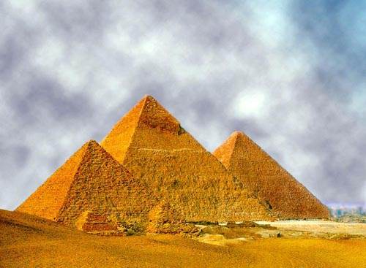
Pyramid in Egypt
埃及金字塔

Slide 28
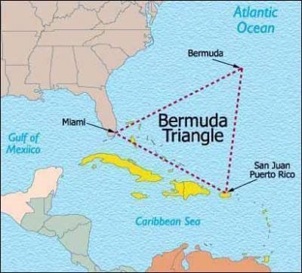
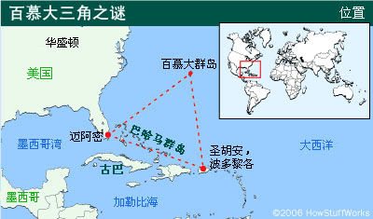
Bermuda Triangle 百慕大三角洲
A lot of ships and planes were lost here .

Slide 29
Homework
1. To retell the story.
2.To do the exercises.

