Slide 1
陕旅版四年级上册
Unit8 Boys Like to Play Ball 第1课时
WWW.PPT818.COM

Slide 2
What’s your hobby?

Slide 3
Circle what you like to do

Slide 4
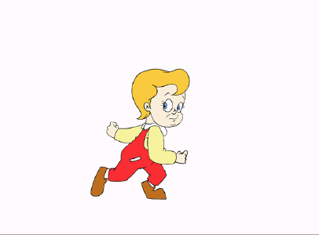
run
Let’s learn

Slide 5
swim

Slide 6
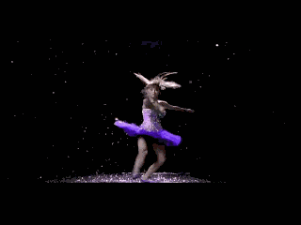
dance

Slide 7
jump rope

Slide 8
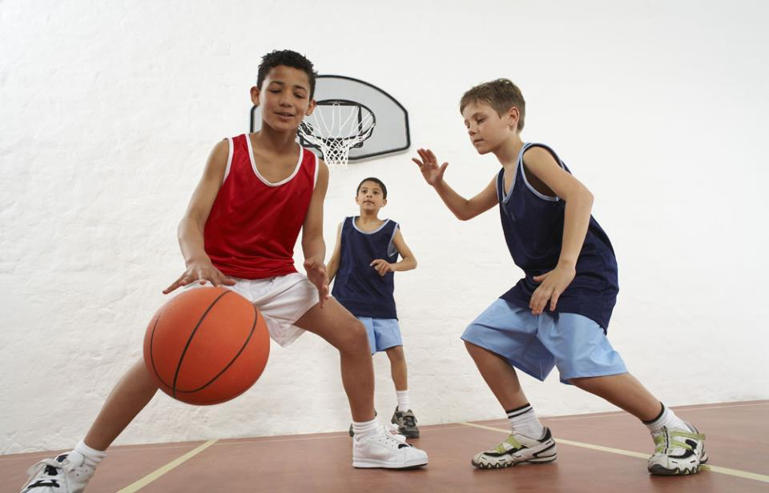
play basketball

Slide 9
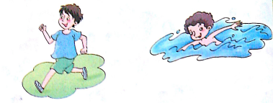
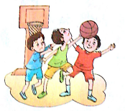
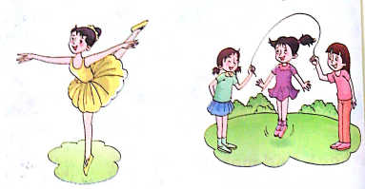
What do you like to do?

Slide 10
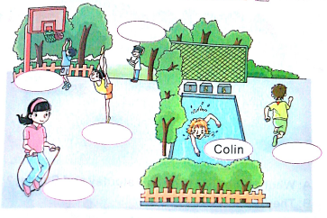
Listen and write their names

