Slide 1
Unit 3 Topic 1
English is widely spoken throughout the world.
Section B
WWW.PPT818.COM

Slide 2
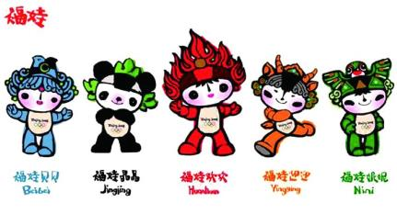
Fuwa /love/ people
Fuwa is loved by people.

Slide 3
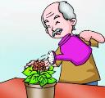
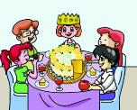
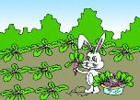
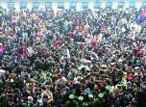
4 Make sentences with the passive voice after the example. Then read them aloud, paying attention to the stress and weak form.
flowers/ water/ he
Example:
The `flowers are `watered by him `every `day.
cake/ divide into pieces/ she
The cake is divided into pieces by her.
carrots/ dig/ rabbit
The carrots are dug by the rabbit.
baby/ lay in the bed/ woman
The baby is laid in the bed by the woman.
many problems /cause /large population
Many problems are caused by the large population.

Slide 4
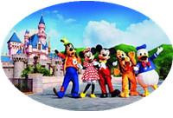
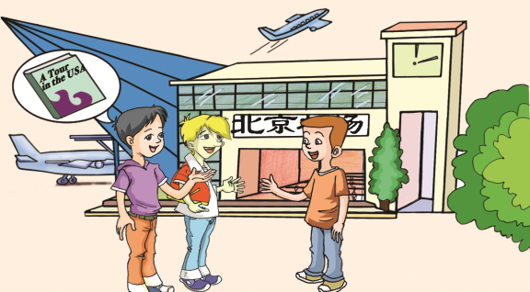
Where is Wang Junfeng going?
Which cartoon characters are found in Disneyland?

Slide 5
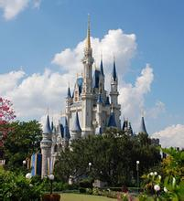
Is Disneyland enjoyed only by American children?
No. Disneyland is enjoyed by people throughout the world.
Which language is spoken as the official language there?
English is spoken as the official language there.

Slide 6
Which language is spoken as the official language in France?
French __________ as the official language in France.
is spoken

Slide 7
Which language is spoken as the official language in Cuba? Let’s listen and find out the answer.
Listen and choose the right answer.
出差
( ) 1.Why is Jane’s father going to Cuba?
A. He is going to Cuba for traveling.
B. He is going to Cuba on business.
C. He is going to Cuba to learn about the culture.
( ) 2.Which language is spoken as the official language in
Cuba?
A. English. B. French. C .Spanish.
( ) 3. Does Jane’s father have trouble communicating in Cuba?
A. Yes, he does. B. No, he doesn’t
C. We’re not sure.
B
n. 西班牙语
C
A
v.沟通，交流

Slide 8
1b Listen to 1a and mark T (True) or F (False).
1.Jane’s father is going to Cuba on business tonight. ( )
2. English is spoken as the official language in Cuba. ( )
3. English is not similar to Spanish. ( )
4. It is impossible for Jane’s father to have trouble in Cuba. ( )
5. An interpreter can help Jane’s father understand Spanish and the culture. ( )
T
F
T
F
T

Slide 9
Pair work
1c Practice the conversation in 1a. Then
complete the table and make up a new
conversation based on 1a.
Country | Official language
France
Japan
Singapore
Canada
French
Japanese
English
English

Slide 10
Language points
1. I’m going to Cuba on business tonight.
on business
出差
我爸爸要到北京出差，我要帮助他整理行李。
e.g. My father will _____ _____ _____ ____ ________, and I will help him to ______ _____ ____.
go to Beijing on business
pack his bag
2. Is Spanish similar to English?
be similar to
和…相似
我的自行车和她的差不多。
e.g. My bike is similar to hers.

Slide 11
Language points
3. Is it possible for you to have trouble communicating?那你交流起来可能会有困难吗？
It’s possible/ impossible (for sb.) to do sth.
某人有可能/不可能做
e.g. (1)It’s possible for me ________________ (到达机场）before 6 p.m.
to reach the airport
(2)我们不可能在两个小时内解决这个问题。
It’s impossible for us to solve the problem in two hours.
have trouble/ difficulty (in) doing sth. 做某事有困难
e.g.她如此小以至于读这本长篇小说有困难。
She is so young that she has difficulty ______________
_______________ .
(in) reading
the long novel
had no trouble（in) finding the way to

Slide 12
Language points
4. If necessary, I’ll ask an interpreter for help.如果必要的话，我会找一个翻译帮忙。
if necessary 如果有必要
if possible 如果有可能
if so 如果是这样
if you like 如果你喜欢
e.g.(1) You can keep a diary to improve your English
___________.（如果有可能）
if possible
(2)如果有必要，你可以打电话向我求助。
If necessary, you can call me for help .

Slide 13
Complete the sentences with the correct forms of the given phrases.
on business a few the same have trouble ask…for help similar to
1.His new pen looks ___________ one of mine.
2.There are only __________ potatoes left.
3. The twin sisters have ___________ nose.
4. Bob is coming to Beijing _____________ next Sunday.
5. Many kids __________________ getting along
with their parents nowadays.
6. When you are in trouble, you can ________
your teacher _______.
similar to
a few
adj.双胞胎之一的 n. 双胞胎之一
the same
on business
have trouble
ask
for help

Slide 14
3 Listen to the passage and answer the questions.
What does Mary do?
_________________________________________________
Why does Mary have no trouble understanding people from different countries?
_________________________________________________
Where is English used as a second language?
_________________________________________________
Where did Mary go last month?
_________________________________________________
5. Can Mary speak Chinese?
_________________________________________________
She is a businesswoman.
Because most of them can speak English.
In India and some other countries.
(Mary went to) China.
No, she can’t.

Slide 15
Exercises
Change the following sentences into the passive
voice sentences.
1. Some people destroy the environment.
2.He doesn’t water the flowers every day.
3.Does a large population cause many problems?
4.They clean their classroom every day.
The environment is destroyed by some people.
The flowers are not watered by him every day.
Are many problems caused by a large population?
Their classroom is cleaned by them every day.

Slide 16
Summary
Some words: pack, tonight, Spanish, communicate,
conversation, interpreter, explain,
impossible, twin, divide, dig, lay
2. Some phrases: on business, be similar to,
have trouble (in) doing sth, ask for
help, divide… into
3. Some sentences:
(1)If necessary, I’ll ask an interpreter for help.
(2)Have a good trip. I wish you success.
We learn:
We can:
1. Understand the official language of some countries.
2.Use passive voice more properly.

Slide 17
Assignment:
Read 1a.
Memorize the useful expressions and key sentences which we learn today.
Finish Section B in your workbook.
Preview Section C.

