Slide 1
Help
Module 12
Unit 2
Stay away from windows and heavy furniture.
WWW.PPT818.COM

Slide 2
同学们，上一课学习的单词你们都掌握了吗？现在大家来检验一下，点击下面的音频开始听写吧！

Slide 3
What should we do in an earthquake?

Slide 4
讲解
知识点
1
stay away from离开，不接近（某人）；不去（某处）
考向
stay away意为“离开”；stay away from中，from后可以接表示人或地点的名词或代词。
eg：I want to stay away from danger.
我想远离危险。

Slide 5
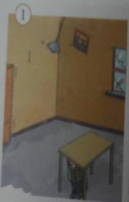
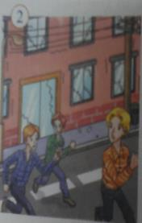
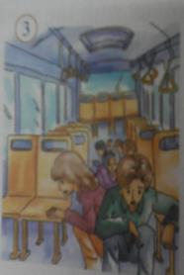
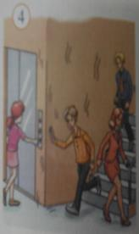
1
Reading and vocabulary
Work in pairs.Look at the pictures and ask and answer the questions.
1 Where are the people？
2 What are they doing？Why？

Slide 6
2
Look at the title of the passage and think about what to do in an earthquake.

Slide 7
3
Read the passage and check your answer to Activity 2.
What to do in an earthquake
Earthquakes always happen suddenly，so it is difficult to warn people about them. Usually people have little or no idea about what to do during an earthquake，so here is some advice：
Inside
1 Do not jump out of ❷ high buildings.
2 Hide under a table.Stay away from windows and heavy

Slide 8
furniture. Keep clear of ❸ fires.
3 Leave the building quickly when the ground stops
shaking， but do not use the lift.
4 Keep calm ❹ ，especially when you are with other
people. Be brave ❺ and be helpful.
Outside
1 Move away from buildings，because parts of a
building may fall on you.
2 Do not stand near street lights or under power lines.
3 Stay away from bridges and trees.If you are in a bus or
car，stay in it.

Slide 9
4 In the mountains，be careful of falling rocks.
5 On a beach，run away from the sea and move quickly
to higher ground.
In short， follow what you learnt in school.You can be safe and you can also help save others.

Slide 10
讲解
知识点
out of 从……向外
2
eg：He walked out of the gate. 他走出大门。
考向
out of 的其他含义：
“远离；（表示不在原状态）脱离”
eg：He's out of danger.
他脱离了危险。

Slide 11
讲解
“因为，出于，由于”
eg：He asked the question out of curiosity.
他出于好奇问了这个问题。
典例
她从窗户向外看并且发现了一个男孩在哭。
She looked the window and found a boy crying.
out of

Slide 12
讲解
知识点
keep clear of 不靠近，避开，不接触
3
eg：You should keep clear of that fellow.
你应该避开那家伙。
考向
keep clear of 为动词短语，of后常加名词
或代词。

Slide 13
讲解
知识点
keep calm 保持冷静
4
keep在这儿是连系动词，意为“保持；留在”，其后跟形容词构成系表结构。常用于
以下结构：
（1）“keep＋形容词”表示“保持某种状态”。
eg：Please keep quiet.请保持安静。
（2）“keep＋sb./sth.＋形容词”表示“使某人/
某物保持某种状态”。
考向一【重点】

Slide 14
eg：We should keep the classroom clean.
我们应该保持教室干净。
（3）“keep＋sb./sth.＋介词短语”表示“让某人
/某物……”。
eg：Her mother keeps her at home at night.
晚上她妈妈让她呆在家里。
（4）“keep sb./sth. doing sth.”表示“让某人/某物
一直做某事”。
eg：I'm very sorry to keep you waiting.
对不起，让你久等了。

Slide 15
拓展
keep还可以作实义动词，意为“保管；饲养；坚持”等。
eg： She kept a dog when she was young.
当她年轻的时候，她饲养了一条狗。

Slide 16
讲解
典例
—Don't forget to return the book to the library.
You can it for two weeks.
—OK.
A. borrow B. have C. lend D. keep
D
【点拨】寻找题眼法。for two weeks表示一段时间，而borrow， lend是非延续性动词，排除A和C，从return可以看出你可以保管这本书，故选D。

Slide 17
考向二
calm在此作形容词，意为“平静的，安静的，镇定的”相当于cool。calm还可作动词，意为“使平静，使镇定”，常用短语calm down意为“（使）平静，镇静，安静”。

Slide 18
讲解
知识点
brave/breɪv/adj.勇敢的
5
eg：The boy is very brave.
那个男孩非常勇敢。
brave是表示特点的形容词，其前加the可表示一类人，作主语时其谓语动词应用复数形式。它的副词形式为bravely勇敢地。
考向【重点】

Slide 19
讲解
D
典例
His 3­year­old son is very because he isn't afraid of the dark.
A. lovely B. lonely
C. active D. brave
【点拨】词义辨析法。考查形容词。根据句意“他三岁的儿子非常勇敢，因为他不怕黑。”可知选D。

Slide 20
4
Read the sentences.Decide if the following actions are right（√）or wrong（×）.
When the earthquake started...
√
1 ...I hid under a table.□
2 ...Sam sat on his desk.□
3 ...Alice ran out of the building.□
4 ...Peter and Helen stayed in their car.□
5 ...my family and I moved away from the beach.□
×
×
√
√

Slide 21
5
Answer the questions. Use the words and expressions in the box.
1 What is difficult to do before an earthquake？
2 Where should you stay before the ground stops shaking？
3 What should you do when you are with other people？
4 What shouldn't you stand near or under in the street？
brave inside keep calm power lines street lights warn
It's difficult to warn people about earthquakes.
We should hide under a table.Stay away from windows
and heavy furniture.
We should keep calm，be brave and be helpful.
We shouldn't stand near street lights or under
power lines.

Slide 22
6
Writing
Work in pairs.Do the following research.
Inside your school
· Make a list of safe places and dangerous places at your
school if an earthquake happens.
· Note where the nearest stairs and doors to the outside of
the school buildings are.

Slide 23
Outside your school
· Make a list of places near your school.Note if
they are safe or dangerous.
· Note where the streets go，and where street
lights and power lines are.
Learning to learn
When you read instructions，make sure of what they tell you to do，and also focus on the steps of activities.

Slide 24
7
Write some instructions about what to do in an earthquake.
Go out and meet on the playground.
Do not use the lift.
Now work in pairs. Check and share your instructions.

Slide 25
范例：
1 Stay away from windows and heavy furniture.
Hide under a table.
2 Leave the building quickly when it's safe.
3 Don't stand near street lights or under power
lines.

Slide 26
一、单项选择
1．—________ dressed now! We have to go in ten minutes.
—OK, Mom.(济南)
A．Getting B．Get C．To get D．Gets
2．He often thinks of and helps others. _____, he is
very helpful.
A．First of all B．At first C．In the end D．In short
B
D
【点拨】考查短语辨析。first of all首先；at first起初；in short简要地说；in the end最后。句意为“他经常想着别人和帮助别人，简要地说，他非常乐于助人。”故选D。

Slide 27
3. Water can't change into ice_____0℃.
A．above B．on C．under D．below
4. My friends advise me to take more exercise so that I can
________healthy.
A. improve B．increase C．keep D．find
A
【点拨】考查介词，句意为“水不可能在零度以上结冰。”排除D。on 在……上，有接触；under在……下面。故选A。
C
【点拨】本题用语法判定法。improve提高，改善；increase增加，增长；keep保持；find发现。其中keep可以作为系动词，healthy是形容词，故选C。

Slide 28
5．—Look, there're many dead fish in the river.
—We must do everything we can________ waste water
from running into rivers.
A．keep B．kept
C．to keep D．keeping
C
【点拨】本题用语法判定法。句意为“看，河里有许多条
死鱼。”“我们必须做一切我们能做的事来阻止污水流进
河里。”其中动词不定式作目的状语，故选C。

Slide 29
二、根据句意及首字母提示补全单词
6. On a c_____day，we can see most parts of London
from the tower.
7. Our government w_____us of H7N9 bird flu，so we
must look after ourselves.
8. When an e__________happens，we must keep calm.
9. I couldn't find my pen because it was u______ my chair.
10. They decide to meet o______the cinema.
lear
arns
arthquake
nder
utside

Slide 30
三、用所给词的适当形式填空
11. Our teachers always warn us____________(not waste)
time.
12. Keep______(quiet)．The baby is sleeping.
13. There's not a lot of________(power)，so we must save it.
14. He speaks loudly so that we can hear him ______(clear)．
15. —Nancy, I really don't know how to write articles.
—Don't worry. _____ (use) a mind map to organize
your ideas. (南京)
not to waste
quiet
power
clearly
Use

Slide 31
四、根据汉语完成句子
16. 远离污水。
________ ________from waste water.
17. 请向窗外看！她在跳舞。
Please________ ________ ______the window！
She is dancing.
18. 不要从高楼跳出去。
Don't______ _______ ______high buildings.
19. 简要地说，在课堂上仔细听老师讲。
____ _______，listen to the teacher carefully in class.
20. 他是一个多么勇敢的男孩啊！
What____ _______ _____he is!
Stay away
look out of
jump out of
In short
a brave boy

Slide 32
本节课主要学习了重点单词: earthquake, warn,inside,under,window,calm,brave,helpful,
powerful以及短语keep clear of,in short,stay away from；学会祈使句在具体语境中提出建议或暗示的用法。

Slide 33
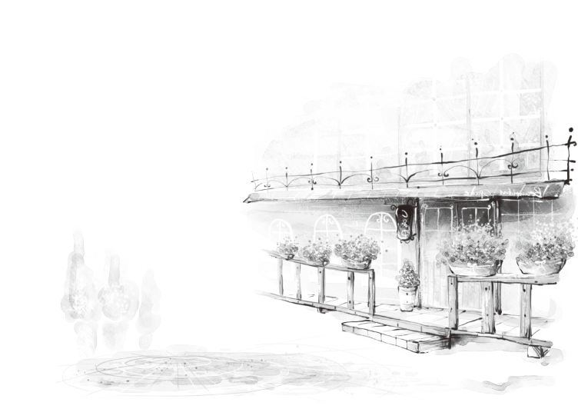
1.熟记本课时的词汇
2.完成本课时的课后作业
课后作业A
(选自《典中点》)
课后作业B
(选自《点拨训练》)

