Slide 1
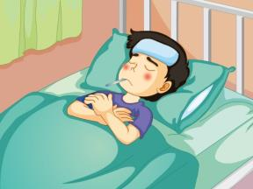
Unit 4 What’s wrong with you?
人教精通版英语五年级下册
WWW.PPT818.COM

Slide 2
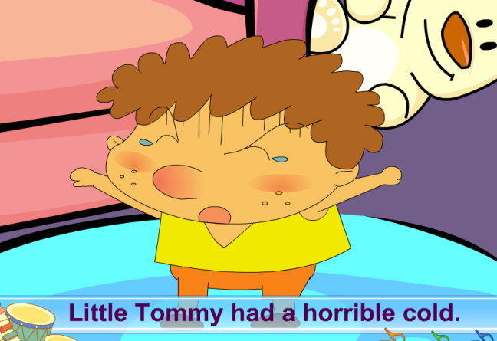
>>Warm-up
Let’s sing

Slide 3
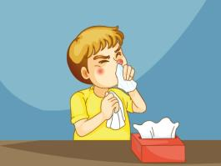
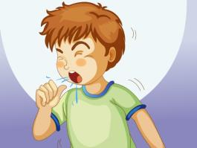
>>Lead-in
Let’s review
cough
bad cold
headache
I’m ill today. I have a _________.
fever

Slide 4
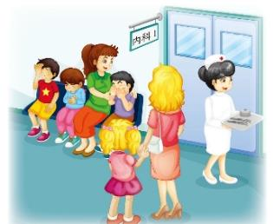
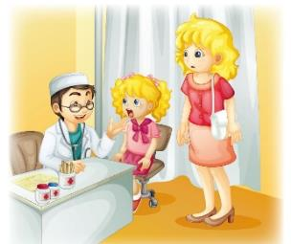
>>Lead-in
Where are they?
What are they doing?

Slide 5
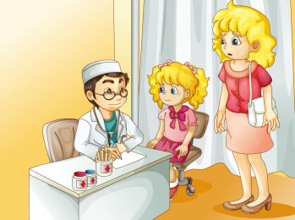
>>Presentation
Just talk
1. What’s wrong with Kate?
2. What should she do?
3. Can she go to school tomorrow?

Slide 6
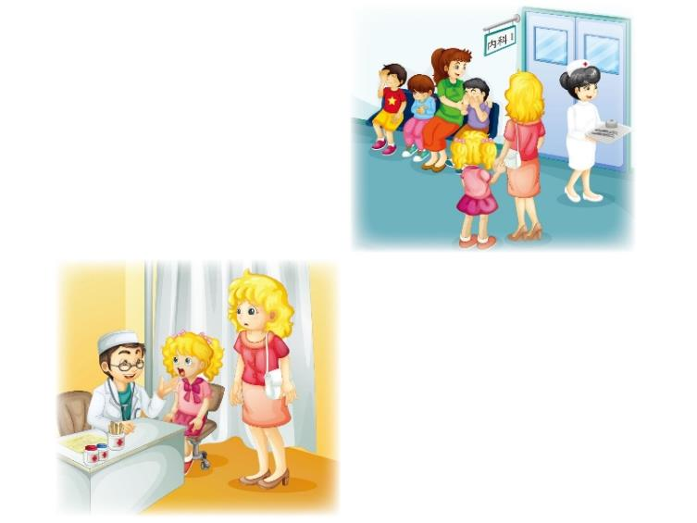
>>Practice
Just talk
1. What’s wrong with Kate?
She has a bad cold.
2. What should she do?
She should take some medicine and stay in bed. She should drink more water.
3. Can she go to school tomorrow?
No, she should take a good rest.

Slide 7
>>Presentation
Just talk
Doctor: May I have your name?
Kate: My name is Kate.
Doctor: How old are you?
Kate: I’m eleven.
Doctor: What’s wrong with you?
Kate: I have a fever and a headache.
Doctor: Open your mouth. Say, “Ah…”
Kate: Ah…

Slide 8
>>Presentation
Just talk
Doctor: You have a bad cold. You should take
some medicine and stay in bed. You
should drink more water.
Kate: Can I go to school tomorrow?
Doctor: No. You should take a good rest. I hope
you will get well soon.
Kate: Thank you, Doctor.

Slide 9
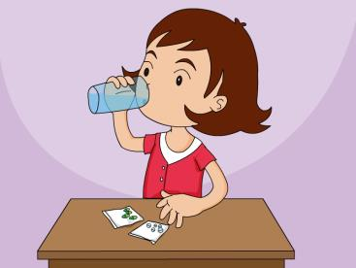
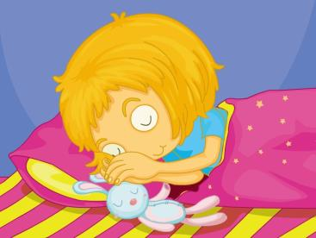
>>Presentation
take some medicine
take a good rest

Slide 10
>>Practice
Match and say
May I have your name?
No. You should take a good rest.
What’s wrong with you?
My name is Kate.
Can I go to school tomorrow?
I have a fever and a headache.

Slide 11
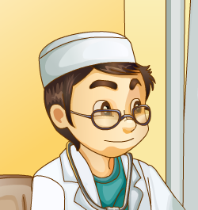
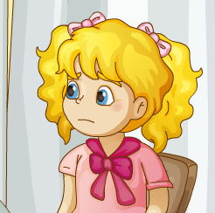
>>Practice
Pair Work
May I have your name?
How old are you?
…
My name is Kate.
I’m eleven.
…

Slide 12
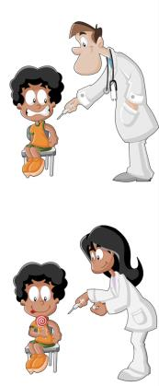
>>Practice
Group Work
What’s wrong with you?
I have…
Can I …?
You should…

Slide 13
>>Summary
重点词组：
take some medicine
take a good rest
如何询问和回答病情？
--- What’s wrong with you?
--- I have a fever and a headache.
如何建议对方吃药和休息？
You should take some medicine and take a good rest.

Slide 14
>>Homework
1. 观看课文动画，按照正确的语音、语调朗读课文。
2 . 表演本课的情景对话 。
3 . 预习Lesson22。
close

