Slide 1
Unit1 We have new friends.
人教精通版五年级上册
Lesson 2
WWW.PPT818.COM

Slide 2
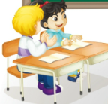
>>Review
Look and say
Self-introduction(自我介绍)
I’m …
I come from…
Name
Bob
Age
11
Country
Britain
Name
Zhou Pei
Class
Age
10
Miss Liu
Country
Beijing

Slide 3
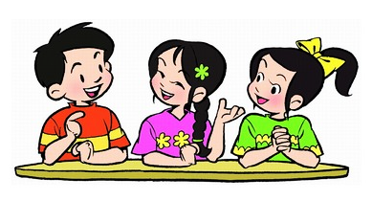
>>Lead-in
Free talk
What’s your name?
How old are you?
Where are you from?

Slide 4
>>Presentation
Just practise

Slide 5
>>Presentation
Just practise
NAME: _______
AGE: _________
COUNTRY:
_____________
Ben
Ten
Britain
I’m Ben. I’m ten. I come from Britain.

Slide 6
>>Presentation
Just practise
NAME: _______
AGE: _________
COUNTRY:
_____________
Betty
Eleven
Australia
I’m Betty. I’m eleven. I come from Australia.

Slide 7
>>Presentation
Just practise
NAME: _______
AGE: _________
COUNTRY:
_____________
Bill
Twelve
New Zealand
I’m Bill. I’m twelve. I come from New Zealand.

Slide 8
>>Presentation
Just write
Can you write them?
hello hi
I am
I’m = I am
I’m Bob.
I’m eleven.

Slide 9
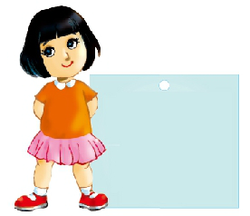
>>Practice
Write and say
Write down your information and introduce yourself in English.
NAME: _______
AGE: _________
COUNTRY:
_____________

Slide 10
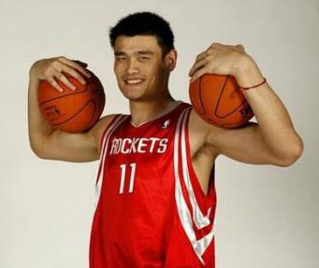
>>Practice
Look and say
Name: Yao Ming
Age: 36
Country:
Can you introduce him?

Slide 11
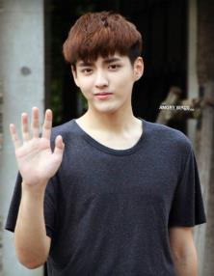
>>Practice
Look and say
Name: Wu Yifan
Age: 26
Country:
Can you introduce him?

Slide 12
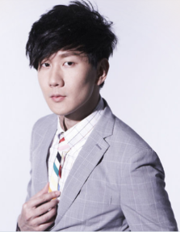
>>Practice
Look and say
Name: Lin Junjie
Age: 35
Country:
Can you introduce him?

Slide 13
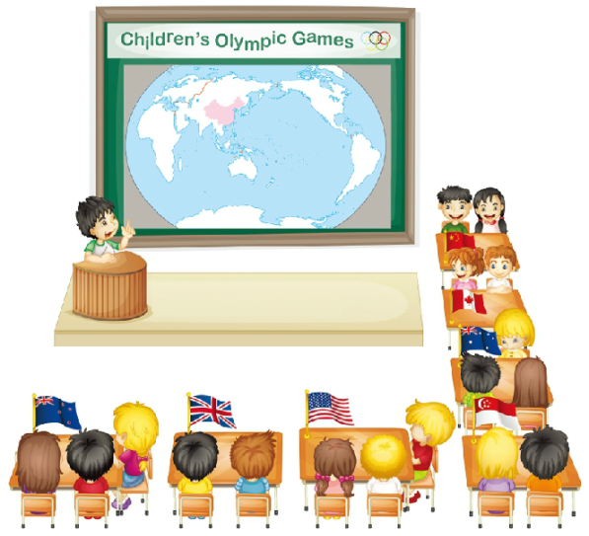
>>Practice
Let’s act
Hello, I’m Yang Ming. I’m eleven.
I come from China.

Slide 14
>>Practice
Let’s chant

Slide 15
>>Summary
怎样给别人介绍自己呢？
I’m … I’m … I come from …
例句
I’m Bob.
I’m eleven.
I come from Britain.

Slide 16
>>Homework
1.观看课文动画，按照正确的语音、语调朗读课文对话。 2.仿照本课内容，制作人物卡片，并向大家介绍。人物可以是朋友，也可以是名人。
3. 预习 Lesson 3。

