Slide 1
Wind
WWW.PPT818.COM

Slide 2
Read and guess
A riddle
It has no shape.
It has no colour.
It has no smell,
And you cannot catch it.
You can hear it,
But you cannot see it.
What is it?
It is wind.

Slide 3
请教师自行插入文件

Slide 4
Read aloud
Who is wearing a T-shirt? A T-shirt, a T-shirt!
Who is wearing a T-shirt? Please stand up!
Who is wearing a jacket? A jacket, a jacket!
Who is wearing a jacket? Please stand up!
Who is wearing a dress? A dress, a dress!
Who is wearing a dress? Please stand up!
Here comes a big wind! A big wind, a big wind.
Here comes a big wind! It blows away the clothes!

Slide 5
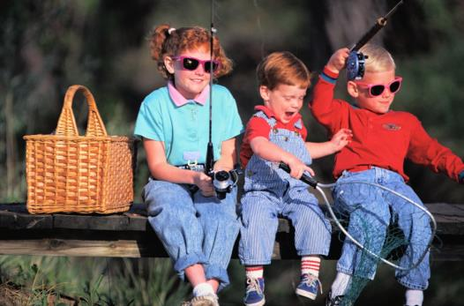
Read and think
The children are happy.
The children are playing happily.

Slide 6
Read and choose
happy happily
1. My mother has a new dress. She is ______.
2. The children are playing football _______.
3. The boys fly kites _______ in the park.
4. I am ______ with my new toy.
happy
happily
happily
happy

Slide 7
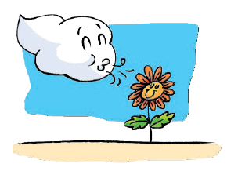
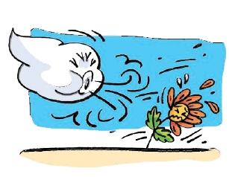
The wind is gentle.
The wind is blowing ______.
gently
The wind is strong.
The wind is blowing _______.
strongly

Slide 8
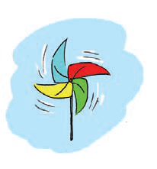
The wind is blowing gently.
The windmill is moving ______.
slowly
The wind is blowing strongly.
The windmill is moving ______.
quickly

Slide 9
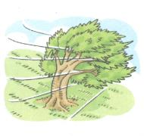
strongly
gently
How is the wind blowing?
It is blowing _______.
Is the wind blowing strongly?
strongly
No. It is blowing ______.
gently

Slide 10
Is the windmill moving quickly?
quickly
Yes, it is moving quickly.
Is the windmill moving quickly?
slowly
No. It is moving slowly.

Slide 11
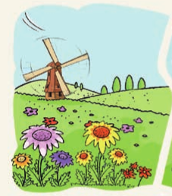
The wind is blowing.
It is blowing gently.
The flowers are dancing in the wind softly.
The wind is blowing.
It is blowing gently.
The windmill is moving slowly.

Slide 12
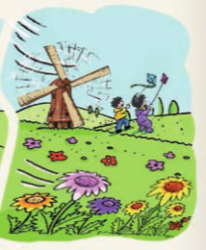
The wind is blowing.
It is blowing strongly.
The children are flying their kites happily.
The wind is blowing.
It is blowing strongly.
The windmill is moving quickly.

Slide 13
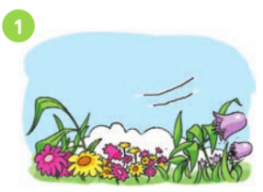
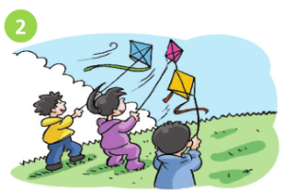
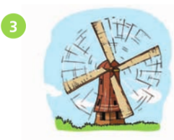
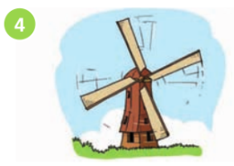
flowers/dance/softly
children/fly kites/happily
windmill/move/quickly
windmill/move/slowly
In Picture __, the wind is blowing …
The … is/are ____________.

Slide 14
Read and complete
gently
1. It’s a nice day today. The wind is blowing ______ (gentle).
2. What can you see on _____ (wind) or ____ (rain) days?
3. The clouds are moving ______ (quick) in the sky.
4. The rain is _____ (heavy). People in the streets go home ______ (quick).
5. The wind blows _______ (strong). Some leaves fall on the ground.
windy
rainy
quickly
heavy
quickly
strongly

Slide 15
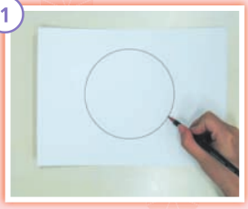
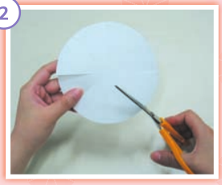
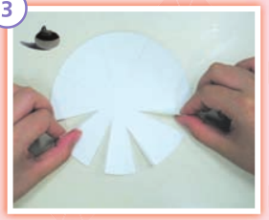
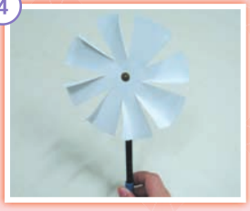
1
2
Draw a circle and cut it out.
Draw eight lines and cut along them.
3
4
Fold.
Pin it to a pencil.

Slide 16
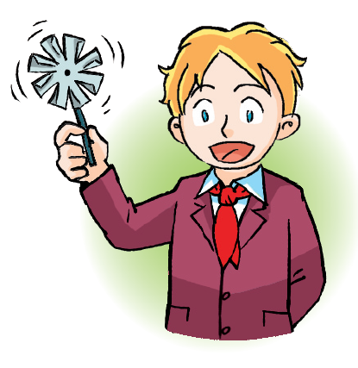
This is my paper windmill.
The wind is blowing …
My windmill is moving …

Slide 17
Read and answer
Hello, I’m Paul. I often visit my grandparents in winter holiday. They live in Harbin. It’s very cold there. The wind often blows strongly. Sometimes it snows heavily. But I have a good time with my friends there. We go skiing, go skating and make snowmen.
Paul
1. Where does Paul go in his winter holiday?
2. How’s the weather in Harbin?
3. Does Paul like the cold weather? Why?

Slide 18
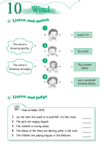
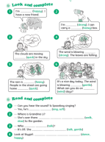
Homework
1. Listen to and read pages 68, 69 and 72.
2. Copy these words and sentences：
gently, strongly, slowly, quickly
The children are flying their kites happily.
3. Finish Workbook pages 56 and 58.

