Slide 1
Unit 10
If you go to the party, you’ll
have a great time!
WWW.PPT818.COM

Slide 2
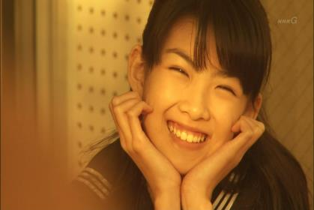
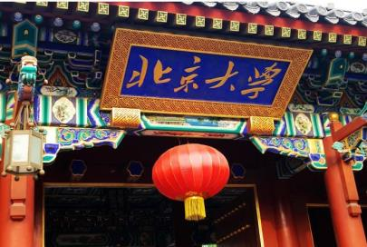
Warming up
Some important things in our life.
be happy
go to college

Slide 3
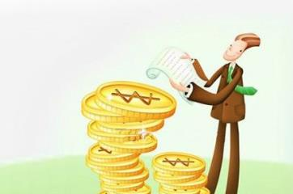
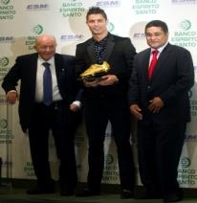
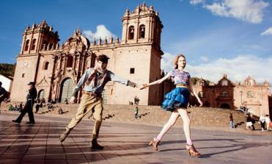
make a lot of money
be famous
travel around the world
get an education

Slide 4
1a
Which of the things below are the most important to you? Circle three things.
_____ be happy ______ travel around the world
_____ go to college ______ make a lot of money
_____ be famous ______ get an education

Slide 5
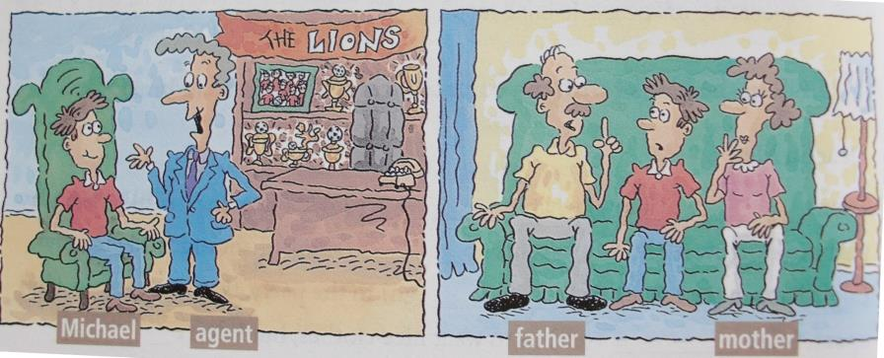
1a
Listen. Look at the list in 1a. Write “A” before each thing the soccer agent talks about and a “p” before each thing Michael’s parents talk about.
Notes:
5

Slide 6
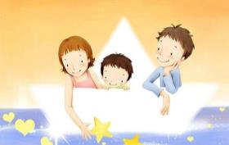
Listen. Look at the list in 1a. Write “A” before each thing the soccer agent talks about and a “p” before each thing Michael’s parents talk about.
1b
_____ be happy ______ travel around the world
_____ go to college ______ make a lot of money
_____ be famous ______ get an education
P
A
P
P
A
P

Slide 7
1c
Listen again. Complete the sentences.
1. If you join the Lions, ____
2. If you become a Lion, ____
3. And if you work really hard, ____
4. If you become a soccer player, ____
5. But if I don’t do this now, ____
c
e
a
d
b
a. you’ll be famous.
b. I’ll never do it.
c. you’ll become a great soccer player.
d. you’ll never go to college.
e. you’ll travel around the world.

Slide 8
Patterns
I think I’m going to work until night. (be tired)
If you do, you’ll be tired.

Slide 9
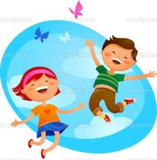
If you do, you’ll be happy.
I think I’m going to the party.

Slide 10
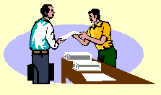
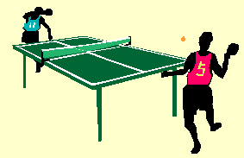
I think I’m going to exercise every day.
If you do, …

Slide 11
Student A is Michael. Student B is his friend. Student B, give Student A advice.
1d
A: What do you think I should do? Can
you give me some advice?
B: I think you should go to college.
A: But if I go to college, I’ll never become
a great soccer player.

