Slide 1
111111111111111111111111111111111111111111111111111111111111111
Unit 4 Li Ming Comes Home
六年级下册
Lesson 21 A Party for Li Ming
WWW.PPT818.COM

Slide 2
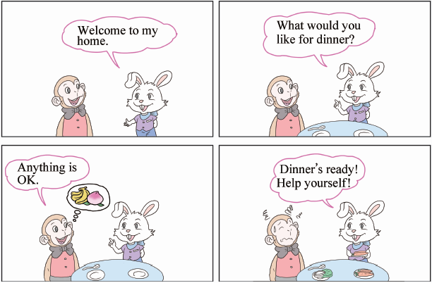

Slide 3
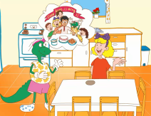
1. Make a call
Danny: Li Ming is leaving soon. Let's have a good­bye party for him.
Jenny: Okay! I will invite some friends.
Danny: Will we tell Li Ming about the party?
Jenny: No. Let's have a surprise party for him!
Jenny calls Steven.
Steven：Hello?
Jenny：Hi, Steven. It's Jenny calling. Would you come to a party for Li Ming?
Steven：Sure! When is the party?
Jenny：Tomorrow. It's a surprise for Li Ming. Please don't tell him.
Steven：Okay. What time does it begin?
Jenny：At 4:00 in the afternoon. Don't be late⑥! We want to surprise Li Ming!
Steven：Okay, I will come before 4:00.Then I will be early!
Jenny：Great! See you tomorrow!
Danny: How many people are coming to the party, Jenny?
Jenny: Let's see...you, me, Li Ming, Steven, Kim, my sister, Mr.Wood, my mum and my dad. Nine!

Slide 4
知识点1
party /'pɑːti / n. 晚会；聚会
We will have a party for Li Ming.
我们要为李明举办一个聚会。
例句：
字母组合ar的发音是/ɑː/。
发音：
have a party 举办聚会
短语：
形近词记忆法：
park n．公园
party(单数)→parties(复数)
词形变化：

Slide 5
知识点 2
tell /tel/ v. 告诉；讲述
Please don't tell him.请不要告诉他。
例句：
字母e的发音是/e/。
发音：
形近词记忆法：
tall adj.高的；bell n．铃；
well adj.身体好 & adv.好；yell v．大喊
tell(原形) →tells(第三人称单数)→telling(现在分词) →told(过去式)
词形变化：

Slide 6
tell构成的短语：
(1) tell sb. sth.告诉某人某事
(2) tell a story 讲故事
(3) tell a lie说谎
(4) tell sb. to do sth.吩咐某人做某事
(5) tell sb. not to do sth.吩咐某人不要做某事
(6) tell sb. about sth.告诉某人有关某事

Slide 7
知识点 3
It's Jenny calling. 我是詹妮。
这是一个打电话的用语，在打电话时，如果要表达“我是……”，要用句型“It's...calling.”或“This is... speaking.”。但是不能用第一人称I。
—Hello? 哪位？
—Hi, Steven. It's Jenny calling. 你好，斯蒂芬。 我是詹妮。
例句：

Slide 8
知识点 4
Would you come to a party for Li Ming? 你愿意来参加为李明举办的聚会吗？
Would you +动词原形 +其他？
句型结构：
用法：
这是一个一般疑问句，意思是“你愿意做某事吗？”用来征求对方的意见，语气比较委婉。
—Would you play football with me？
你愿意和我一起踢足球吗？
—Sure! 当然愿意！
例句：

Slide 9
连词成句。
you, swimming, me, with, would, go (？) (连词成句)
____________________________________________
典例
Would you go swimming with me?

Slide 10
知识点 5
begin /bɪˈgɪn/ v.开始
What time does the party begin?
聚会什么时候开始？
例句：
反义词记忆法：
finish v. 结束
begin(原形) →begins(第三人称单数)→beginning(现在分词)→began(过去式)
词形变化：

Slide 11
start v．开始
同义词：
begin with以……开始
begin to do sth.开始做某事
begin doing sth.开始做某事
短语：

Slide 12
知识点 6
late /leɪt/ adj. 晚的；迟到的
Don't be late for school.上学不要迟到。
例句：
early adj.早的；早到的
反义词：
形近词记忆法：
hate v．讨厌；lake n．湖
be late for 迟到
短语：

Slide 13
Early，early上学早。
Late，late会迟到。
按时上学不迟到，
老师心中好学生。
魔法记忆：

Slide 14
知识点 7
early /'ɜːli/ adj. 早的；早到的
We will be early.我们会很早的。
例句：
加法记忆法：
ear(耳朵)＋ly＝early
典例
My mother always gets up ________．
A．early B．before C．after
A

Slide 15
2. Let's do it!
1．Read Part 1 and write the answers.
a．Who is the surprise party for?
______________________________________
b．What time does the party begin?
______________________________________
c．Who will come to the party?
______________________________________
______________________________________
Li Ming.
At 4:00 in the afternoon on Wednesday.
Danny, Jenny, Li Ming, Steven, Kim, Jenny's sister, Mr. Wood and Jenny's parents.

Slide 16
2. Let's do it!
PLEASE COME TO THE PARTY FOR LI MING
ON___________________________________
AT___________________________________
IN___________________________________
JENNY AND DANNY
Wednesday
4:00 o'clock
the afternoon

Slide 17
2. Let's do it!
2．Look and write.
PLEASE COME TO OUR PARTY
ON SATURDAY
AT HALF PAST FIVE
IN THE AFTERNOON
SUSAN AND BOB
It's four fifteen.
It's five forty­five.
early
late
She's__________. He's__________.

Slide 18
一、单项选择。
( )（1）We had two birthday ________ last month.
A．party B．parties C．partys
( ) （2）I'll tell him ________ the basketball game.
A．to B．for C．about
B
C

Slide 19
( )（3） Don't ________ him the bad news.
A．say B．speak C．tell
C
点拨：
本题考查动词的含义。句意为“不要告诉他这个坏消息。”tell的意思是“告诉”，所以选C。

Slide 20
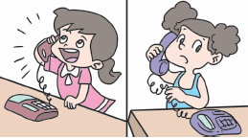
二、我会打电话。
如果你是李华，你刚刚拨通了Amy的电话，你要跟她打招呼并告诉她“我是李华。”应该说：________
A．Hi, Amy. I'm Li Hua.
B．Hi, Amy. It's Li Hua calling.
C．Hi, Amy. My name is Li Hua.
B

Slide 21
三、从方框中选出正确的答语。
( )（1）Will you have a party for Li Ming?
( )（2）Would you come to the party?
( )（3）How many people are coming here?
( )（4）Hello？
A．Hi, Wang Yan. It's Han Mei calling.
B．Ten. C．Yes, we will. D．Sure!
C
D
B
A

Slide 22
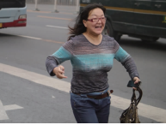
四、根据图片及首字母提示补全单词。
The woman is running to catch(追，赶) the bus. Because she is l_______.
ate

Slide 23
本节课我们学习了以下知识，请同学们一定加强巩固，以便能和同学们进行灵活交流哦！
重点词汇： party, tell, begin, late , early
重点短语：tell sb. sth.
重点句式：It's Jenny calling.
Would you come to a party for Li Ming?

Slide 24
1 熟记本节课所学的句型、短语和单词，必须会听、说、读、写。
2 将Make a call的对话朗读流利。
3 完成配套的课后作业。

