Slide 1
Unit6 Would you like to take a trip?
人教精通版四年级下册
WWW.PPT818.COM

Slide 2
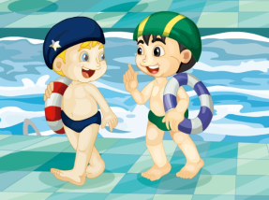
Review
Let’s chant
What will you do this Sunday?
I’ll go swimming.
Cool, cool, cool!
What will you do this Sunday?
I’ll go shopping.
Great, great, great!

Slide 3
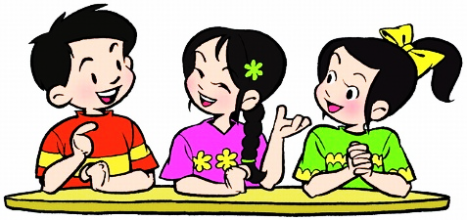
Lead-in
Free talk
What day is today?
What will you do this weekend?

Slide 4
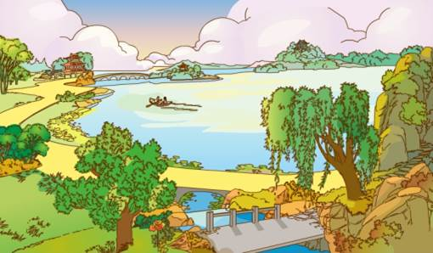
Presentation
Think and say
Would you like to take a trip this weekend?
Where shall we go?
I want to go to the park. How about you?

Slide 5
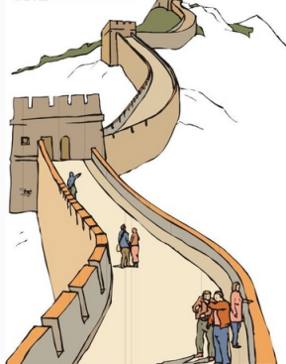
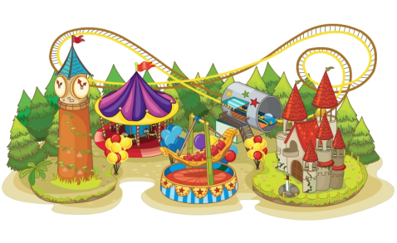
Presentation
—Where shall we go?
—I want to go to …
theme park
the Great Wall

Slide 6
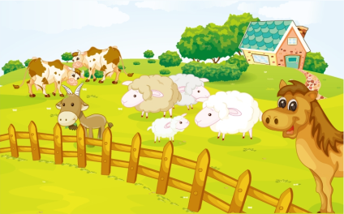
Presentation
—Where shall we go?
—I want to go to …
zoo
farm

Slide 7
Presentation
If we want to see lions and elephants, where shall we go, the zoo or the farm?

Slide 8
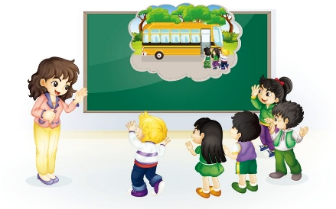
Presentation
Look and say
School is out in two days. The teacher and her class are talking about their ideas about the trip.
What are they talking about?

Slide 9
Presentation
Let’s learn
1
School is out in two days.
4
Certainly! Where shall we go?
Certainly! Where shall we go?
2
Hooray!
Hooray!
Hooray!
Would you like to take a trip?
3

Slide 10
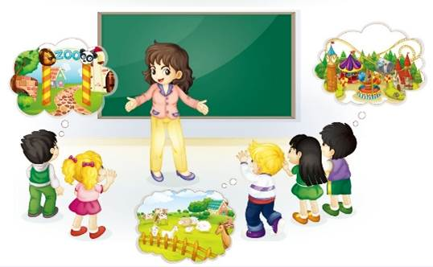
Presentation
Let’s learn
9
Good idea! How about the zoo and the farm?
5
Any ideas?
6
I want to go to the theme park.
10
Cool!
Cool!
Cool!
Cool!
Cool!
We want to go to a farm.
We want to go to the zoo.
We want to go to a farm.
We want to go to the zoo.
8
7

Slide 11
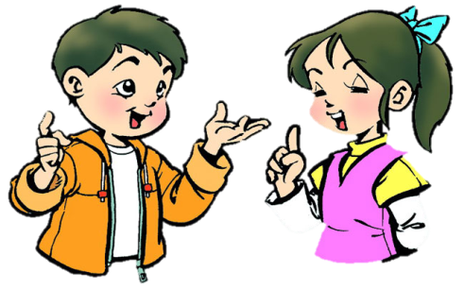
Practice
Role-play
分角色朗读对话，注意模仿语音语调。
小组合作，试着表演出来吧。

Slide 12
Practice
Read it by groups for one minute .
小组读对话一分钟。
一分钟倒计时
60
Learning tip :
50
10
10
四人一组，比赛读句子，看谁能在一分钟内读完，并且读得准确、流利！
20
20
40
30
30
开始

Slide 13
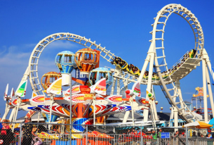
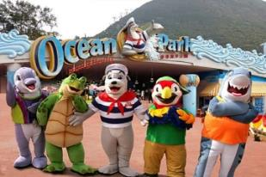
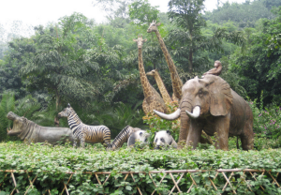
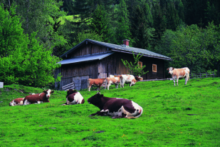
Practice
Think and write
Write down your ideas about the trip, read for us
and find who has the same idea as you.

Slide 14
Practice
Let’s sing

Slide 15
Summary
本课学到的重点单词：
zoo
farm

Slide 16
Summary
当我们计划去旅游时，要征询大家的意见并做相应回答，该如何表达？
—Where shall we go?
—We want to go to …

Slide 17
Homework
1. 跟读课文Just talk部分的录音，注意语音、语调。
2. 搜集适合小朋友旅游的场所，并将英文表达记录在本子上或做成英文手抄报。
3. 预习Lesson 32。
Close

