Slide 1
Unit 3 Topic 1
What’s your hobby?
Section C
WWW.PPT818.COM

Slide 2

Practice
Talk about your hobbies in the past according to
the pictures and the example.
Example:
I used to walk
a pet dog, but I didn’t use to play sports.

Slide 3
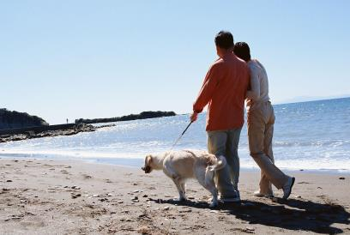
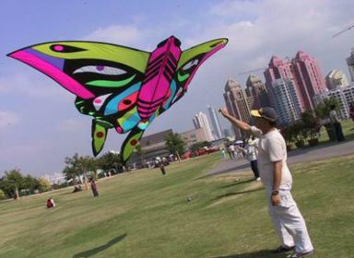
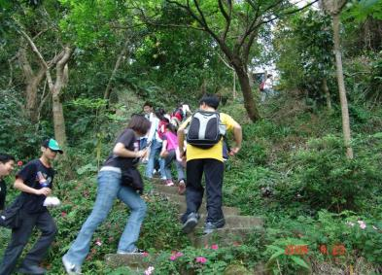
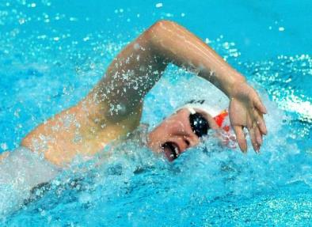
walk a pet dog
fly a kite
climb mountains
swim

Slide 4

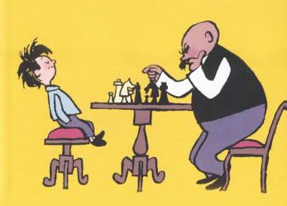
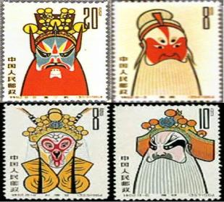
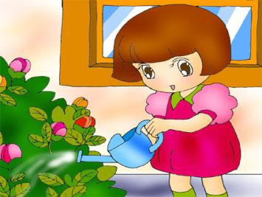
listen to music
play chess
collect stamps
water flowers

Slide 5

Do you know what kind of book it is ?
剪贴簿
A scrapbook .
Let’s learn how to make a scrapbook.

Slide 6

Scrapbooking is a hobby. It was popular for more than 500 years. People called it a friendship book. They kept pictures, letters, poems and other things they wanted to remember.
Today people collect many things in scrapbooks. Some people have funny collections, like the world’s most stupid ideas or pictures of the world’s most ugly dogs. Other people may collect stories about bad weather.
It is easy to get started. First, you should decide what you want to collect. Start with just

Slide 7
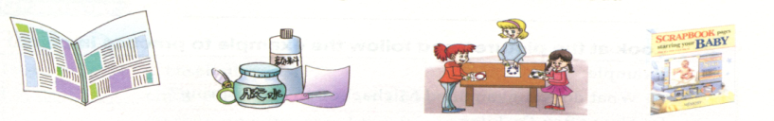
one idea. Next, you will need a book with background paper, scissors and glue. You need the scissors to cut out the pictures or stories. You need the glue to stick them to the background paper.
You can be busy and collect many things or lazy and few things. It’ll be lots of fun to make your scrapbook and you can share it with your friends.

Slide 8


1b Read 1a , then find out the
answer.
What’s the best title of the passage ?
Scrapbooking
The History of Scrapbooking
What is a Scrapbook ?
How to Make a Scrapbook
The title should summarize the main idea of a passage. It can help you predict what a passage is about.

Slide 9

Listen and read 1a,then answer the following question.
What may people collect in scrapbooks today ?
A. ___________________________________
B. ___________________________________
C. ___________________________________
the world’s most stupid ideas
pictures of the world’s most ugly dogs
stories about bad weather

Slide 10
Now,do you know how to make a scrapbook ?
How do you make a scrapbook?
First , __________________________________
Second, ________________________________
______________________
you should decide what you want to collect.
you will need a book with background
paper, scissors and glue.

Slide 11
Do you want to remember the happy hours that you spend with your classmates at school ?
Let’s make a scrapbook about our happy time.

Slide 12
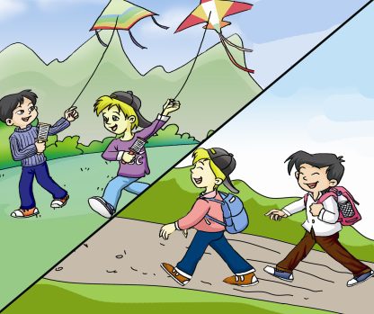
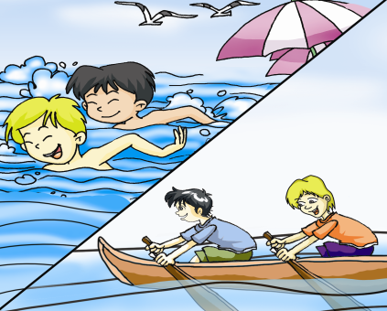
2
Look and say
Look at the pictures. Then follow the example to ask and answer in pairs.
in summer
in spring

Slide 13
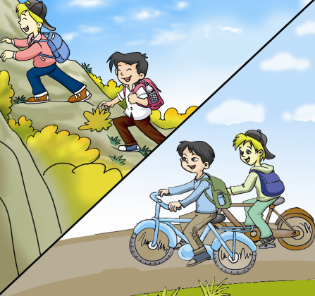
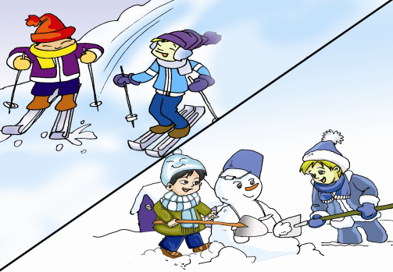
in winter
in fall

Slide 14
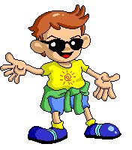
Example
A: What do Kangkang and Michael often do in spring ?
B: They often fly kites.
A: What did they use to do in spring ?
B: They used to go traveling.

Slide 15
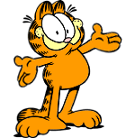
Key points
It is easy to get started. 很容易着手（做剪贴簿）。
get started 开始
It is + adj. (for sb. ) to do sth.
（对于……来说），做某事是……
Eg: 对于我们来说，学一门外语是很重要的。
It’s important ______________ a foreign language.
2. start with 以……开始
Eg: 我们的晚会以一首歌来开始。
Our party started with a song.
for us to learn

Slide 16
3. You need the scissors to cut out the pictures or stories.
cut out 剪下，裁剪
need sth. to do sth. 需要某东西做某事
e.g. 天太冷了，孩子们需要厚衣服来保暖。
It’s too cold ! The children ___________
clothes _________ warm.
他们需要一辆 汽车去上班 。
They _________________ to work.
4. share sth. with sb. 与某人分享某东西
你需要一把剪刀来剪下图片或故事。
need thick
to keep
need a car to go

Slide 17

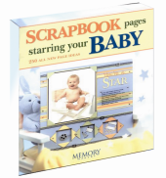
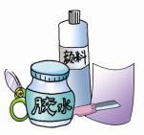
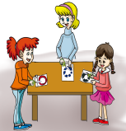
3
Work in groups and discuss how to make a class book. Then write a passage about your ideas. The following table and 1a may help you.
Name | What to collect | How to make it | Why to make it
A class book | Self introduction School life Friends Class photos | First, … Second , … Third, … | Because it will help us …

Slide 18

Reporting
You can report like this:
Many students like making a class book when they finish their school. They call it a friendship book. They keep their class blog, the school life, lovely friends and other things they want to remember.
It is easy to get started. First, you should decide what you want to keep. Second, collect the information you need. Third, put it in order.
It’ll be a lot of fun to make a class book. It will help you remember your school life and keep the friendship.

Slide 19

Exercises
Choose the correct answer.
Bob and I are good friends, and we ___ interests with each other.
A. like B. hate C. share D. with
2. I ___ play sports , but now I like it.
A. am not used to B. wasn’t used to
C. didn’t use to D. don’t use to
3. When people are sick, hobbies can help them get ______ .
A. good B. nice C. best D. well

Slide 20
summary
I know some phrase :
start with
need … to do…
share … with …
I know how to make a scrapbook.
First，… Second，… Third，…

Slide 21
Homework
Read 1a, and try to retell the passage.
Make a scrapbook in your free time.

