Slide 1
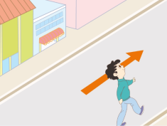
Unit2 There is a park near my home.
人教精通版六年级下册
WWW.PPT818.COM

Slide 2
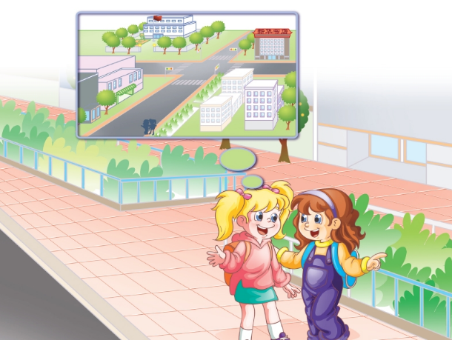
>>Review
Look and say
Where is the bookshop?

Slide 3
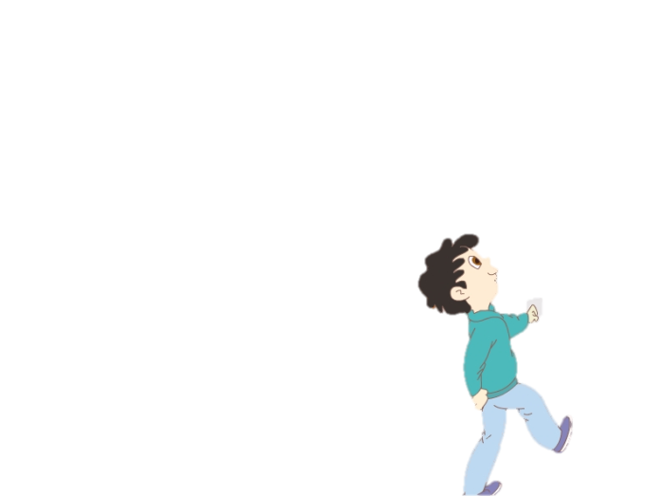
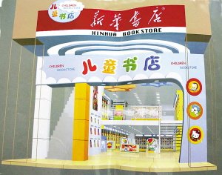
>>Lead-in
Look and say
Xiaogang wants to go to Xinhua Bookshop.
Where is it?
Can you help him?

Slide 4
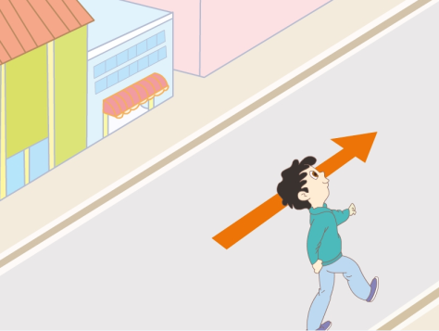
>>Presentation
Look, read and say
First, he should ...
go down this street.

Slide 5
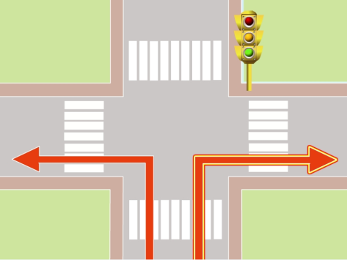
>>Presentation
Look, read and say
Then, …
turn right at the traffic lights.

Slide 6
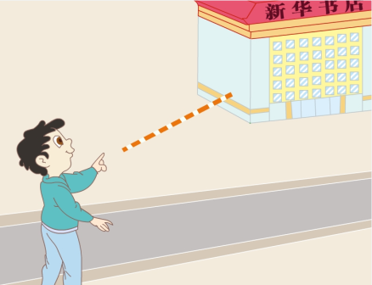
>>Presentation
Look, read and say
The bookshop is …
on the left.

Slide 7
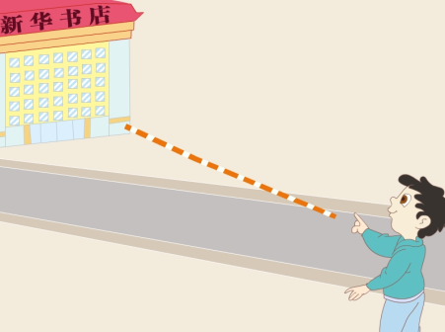
>>Presentation
Look, read and say
But he must …
He can get to the bookshop.
cross the street.

Slide 8
>>Practice
Game1
Magic fingers
go down this street
cross the street
on the left
turn right at the traffic lights

Slide 9
>>Practice
Game2
What’s missing?

Slide 10
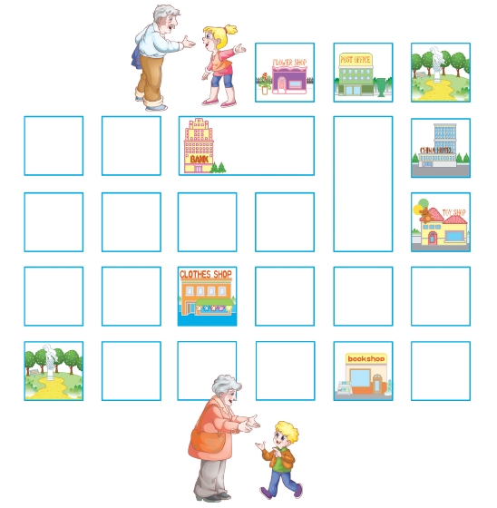
>>Practice
Let’s play
You can …
Where’s the clothes shop?
NANJING ROAD
BEIJING ROAD
GUANGZHOU ROAD
HARBIN STREET
WUHAN ROAD
BOOKSHOP
HANGZHOU STREET
HAINAN STREET
Where’s the park?
You can …/Go …

Slide 11
>>Consolidation
Look and match
1
2
on the left
go down this street
cross the street
3
4
turn right at the traffic lights

Slide 12
>>Practice
Let’s chant

Slide 13
>>Summary
本课的重点词汇：
go down this street
on the left
turn right at the traffic lights
cross the street
2.本课的重点句型：
Where is the bookshop?
Go down the street.
The bookshop is on the left.

Slide 14
>>Homework
1.观看课文动画，按照正确的语音、语调朗读课文。 2.在四线三格中正确抄写本课新学的短语，不少于五遍。
3.预习 Lesson11。

