Slide 1
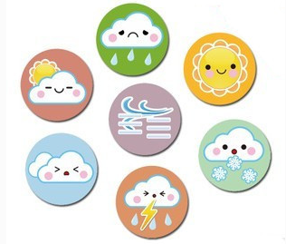
Unit5 What’s the weather like today?
陕旅版
五年级下册
第三课时
WWW.PPT818.COM

Slide 2
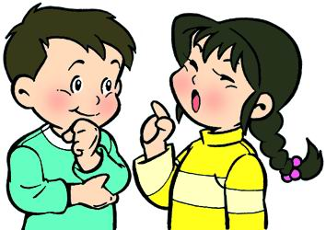
>>Review
Make a new dialogue
-How is the weather like …?
-It’s (cloudy/windy/sunny/rainy)…

Slide 3
>>Warm-up
Free talk
Did you look at the sky at night?
What can you see in the sky at night?
How many stars can you see?
What else can you see?

Slide 4
>>Lead-in
Discuss and fill with
How is the weather in … today?
Beijing
Shanghai
Guangzhou
Lanzhou
Chengdu

Slide 5
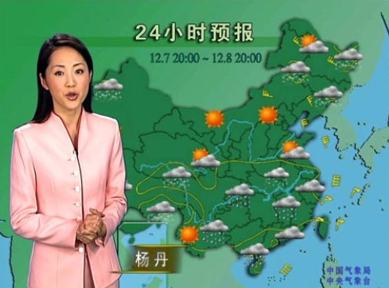
>>Presentation
Let’s learn
What’s the weather like (in…)?
It’s ….
How is the weather (in…)?

Slide 6
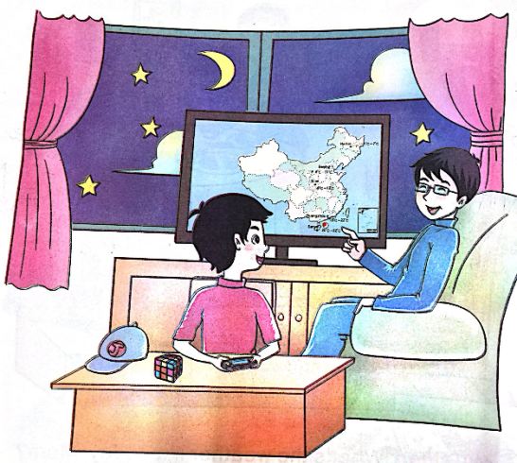
>>Presentation
Look and imagine
What’s can you see in the sky?

Slide 7
>>Presentation
Listen, then ask and answer
Q 1: What’s the weather like now?
It’s fine.
Q 2: What can you see in the sky?
I can see the moon and stars.
Q 3: How is the weather tomorrow?
It will be windy and cool tomorrow.
Q 4: What is Liu going to do tomorrow?
He is going to climb the mountains.
答案

Slide 8
>>Presentation
Let’s learn more
Liu: What’s the weather like now, Dad?
Dad: It’s fine. I can see the moon and
stars in the sky.
Liu: How is the weather tomorrow?
It is Saturday. We can going to
climb the mountains with our
teachers.
点击小喇叭或文本框都可以播放音频

Slide 9
>>Presentation
Let’s learn more
Dad: The weather report says it will be
windy and cool tomorrow. You’d
better wear your coat.
Liu: I will, Dad. Thank you.
点击小喇叭或文本框都可以播放音频

Slide 10
>>Practice
Read it by yourselves for one minute.
自读对话一分钟。
一分钟倒计时
60
10
50
Tips:
当你自己朗读时，遇到不会读或不明白意思的单词或句子，可以把它圈起来，请教同学或老师！
20
40
30
开始

Slide 11
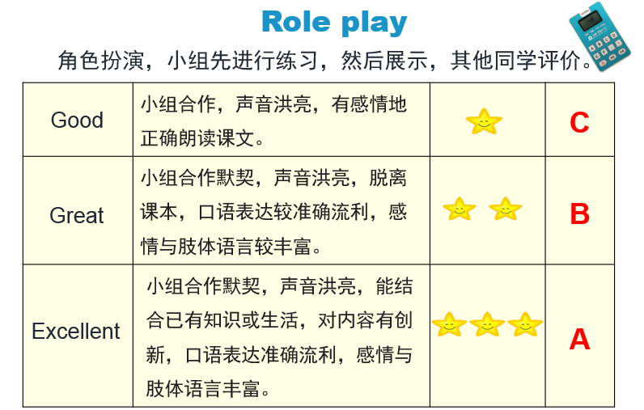
>>Practice

Slide 12
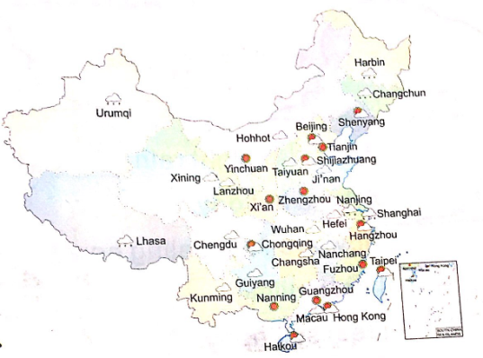
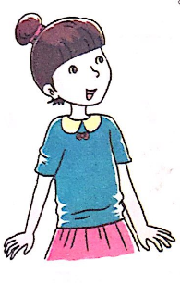
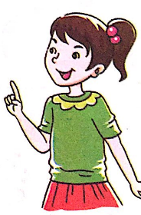
>>Practice
Let’s play
A: What’s the weather like in …?/
How is the weather in …?
B: It’s …

Slide 13
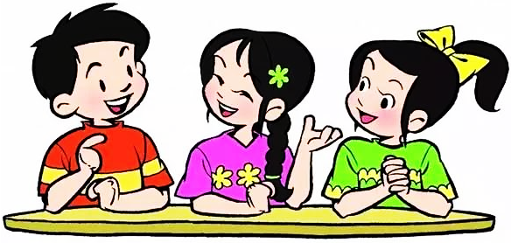
>>Practice
Make a new dialogue
A: What’s the weather like in …?/
How is the weather in …?
B: It’s …What’s / How’s …?
C: It’s …

Slide 14
>>Practice
Listen and tick
Chongqing
√
Fuzhou
√
Dalian
√
Hong Kong
√
Harbin
√

Slide 15
>>Summary
本课所学的重点单词：
moon star weather report

Slide 16
>>Summary
本课所学的重点句型：
-How is the weather tomorrow?
-It will …
e.g.
-How is the weather tomorrow?
-It will be sunny.

Slide 17
>>Homework
1.听课文录音并跟读，按照正确的语音、语调朗读并表演课文对话。 2.Pair work: 2人一组，仿照课文Let’s learn more创编新对话。
3.预习B Read the words。
close

