Slide 1
111111111111111111111111111111111111111111111111111111111111111
Unit 2 School in Canada
六年级上册
Lesson 8 Li Ming Meets Jenny’s Class
WWW.PPT818.COM

Slide 2
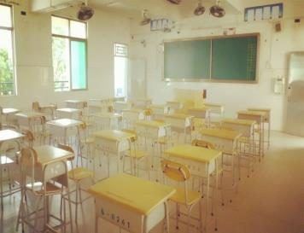

Slide 3
1. Jenny’s class
Jenny : Mr. Wood，this is my friend Li Ming.
Mr. Wood: Hi, Li Ming! Nice to meet you!
Li Ming: Nice to meet you, Mr. Wood!
Jenny : Li Ming, this is my friend Kim. Kim, this is Li Ming.
Kim: How are you, Li Ming?
Li Ming: Very well, thanks！
Kim: Where are you from?
Li Ming: I am from China.
Li Ming: What subjects do you have in your school?
Kim: We have English, math, science, art...
Li Ming: How many classes do you have each school day?
Kim: Three classes in the morning and two in the afternoon. We have lunch at school.

Slide 4
讲解
知识点 1
well / wel/ adj. 健康int.（说话时稍微停顿）对了，噢
My mother feels very well today.
我的妈妈今天感觉身体很好。
例句：
wall（n.）墙
形近词：
拓展
well也可作副词，意思是“好”，用来修饰动词。如：—You sing well. 你唱得很好。
—Thanks. 谢谢。

Slide 5
讲解
知识点 2
Where are you from? 你来自哪里？
这个问句用来询问对方来自哪里。其中Where 意为“哪里”，用于询问某人或某物所处的位置。因为主语是第二人称you，所以be 动词用are。答语为“I’m /We’re from + 地点.”。
例句：—Where are you from? 你来自哪里？
—I’m from America.我来自美国。

Slide 6
讲解
知识点 3
What subjects do you have in your school?在你们学校你们有什么科目？
句型结构为“What subjects do you have + 其他?”，
用于询问对方有什么课程。答语为“I/We have + 学科名称（English， art， PE...）.”。
例句：—What subjects do you have in your school?
在你们学校你们有什么科目？
—We have Chinese， English， math and PE.
我们有语文、英语、数学和体育。

Slide 7
讲解
知识点 4
How many classes do you have each school day?
每一个上学日你们有多少节课？
用于询问对方有多少节课的句型
句型结构为“How many classes do you have + 其他?”，其中How many 表示“多少”，后面接可数名词的复数形式。do 是助动词，无实际意义。
答语为“I/We have + 基数词+ class（es）. /基数词.”。

Slide 8
讲解
—How many classes do you have in the afternoon?
下午你们有多少节课？
—We have three classes. 我们有三节课。
例句：
How much 也可以用来询问数量，但是后面要
接不可数名词，意思是“多少”。
拓展

Slide 9
讲解
单项选择。
— ________books do you have?
—I have three.
A. How B. How much C. How many
典例
C
how many修饰可数名词复数，how much修饰不可数名词，用来询问数量的多少。
点拨：

Slide 10
class / klɑːs/ n. 班级；课
讲解
We are having an English class.
我们正在上英语课。
例句：
classes
复数：
glass (n.) 玻璃杯
形近词：
合成词：classroom (n.) 教室classmate (n.)同学
短语：
拓展
合成词：classroom (n.) 教室 classmate (n.)同学
class (n.) 同学们（特指全体学生，单复数同形）
其他含义：

Slide 11
讲解
each / iːtʃ/ adj. 每个
Each student has an apple.
每个学生有一个苹果。
例句：
由一个单词减去一个字母或字母组合后，成为一个新单词来记忆单词的方法。如：
beach（沙滩） - b = each（每个）
减法记忆法：

Slide 12
2. Let’s do it!

Slide 13
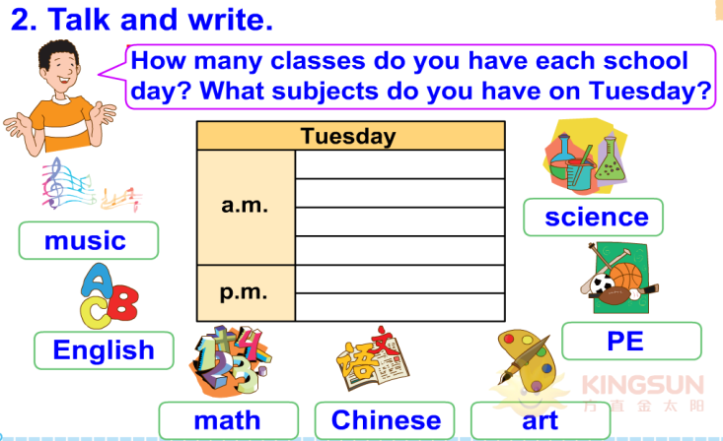
2. Let’s do it!

Slide 14
习题
1.单项选择。
—How are you, Lucy?
— ___________.
A. Yes, I am B. Very well, thanks C. Of course
2.对画线部分提问。
His family are from Japan．
________ ________ his family ________?
B
Where
are
from

Slide 15
习题
3. 圈出下列单词中不同类的一项。
(1) A. teacher B. friend C. well
(2) A. from B. class C. of
(3) A. each B. eat C. see

Slide 16
本节课我们学习了以下知识，请同学们一定加强巩固，以便能和同学们进行灵活交流哦！
重点词汇：class, Chinese, science, music, art
重点短语：at school, have lunch, in the morning
重点句式：How many classes do you have each school day?
—What subjects do you have in you school?
—We have English, math, science, art…
—Where are you from?
—I am from China.

Slide 17
Thank you!

