Slide 1
Section C Discovering Useful Structures & Listening and Talking
人教版高中英语必修二
UNIT 4 History and traditions
WWW.PPT818.COM

Slide 2
Ⅰ
Ⅱ
Ⅲ
Ⅰ.知识体系图解
charge
announce
amount
gallery
approach
ensure
landscape
generous
butter
honey
ancestor
position
courtyard
snack
eager

Slide 3
Ⅰ
Ⅱ
Ⅲ
作为……而著名
……的数目
……的数量
在……入口
注视……
照料
渴望做
被……吸引

Slide 4
Ⅰ
Ⅱ
Ⅲ
Ⅱ.选词填空
1.There’s a postage and packing fee in addition to the repair .
2.It was that new speed restrictions would be introduced.
3.A is a place that has permanent exhibitions of works of art in it.
4.As you the town,you’ll see the college on the left.
5.In order to success we must have a complete and thorough plan.
gallery,approach,announce,ensure,charge
charge
announced
gallery
approach
ensure

Slide 5
Ⅰ
Ⅱ
Ⅲ
Ⅲ.用过去分词作定语完成句子
1.Jim has retired,but he still remembers the happy time
(和学生们一起度过的).
2.To return to that problem,I’d like you to look at a study
(在法国做的).
3.The bridge (最近建成的) was designed by a local company.
4.The manager was satisfied to see many new products___________ (开发) after great effort.
5.Nearly all the people (参加面试的) believe confidence is the key to success.
spent with his students
conducted in France
built recently
developed
interviewed

Slide 6
重点词汇
重点句式
重点语法
随堂练习
1.charge n.收费;指控;主管 vt.收费;控告;充电
【课文原句】Judy and I had our car parked in an underground car park near Trafalgar Square,where we could get our car battery charged.
朱迪和我把车停在特拉法加广场附近的一个地下停车场,我们可以在那里充电。
【词汇精讲】句中的charge是及物动词,意为“充电”,charge作动词还可表示“收费;控告”,作名词可表示“收费;指控;主管”。
In just minutes a day,plug in and charge your iPhone quickly.
每天仅用几分钟时间,插上电源,给你的苹果手机快速充电。
I wonder how much you charge for your services.
我想知道你们收取多少服务费。
The man arrested by the police was charged with stealing.
被警察逮捕的男子被指控盗窃。

Slide 7
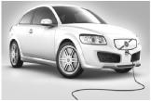
重点词汇
重点句式
重点语法
随堂练习
【词汇拓展】
We can deliver goods to your door free of charge.
我们可以免费送货上门。
A week later,I volunteered to take charge of English study in my class.
一个星期以后,我自愿负责班里的英语学习。

Slide 8
重点词汇
重点句式
重点语法
随堂练习
【温馨提示】charge表示“控告”时,要用charge sb with sth,而accuse表达相同意义时,则应用accuse sb of sth。

Slide 9
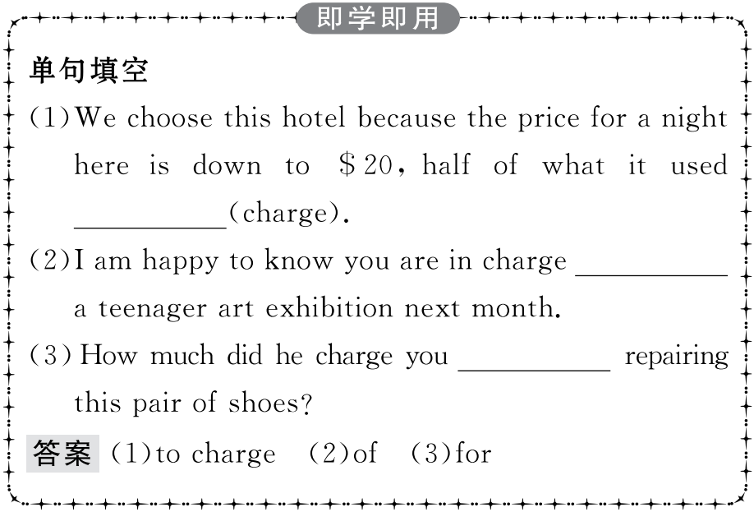
重点词汇
重点句式
重点语法
随堂练习

Slide 10
重点词汇
重点句式
重点语法
随堂练习
2.announce vt.宣布;通知;声称
【课文原句】...we heard it announced that there were no audio guides left.
……我们听到宣布没有音频指南了。
【词汇精讲】announce是及物动词,意为“宣布;通知;声称”。
We are pleased to announce that all five candidates were successful.
我们高兴地宣布,五位候选人全都当选了。
They announced that the flight would be delayed.
广播通知该航班将延误。
She announced that she’d given up smoking.
她宣称她已戒烟。

Slide 11
重点词汇
重点句式
重点语法
随堂练习
【词汇拓展】
It has been announced that railway fare will be raised by 10 percent on and after March 1st.
已宣布铁路运费会从三月一日起提高10%。
I was totally unprepared for the announcement the next day.
我对第二天的通告完全没有准备。

Slide 12
重点词汇
重点句式
重点语法
随堂练习

Slide 13
重点词汇
重点句式
重点语法
随堂练习
3.amount n.金额;数量
【课文原句】We found ourselves very surprised by the large number of visitors and the amount of noise at the entrance of the National Gallery.
我们对国家美术馆入口处的大量游客和喧闹声感到非常惊讶。
【词汇精讲】amount是名词,意为“金额;数量”。
The insurance company will return any amount due to you.
保险公司将退还你应得的所有款项。
He needs that amount of money to survive.
他需要那一笔钱以生存下去。

Slide 14
重点词汇
重点句式
重点语法
随堂练习
【词汇拓展】
Although the job takes a significant amount of time,most students agree that the experience is worth it.
虽然这份工作要花大量的时间,但大多数学生都同意这次经历是值得的。
Lots of students in our class spend a large amount of time doing homework.
我们班很多同学花费大量时间来做家庭作业。

Slide 15
重点词汇
重点句式
重点语法
随堂练习
【温馨提示】“a huge amount of+不可数名词”作主语时,谓语动词用单数形式;“huge amounts of+不可数名词”作主语时,谓语动词用复数形式。
A huge amount of money was spent on the new bridge last year.
=Huge amounts of money were spent on the new bridge last year.
去年建这座新桥花了很多钱。

Slide 16
重点词汇
重点句式
重点语法
随堂练习

Slide 17
重点词汇
重点句式
重点语法
随堂练习
4.approach n.方法;途径;接近 vt.接近;接洽;着手处理 vi.临近
【课文原句】It was hard to approach the painting as there were so many people around.
周围人太多,很难接近那幅画。
【词汇精讲】approach作及物动词,意为“接近;接洽;着手处理”,作不及物动词,意为“临近”,作名词,意为“方法;途径;接近”。
Now we’re leaving the business district and approaching the harbour.
现在我们正离开商业区接近码头。
As the time for graduation is approaching,we are busy with our papers.
随着毕业的临近,我们都忙着写论文。

Slide 18
重点词汇
重点句式
重点语法
随堂练习
【词汇拓展】
Let’s take a new approach to the problem.
让我们用一个新方法来处理这个问题吧。
【温馨提示】approach作名词,后面常跟介词to表示“……的方法”,而way,method,means表示“方法”时后常跟介词of。

Slide 19
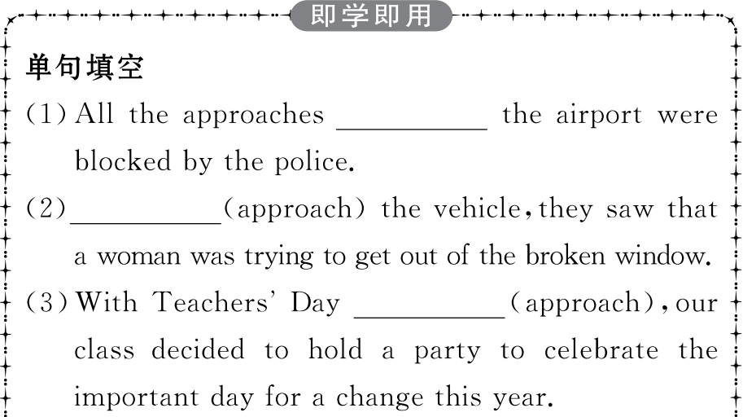
重点词汇
重点句式
重点语法
随堂练习

Slide 20
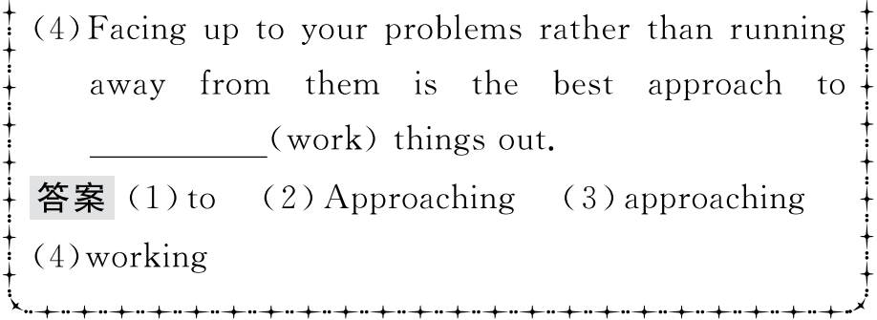
重点词汇
重点句式
重点语法
随堂练习

Slide 21
重点词汇
重点句式
重点语法
随堂练习
5.ensure vt.保证;确保;担保
【课文原句】She had a copy of the painting boxed to ensure that it was delivered safely.
她把画的复制品装箱,确保递送安全。
【词汇精讲】ensure是及物动词,意为“保证;确保;担保”,后接名词、代词或从句作宾语。
Please ensure (that) all lights are switched off.
请务必将所有灯都关掉。
In order to ensure success we must have a complete and thorough plan.
为了保证成功,我们必须要有一个完整周密的计划。

Slide 22
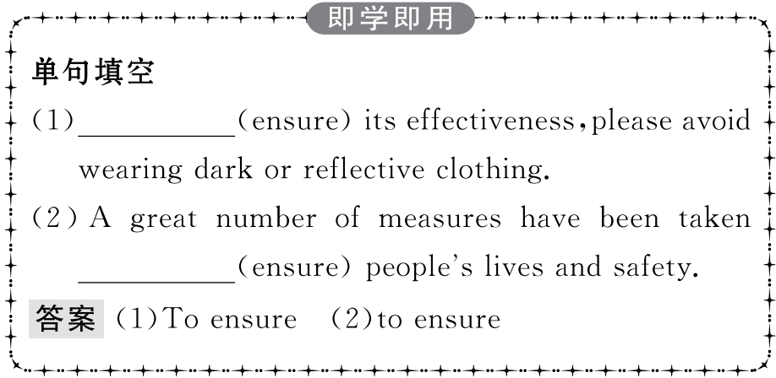
重点词汇
重点句式
重点语法
随堂练习

Slide 23
重点词汇
重点句式
重点语法
随堂练习
6.eager adj.热切的;渴望的
【课文原句】I was eager to see that...我急切地想看到……
【词汇精讲】eager是形容词,意为“热切的;渴望的”,可作定语或表语。
She looked at the crowd of eager faces around her,excited.
她看着周围渴望的面孔,非常兴奋。
Young people are most eager to learn.
青年人最渴望学习。

Slide 24
重点词汇
重点句式
重点语法
随堂练习
【词汇拓展】
Young people are eager for knowledge.
年轻人渴望得到知识。
She is looking forward more and more eagerly to her son’s holiday at home.
她眼巴巴地盼着儿子休假回家。

Slide 25
重点词汇
重点句式
重点语法
随堂练习

Slide 26
重点词汇
重点句式
重点语法
随堂练习
过去分词作定语和宾语补足语
一、过去分词作定语
过去分词是非谓语动词的一种形式,它既保留了动词的某些特征,又具有形容词和副词的特征。
1.过去分词作定语时的位置
单个过去分词作定语一般置于被修饰的词语之前,过去分词短语作定语时一般置于被修饰的词语之后。
To her the outside world was a totally unknown quantity.
对她来说,外部世界完全是个未知数。
Who were the so-called guests invited to your party last night?
昨晚被邀请参加你的聚会的那些所谓的客人是谁呀?
Things bought through computers are much cheaper.
通过电脑购买的物品要便宜得多。

Slide 27
重点词汇
重点句式
重点语法
随堂练习
2.过去分词作定语时的功能
过去分词作定语时,其功能相当于一个定语从句,因此可以改为相应的定语从句。
The injured workers are now being taken good care of in the hospital.
= The workers who were injured are now being taken good care of in the hospital.
受伤的工人现正在医院受到良好的照料。
Polluted air and water are harmful to people’s health.
=Air and water which have been polluted are harmful to people’s health.
被污染的空气和水对人们的健康有害。

Slide 28
重点词汇
重点句式
重点语法
随堂练习
3.过去分词作定语时的意义
一般来说,及物动词的过去分词作定语,表示一个被动的、已完成的动作;不及物动词的过去分词作定语不含有被动意义,只表示该动作已完成。
The damaged car is being repaired in the garage.
被损坏的车正在修理厂维修。
This is a book written by the famous film star.
这是那个著名的电影明星写的书。
When there is a wind,the fallen leaves are swept up into the sky.
有风时,落叶被刮到天空中。
Tom’s grandfather is a retired engineer.
汤姆的爷爷是位退休工程师。

Slide 29
重点词汇
重点句式
重点语法
随堂练习
二、过去分词作宾语补足语
1.特征及含义
(1)及物动词的过去分词作宾语补足语与宾语有逻辑上的被动关系,表示被动意义或已完成意义,有时候两者兼而有之。
When I opened the door,I found the ground covered with snow.
当我打开门时,我发现地面被雪覆盖着。
Back from his two-year medical service in Africa,Dr Lee was very happy to see his mother taken good care of at home.
李博士在非洲进行了两年的医疗服务,回来后看到他的母亲在家里被照顾得很好他很高兴。

Slide 30
重点词汇
重点句式
重点语法
随堂练习
(2)不及物动词用作宾语补足语时,与宾语没有逻辑上的动宾关系,只表示动作的完成或状态。
They found all the guests gone when they woke up.
当他们醒来时,发现所有的客人都走了。
When I came in,I saw a strange girl seated in the corner.
我进来时看到一个陌生的女孩坐在角落里。

Slide 31
重点词汇
重点句式
重点语法
随堂练习
2.使用过去分词作宾补的几种情况
(1)在感官动词watch,notice,see,hear,listen to,feel,find,observe等后。
He found his hometown greatly changed.
他发现他的家乡变化很大。
Mr Brown saw the walls painted white when he came back.
布朗先生回来后发现墙被刷成了白色。
(2)在表示“致使”的动词如get,keep,leave,have,make等后。
We must try our best to get the work finished before Friday.
我们必须尽力在周五前完成工作。
Please keep me informed if anything happens.
如果发生任何事情请通知我。
The speaker raised his voice in order to make himself heard.
为了让自己被听到,演讲者提高了声音。

Slide 32
重点词汇
重点句式
重点语法
随堂练习
(3)在表示爱憎、意愿的动词如want,wish,like,hate等后。
Would you like it wrapped in brown paper,sir,or in white?
先生,你喜欢把它用棕色的还是白色的纸包上?
I’d like the house decorated with coloured lights.
我想让房子装饰上彩灯。
(4)用在with结构中,该结构通常在句中作时间、方式、条件、原因等状语。
With the problem settled,the manager went home happily.
事情得到解决,经理高高兴兴地回家了。
She stood in front of him,with her eyes fixed on his face.
她站在他面前,眼睛注视着他的脸。

Slide 33
重点词汇
重点句式
重点语法
随堂练习
3.使役动词have,get后接非谓语动词作补语的异同点:
Before driving into the city,you are required to get your car washed.
在开车进城之前,你需要洗洗车。
Don’t have the lights burning all the time.
不要让灯一直亮着。
It is wrong of you to have the boy stand outside the room.
让男孩站在房间外面是错误的。

Slide 34
重点词汇
重点句式
重点语法
随堂练习
Ⅰ.单词拼写
1.She never loses weight because she eats (小吃)between meals.
答案:snacks
2.Make sure that you are working in a comfortable p .
答案:position
3.The woods and fields are typical features of the English (风景).
答案:landscape
4.Although he was poor,he was quite (慷慨的)to his needy friends.
答案:generous
5.My brother is in a hurry to grow up,e for knowledge and experience.
答案:eager

Slide 35
重点词汇
重点句式
重点语法
随堂练习
Ⅱ.用过去分词作宾语补足语完成句子
1.When he returned 20 years later,he found his city (变化很大).
答案:greatly changed
2.If he calls,I will keep you (知道) as soon as possible.
答案:informed
3.The old man stood there,with his eyes (盯着那幅画).
答案:fixed on the picture
4.I will try my best to get the work (晚饭前完成).
答案:finished before supper
5.We often hear the song (用英语唱).
答案:sung in English

