Slide 1
Unit 2 Housework
What’s mum doing?
WWW.PPT818.COM

Slide 2
Chant it.
What are you doing? I’m washing clothes.
What are you doing? I’m cooking the meal.
What are you doing? I’m cooking the chicken.
What are you doing? I’m watering the flowers.

Slide 3

Guessing game
What’s he/ she doing?
He’s\She’s…

Slide 4

Guessing game
What’s he/ she doing?
He’s\She is…

Slide 5

Guessing game
What’s he/ she doing?
He\She is…

Slide 6

wash the dishes
dish dishes
What’s she doing?
She’s washing the dishes.”

Slide 7

play computer games

Slide 8
What’s mum doing ？
She’s＿
What’s dad doing?
He’s＿
Questions

Slide 9
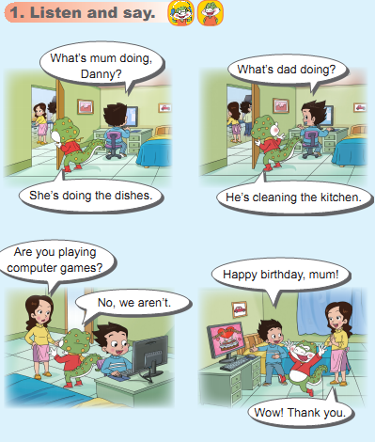

Slide 10
What’s mum doing？
She’s ______________
What’s dad doing?
He’s ______________
doing the dishes.
cleaning the kitchen.
Questions!

Slide 12

Pair work:
What’s he/she doing?
He /She is …ing .

Slide 13
Play a game.
请同学们连续做几个动作,如: do the dishes, play computer games, clean the kitchen然后当听到教师说:stop ,你们立刻变成木头人,保持原有的姿势不能动。然后我们就利用我们学习的知识去解救这些木头人,OK ?
(分为四组,教师先解救一人,然后这个人再去解救其他人。)
设计意图: 通过游戏,把新旧知识有机结合,在练习新句型的同时,把过去的知识加以更新和巩固。通过对话练习,培养合作精神。

Slide 14

What is she doing?
She is reading.

Slide 15
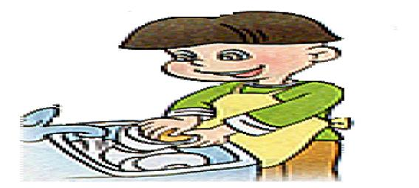
What is he doing?
He is doing the dishes.

Slide 16
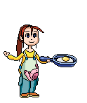
What is she doing?
She is cooking the meal.

Slide 17

What is he doing?
He is singing.

Slide 18

What is she doing?
She is writing.

Slide 19
Group work:人人争做小记者：
人人争做小记者。活动形式是小组内互相采访，根据事先准备的表格，用句型What’s he\she doing? He\She’s…来采访别人,练习后到台前表演.
Housework Names | cleaning the kitchen | watering the flowers | washing the clothes | doing the dishes

Slide 20
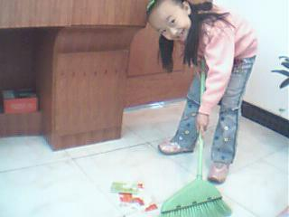
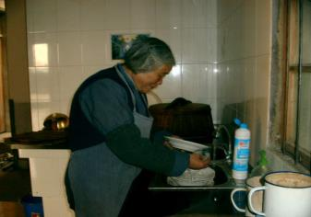
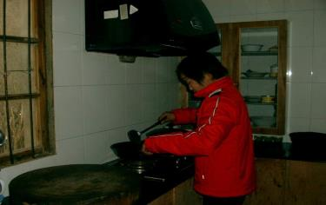
What’s your brother\sister\grandma\mum doing?
He’s\She’s…

Slide 21
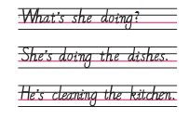
Let’s copy!

Slide 22
Let’s copy!
1.让学生认读，注意语音语调准确流畅。
2.教师规范板书以上句子，强调标点符号及句子首字母大写。
3. 让学生抄写课本上的句子。

Slide 23
Homework:
1.听本课录音，模仿跟读。
2.观察记录同学们课外活动内容，运用所学语言进行描述或问答练习。

