Slide 1
The world has changed for the better
Unit 1 Topic 3
Section B
WWW.PPT818.COM

Slide 2
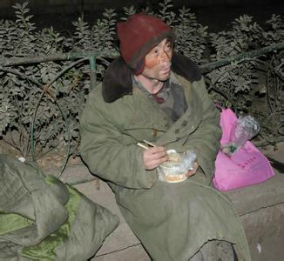
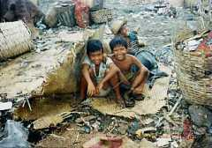
homeless people

Slide 3
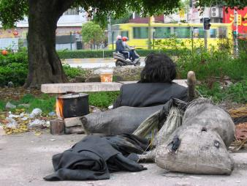
The world has changed for the better.
program n.节目
homeless people
manage v.完成，能解决
people in need
offer sb. sth.=offer sth. to sb.
medical treatment
job training
provide sb. with sth.=provide sth. for sb.

Slide 4
1b Listen to 1a and mark T(true) or F(False).
Maria and Jane are talking about a program in China . ( )
The program helps the homeless people in many ways . ( )
The program also trains those people in need to help them find jobs again . ( )
It is important to let homeless people feel good about themselves . ( )
The world has not changed people’s lives ( )
F
T
T
T
F

Slide 5
1c Read 1a and fill in the blanks .
There is a wonderful program that helps __________people in Canada. The program not only __________ enough food, ________________and homes for the homeless people, but also _______ them in order to help them________________again. Thanks to the program, the homeless people feel _______about themselves.
homeless
provides
medical treatment
trains
(to) get/find jobs
good

Slide 6
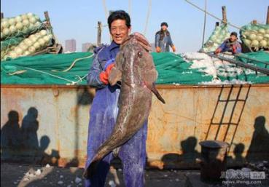
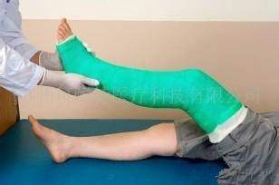
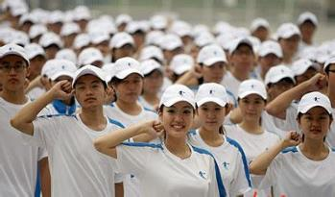
fisherman
soldier
The story of Xiao Lin
wound
n.创伤
v.伤，伤害
secretary
engineer
n.工程师
n.秘书

Slide 7
The story of Xiao Lin
n.俱乐部
Xiao Lin is not only the secretary of the Helpers’ Club but also an excellent computer engineer. He’s the son of a fisherman. His father died in 1992. Xiao Li joined the army in 2000,but he left the army because of a leg wound in 2002. Then in 2003, He came to Beijing. He joined the Helpers’ club next year. He bought a house in 2005 and borrowed a car in 2012…

Slide 8
We can also tell the story like this :
Xiao Lin is not only the secretary of the Helpers’ Club but also an excellent computer engineer. He’s the son of a fisherman. His father has been dead for many years . He has been away the army for twelve years because of a leg wound. He has been in Beijing since 2003. He has been a member of Helpers’ Club since 2004. He has had a house since 2005. He has kept the car for two years.

Slide 9
1992 His father died in 1992.
His father has been dead for many years.
2002 He left the army because of a leg wound in 2002.
He has been away from the army for twelve years
because of a leg wound.
2003 He came to Beijing in 2003 .
He has been in Beijing since 2003 .
2004 He joined the Helpers’ Club in 2004.
He has been a member of Helpers’ Club since2004.
2005 He bought a house in 2005.
He has had a house since 2005.
2012 He borrowed a car in 2012.
He has kept the car for two years .

Slide 10
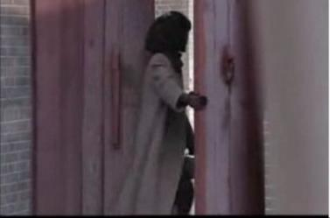
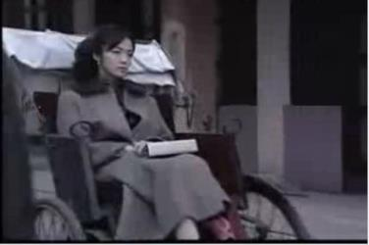
for 2 hours
短暂性动词 → 延续性动词
leave → be away from
past
present
10:00
8:00
since 8:00
The woman left home at 8:00.
She has been away from home since 8:00.
= She has been away from home for 2 hours.

Slide 11
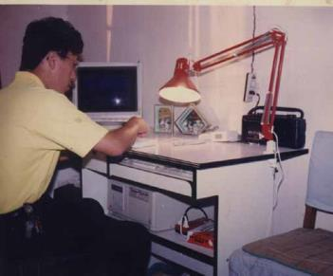
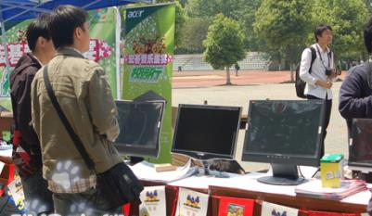
for two years
短暂性动词 → 延续性动词
buy → have
past
present
2009
2007
since 2007
He bought a computer in 2007.
He has had a computer since 2007.
= He has had a computer for two years.

Slide 12
短暂性动词
come --------
leave --------
get to know --------
die --------
buy --------
begin --------
borrow --------
marry --------
catch a cold --------
close --------
join --------
fall ill --------
延续性动词
be
be away (from)
know
be dead
have
be on
keep
be married
have a cold
be closed
be a member of / be in
be ill

Slide 13
Fill in the blanks.
1. His father ________ (die) in 1992.
His father ________________ (be dead) for
many years.
2. He ________ (leave) the army because of a leg
wound.
He ____________________ (be away from) the
army for seven years because of a leg wound.
3. He ________ (come) to Beijing in 2003.
He ____________ (be in) Beijing since 2003.
died
has been dead
left
has been away from
came
has been in

Slide 14
4 He ________ (join) Helpers’ Club in 2004.
He __________ (be) a member of Helpers’
Club since 2004.
5. He ________ (buy) a house in 2005.
He __________ (have) a house since 2005.
6. He __________ (borrow) the car in 2008.
He __________ (keep) the car for one year.
joined
has been
bought
has had
borrowed
has kept

Slide 15
Choose the best answer.
1. His father ______ the Party since 1978.
Ａ. joined Ｂ. has joined
Ｃ. was Ｄ. has been in
2. —How long have you _____ here?
—About two months.
Ａ. been Ｂ. gone Ｃ. come Ｄ. arrived
3. Hurry up! The play _____ for ten minutes.
Ａ. has begun Ｂ. had begun
Ｃ. has been on Ｄ. began
4. My parents _____ Shandong for ten years.
Ａ. have been to Ｂ. have been in
Ｃ. have gone to Ｄ. have been
5. His uncle ______ for more than 9 years.
A. has come here B. has started to work
C. has lived there D. has left the university

Slide 16
3b Retell Xiao Lin’s experiences to your partner based on the box in 3a. Work in pairs and make a similar box about your partner .

Slide 17
2 Complete the passage with the correct forms of the given phrases in the box.
get used to , feel good , provide with , in need ,
decide on , medical treatment
The heaviest rainstorm since 1951 hit Beijing and caused floods in some areas on July 21, 2012. Many people got in trouble and some even lost their homes. Our government _______them ____tents and __________ immediately . Some volunteers drove to pick up the people_______. They _________many different ways to help the homeless. The whole city was in a helpful mood. “I _________because I could help so many people out and I hope they will _________the new life ,” said the farm worker , Li Chuannan.
provided
with
medical treatment
in need
decided on
feel good
get used to

Slide 18
4 Listen and read the following sentences with since and for, paying attention to the stress, weak form, liaison and pause.
Since and for are often unstressed in a sentence.
1.`I have `lived in `New `York for `three years.
2.`He has been `away from `home for `twelve days.
3. Since it `started, /it has `helped `hundreds of `people `return to work /and `live a `normal life.

Slide 19
Summary
We learn:
Some words: program, homeless, manage, treatment,
training, immediately, secretary, helper,
club, engineer, wound
2. Some phrases:offer sb sth;
provide … with…
3. Some sentences :
(1) Well, once they find people in need, they decide on suitable ways to offer them help.
(2)The program also provides them with job training so that they can find jobs again.
We can:
1.Use the Present Perfect Tense with for and since and tell a story in different ways.
(1)His father died in 1992.
(2)His father has been dead for many years.
(3)His father has been dead since 1992.
2. Learn to help homeless people.

Slide 20
Homework
1.Read 1a.
2.Memorize the useful expressions and key sentences which we learn today.
3.Finish Section B in your workbook.
4.Preview Section C.

