Slide 1
Unit 5 Let me show you our new school
WWW.PPT818.COM

Slide 2
What can you see in the video?

Slide 3
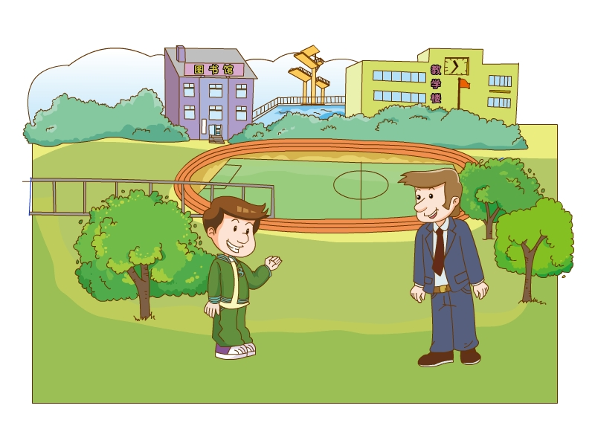
Unit 5 Let me show you our new school
Let’s go!

Slide 4
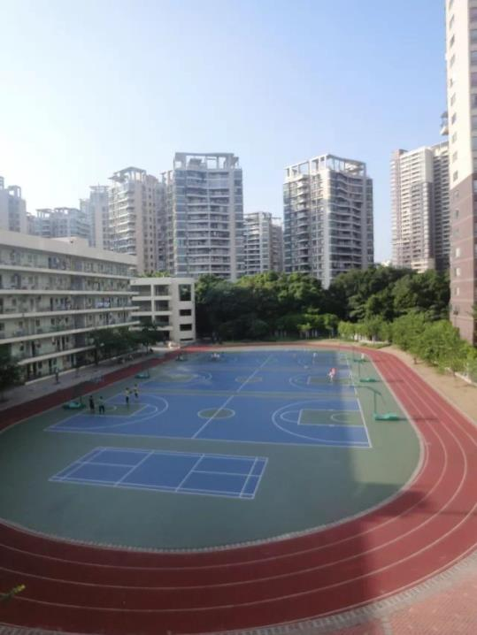
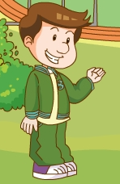
playground

Slide 5
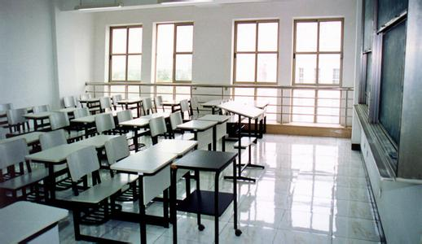
classroom
Do you know what is classroom building？
教学楼

Slide 6
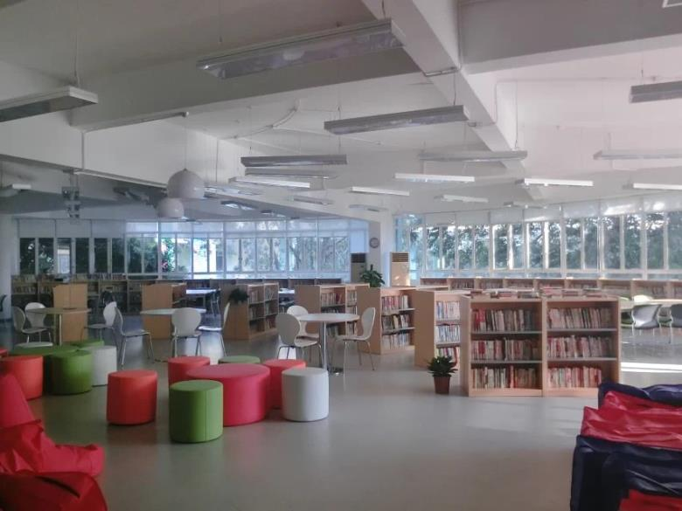
library

Slide 7
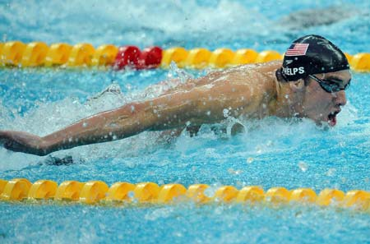
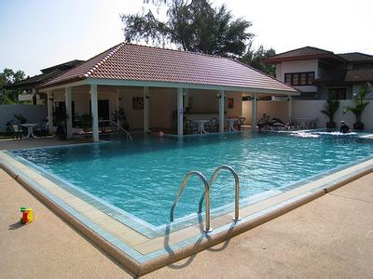
What is he doing?
swimming pool
He is swimming.

Slide 8
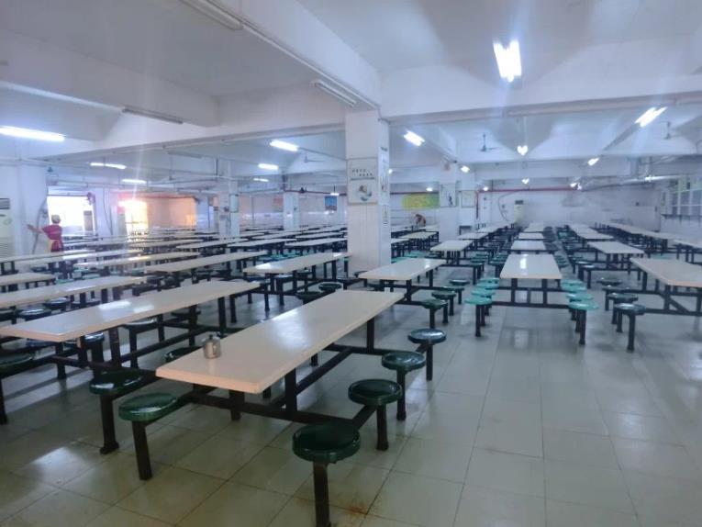
dining hall

Slide 9
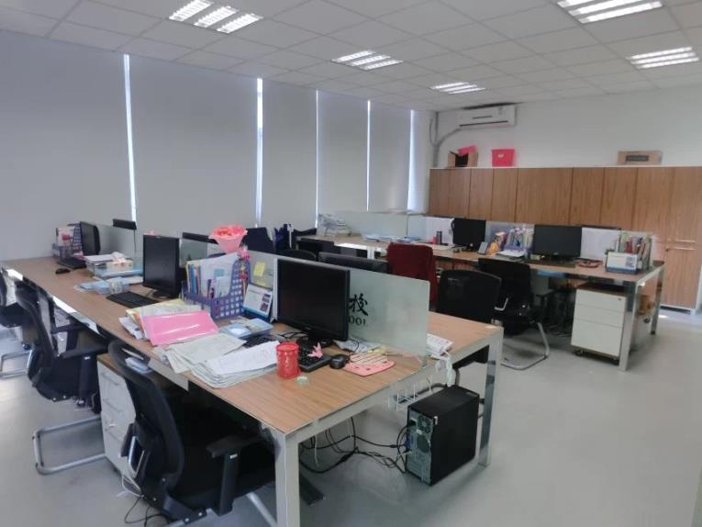
teachers’ room

Slide 10
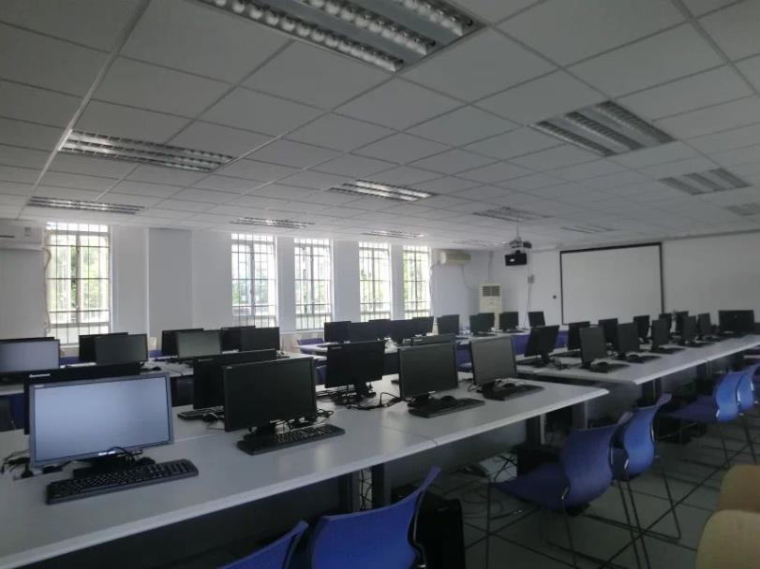
computer room

Slide 11
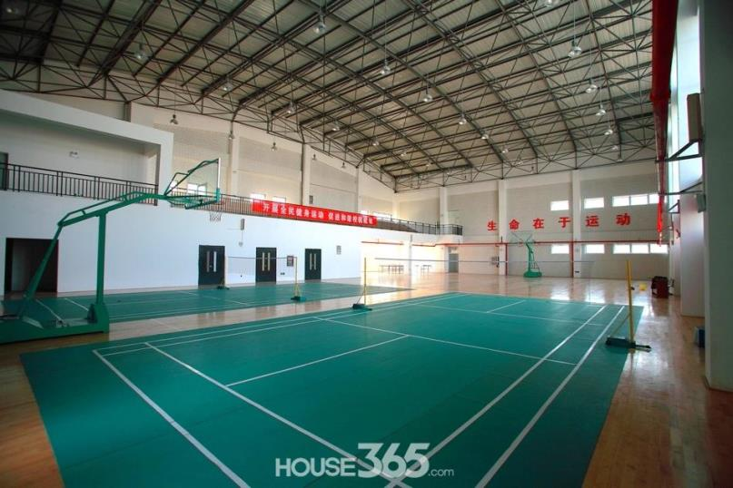
gym

Slide 12
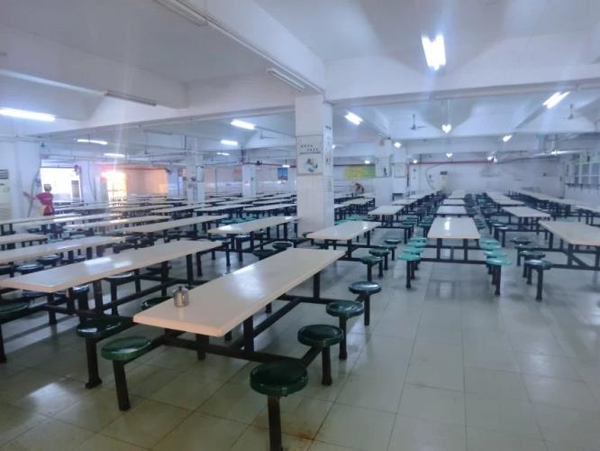
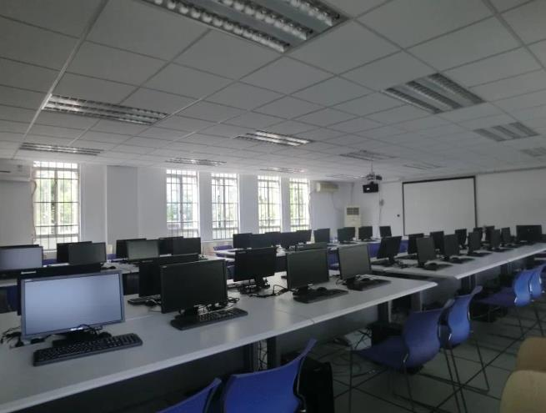
Who can say fast!
Well done！You are great！
teachers’ room
computer room
gym
library
playground
swimmingpool
dinning hall
classroom

Slide 13
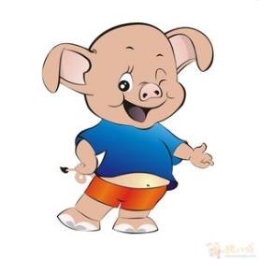
Let’s learn!
Let me show you our new school！
……
classroom
library playground computer room
swimming pool
dining hall teachers’ room
gym

Slide 14
Review the Postion Words!
最近 比较近 近
1.在…旁边,附近
2.在…下面
3.在…前面
4.在…后面
next to beside near
>
>
under
in front of
behind

Slide 15
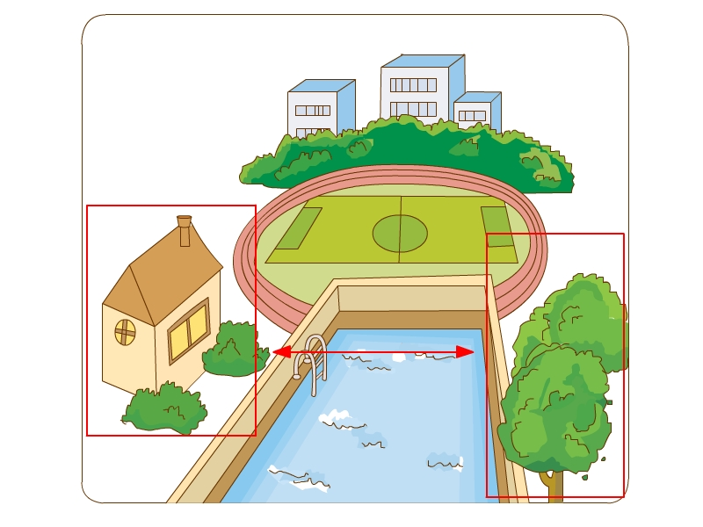
opposite 在…对面
The house is opposite the trees.
house
trees

Slide 16
opposite 在…对面
在操场对面
在体育馆对面
在教室对面
在电脑室对面
在图书馆对面
在游泳池对面
在饭堂对面
opposite the playground
opposite the gym
opposite the classroom
opposite the computer room
opposite the library
opposite the swimming pool
opposite the dining hall

Slide 17
Let’s learn!
A: Where is the classroom?
B：It’s over there，opposite the library.
……
……
在那里
游泳池，在操场对面
饭堂，在体育馆对面
图书馆，在教室对面
教师办公室，在电脑室对面
5. 操场，在游泳池旁边
6. 体育馆，在饭堂前面
7. 教室，在图书馆后面
8. 电脑室，在教师办公室下面
9. 饭堂，在教学楼对面

Slide 18
Sum-up
classroom (classroom building)
library
dinning hall
computer room
teachers’ room
gym
playground
swimming pool
our
opposite
What we learn?
Where is the swimming pool ?
It’s over there, opposite/behind/under/in front of/near/next to/beside the playground.

Slide 19
Homework
用抄写本抄写今天所学单词，并背诵,
明天听写
2. 完成《双基》Module 2

