Slide 1
Unit 1 Li Ming Goes to Canada
Lesson 6 Baby Becky at Home
WWW.PPT818.COM

Slide 2
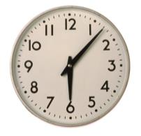
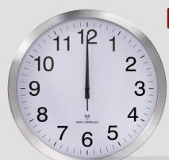
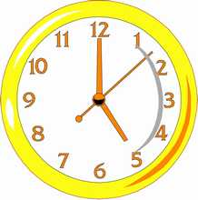
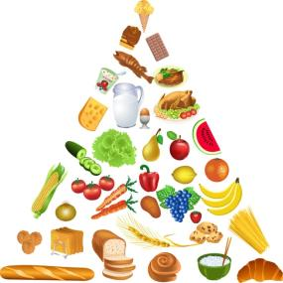
Warming up
1. Look and say
What time is it?
What would you like for…?

Slide 3
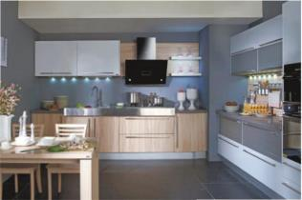
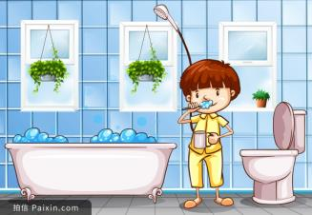
Warming up
2. Act time
3. Free talk
Do you like to help your mother at home?

Slide 4
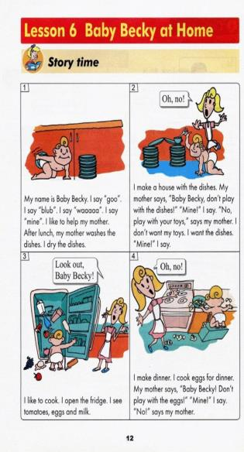
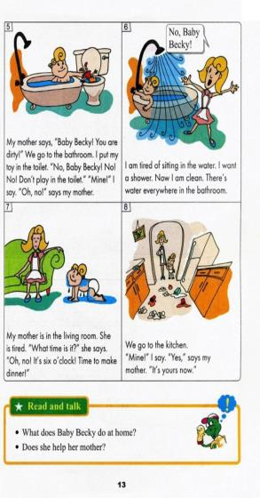
PRESENTATION
Do you remember
Baby Becky?
What is Baby Becky
doing in this story?
Can you guess?

Slide 5
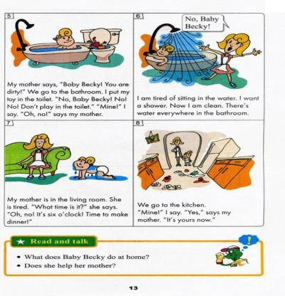
PRESENTATION
Story time

Slide 6
PRESENTATION
(1)What does Baby Becky do for her mother?
(2)Where does Baby Becky help her mother cook?
(3)How does Baby Becky get dirty?
(4)Where does Baby Becky’s mother take her when she is dirty?
(5)Do you like this story? Why?

Slide 7
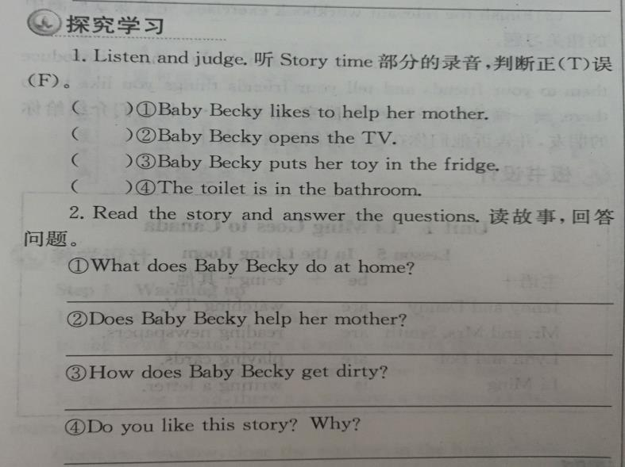
PRESENTATION
T
F
F
T
She helps her mother at home.
Yes, she does.
By playing with eggs.
Yes, I like it. Because it is interesting.

Slide 8
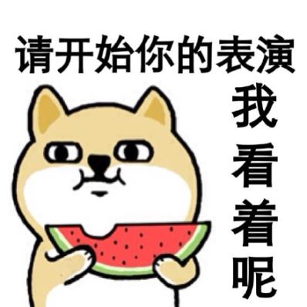
practice
分角色表演本课小故事
2. 小组共同完成课堂检测

Slide 9
consolidation
Free talk:
Do you often help your mother do some housework?
What do you do?

Slide 10
Summing up
1.Words:
lunch, house, dinner, dirty, put, toilet, there, time, kitchen
2.Sentences:
What time is it?
It’s…
There’s…
What would you like…?
I’d like…
3.
这节课我的收获是：_____________
这节课我的不足是：_____________

Slide 11
homework
1.听录音，朗读本课的第一部分
2.完成相关习题
3.Talk and write about“what do you usually do at home?”谈一谈并写一写“你经常在家做什么？”。

