Slide 1
Sounds
3
第一课时
WWW.PPT818.COM

Slide 2
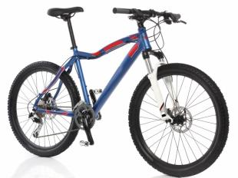
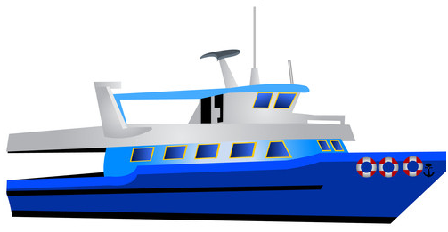
Listen and say

Slide 3
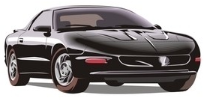
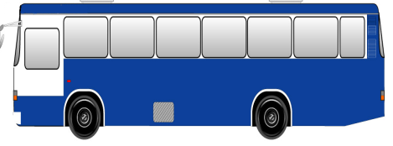
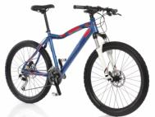
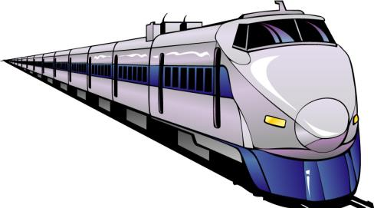
Look and say

Slide 4
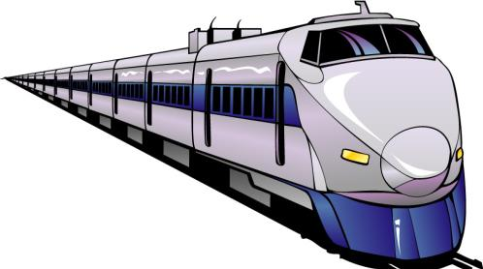
Look and say

Slide 5
Look and read
car
ship
bus
plane
train
bike

Slide 6
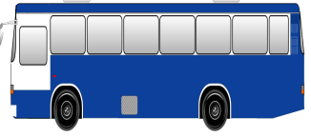
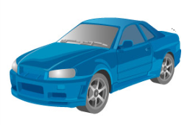
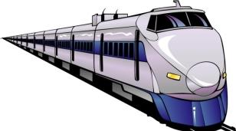
Read and match
bike
bus
train
car
ship
plane

Slide 7
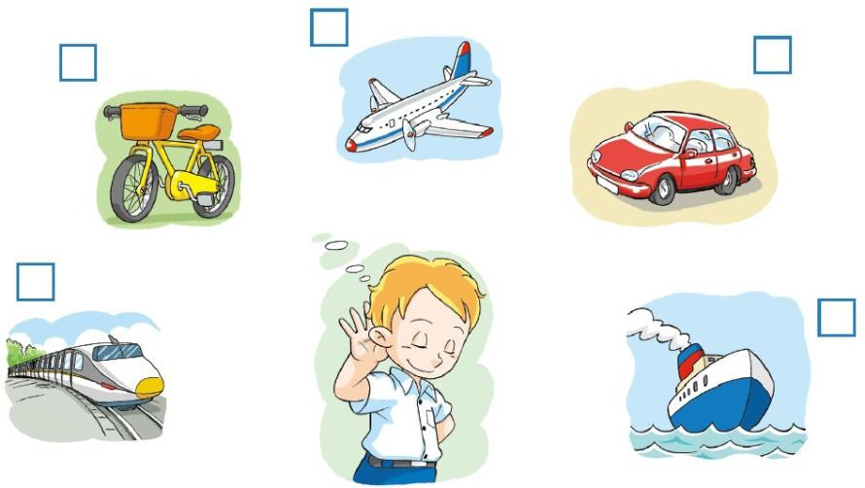

Slide 8
Listen and read
What can you hear?
I can hear a train.
I can hear ...

Slide 9
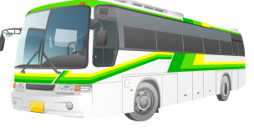
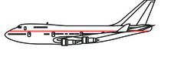
Ask and answer
What can you hear?
I can hear a bus.
I can hear a ship.
I can hear a plane.
I can hear a bike.

Slide 10
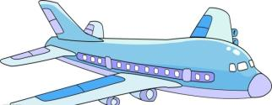
Listen and order

Slide 11
Ask and answer
1
6
4
5
2
7
3

Slide 12
Ask and answer
1
6
4
5
2
7
3

Slide 13
Ask and answer
1
6
4
5
2
7
3

Slide 14
Ask and answer
1
6
4
5
2
7
3

Slide 15
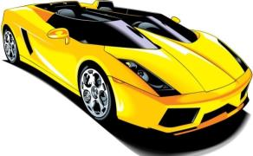
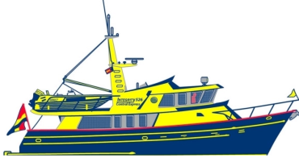
Look and choose
I can see a car.
What can you hear?
I can hear a car.
This is a car.
I can see a ship.
What is this?
What can you see?
What can you hear?

Slide 16
Look and choose
What can you see?
I can see a red train.
This is a red train.
I can hear a train.
I can hear a bike.
What do you hear?
What can you see?
What can you hear?

Slide 17
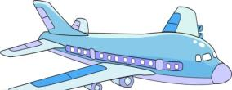
Choose and say
Listen! I can hear a plane.
Look! This is the plane.
It is big.
It is long.
It is blue and white.
I like this plane.

Slide 18
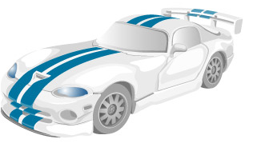
Choose and say
Listen. I can ...
Look. This is the ...
It is ...
...
I like this …

Slide 19
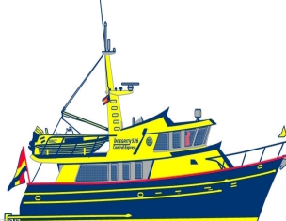
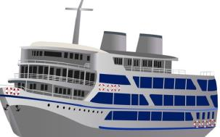
Choose and say
Listen. I can ...
Look. This is the ...
It is ...
...
I like this …

Slide 20
Homework
1 Introduce a vehicle.
2 Copy these words.
bus car ship train plane bike
3 Complete the sentences.
— What can you hear?
— I can hear …

