Slide 1
Unit 2 School life
Reading
WWW.PPT818.COM

Slide 2
Period 2 Reading
课前自主预习
单词闯关 | 1.语言n. ________ 2.在……期间 prep. ________ 3.结束vi. & vt. ________ 4.棒球 n. ________ 5.主动提出，自愿给予vt. ________
language
during
end
baseball
offer

Slide 3
Period 2 Reading
单词闯关 | 6.法语n.________→法国n.________ 7.外国的adj.________→外国人n.________ 8.讨论，议论vt. ________→讨论n.________ 9.赢得；赢，获胜 vt.& vi.________→(过去式)________→获胜者 n．________
French
France
foreign
foreigner
discuss
discussion
win
won
winner

Slide 4
Period 2 Reading
短语互译 | 1.上八年级 ____________________ 2.一周两次 ____________ 3.打棒球 ____________ 4.和某人讨论某事 ________________ 5.好像做某事 ____________ 6.认真地倾听某人的问题 ________________________
in Year 8/in the 8th grade
twice a week
play baseball
discuss sth with sb
seem to do sth
listen carefully to one's problems

Slide 5
Period 2 Reading
短语互译 | 7.bring in ____________ 8.borrow…from… ____________ 9.do sports ____________ 10.a mixed school____________ 11.near the end of… ____________ 12.on Friday afternoon ____________
带进；带来
从……借……
做运动
一所混合型学校
在……快结束时
在周五下午

Slide 6
Period 2 Reading
句型在线 | 1. 在我所有的科目当中，我最喜欢法语。 ________ all my subjects, I like French ________. 2. 学外语是有趣的。 ________ foreign languages ________ fun. 3. 在本周期间，我们可以从学校图书馆借更多的书。 ________the week, we can __________________________ the school library.
Among
best
Learning
is
During
borrow more books from

Slide 7
Period 2 Reading
句型在线 | 4.在这一周接近尾声时，我们在课上和同学们讨论所读的书。 _________________ the week, we ________ the books ________ our classmates in class. 5.当我们阅读有趣的书时，时间似乎过得更快。 Time _____________ faster when we are reading interesting books. 6.他经常认真地倾听我的问题，并给我提供帮助。 He often _______________ my problems and ____________.
Near the end of
discuss
with
seems to go
listens carefully to
offers me help

Slide 8
Period 2 Reading
课文初探 | 判断正(T)误(F)： ( )1.Nancy's school is a mixed school. ( )2.Nancy's favourite subject is Biology. ( )3.John's school has a Reading Week every year. ( )4.John goes to the Buddy Club twice a week. ( )5.John's baseball team won two games last month.
T
F
F
F
T

Slide 9
Period 2 Reading
课堂互动探究
词汇点睛
●1 French n．法语
[观察] Among all my subjects, I like French best.
在我所有的科目当中，我最喜欢法语。
What's this in French？这用法语怎么说？
[探究] French为________名词，意为“法语”；French还
可以作________，意为“法国(人)的；法语的”。
不可数
形容词

Slide 10
Period 2 Reading
[拓展] France为________，意为“法国”。Frenchman为名词，意为“(男)法国人”，其复数形式为_____________；Frenchwoman为名词，意为“(女)法国人”，其复数形式为_____________。
名词
Frenchmen
Frenchwomen

Slide 11
Period 2 Reading
活学活用
1．There are three ________ in our company. One of them is
John and he can speak ________ well.
A．Frenchmen; France B．Frenchmans; French
C．Frenchmen; French D．Frenchmans; France
C
【解析】考查名词辨析。根据句意“我们公司有三个法国人。约翰是他们中的一个，他法语讲得好”可知第一空考查名词的复数，Frenchman的复数为Frenchmen；第二空考查speak French，意为“讲法语”。France为名词，意为“法国”。故选C。

Slide 12
Period 2 Reading
●2 foreign adj.外国的
[观察] Learning foreign languages is fun.学外语是有趣的。
[搭配] foreign languages 外语 foreign countries 外国
[拓展] foreign的名词形式为________，意为“外国人”，其复数形式为________。
Some foreigners will visit the Great Wall tomorrow.
一些外国人明天将参观长城。
foreigner
foreigners

Slide 13
Period 2 Reading
2．(1)Many ________ (外国的) travellers come to visit the Great
Wall every year.
(2)They practise spoken English by talking with ________
(foreign)．
foreign
foreigners

Slide 14
Period 2 Reading
●3 during prep.在……期间
[观察] During the week, we can borrow more books from the school library. 在本周期间，我们可以从学校图书馆借更多的书。
The sun gives us light and heat during the day.
白天太阳给我们光和热。
[探究] during为________，意为“在……期间”。
介词

Slide 15
Period 2 Reading
3．2017·天水—Did you get WeChat Red ________ the Spring
Festival?
—Yes. It's actually the most popular way of sending traditional
holiday presents now.
A．with B．For C．during D．after
C
【解析】考查介词用法。句意：“春节期间你收到微信红包了吗？”“是的。目前传统节日送礼物最流行的方式就是发微信红包了。”with意为“和，附着”；for意为“为了”；during意为“在……期间”；after意为“在……后”。根据语境可知此处指“春节期间”。故选C。

Slide 16
Period 2 Reading
●4 offer vt.主动提出，自愿给予
[观察] He often listens carefully to my problems and offers me help.他经常认真地倾听我的问题，并给我提供帮助。
He offered me a cup of tea. 他主动给我倒了一杯茶。
[探究] offer意为“主动提供，自愿给予”，表示“主动做(某事)”，也可以指主动提出建议、意见等。固定短语offer sb sth＝____________，意为“________________”。
offer sth to sb
给某人提供某物

Slide 17
Period 2 Reading
4．My friend Simon often ________some advice ________ me,
which is really very useful.
A．provides; with B．offers; to
C．offers; for D．provides; to
B
【解析】考查动词短语辨析。句意：我的朋友西蒙经常给我提供一些有用的建议。provide sth for sb＝provide sb with sth，意为“为某人提供某物”；offer sb sth＝offer sth to sb，意为“主动提出给某人某物”。故答案为B。

Slide 18
Period 2 Reading
●5 win vt. & vi.赢得；赢，获胜
[观察] Our team won two games last month.
上个月我们队赢了两场比赛。
I am sure he will win the game.我确信他会赢得这场比赛。
[探究] win既可以作________动词，又可以作________动词，其过去式为________。
及物
不及物
won
[拓展] ________为名词，意为“获胜者”。
winner

Slide 19
Period 2 Reading
5．2017·无锡 The ________(win) of this year's Young Star Award
is…Daniel! Well done！
winner

Slide 20
Period 2 Reading
句型透视
●1 Learning foreign languages is fun.
学外语是有趣的。
[探究] “learning foreign languages”是________短语，在句中作________，谓语动词用________________形式。
动名词
主语
第三人称单数

Slide 21
Period 2 Reading
活学活用
1．2017·兰州________is the best way to keep a good relationship
with your parents, teachers and other people around you.
A．Active communicating B．Actively communicating
C．Actively communication D．Active communicate
B
【解析】考查非谓语动词。根据句意“积极地去交流是与你的父母、老师以及周围其他人保持良好关系的最好方法”可知此题考查动名词短语作主语，修饰动名词应该用副词。故选B。

Slide 22
Period 2 Reading
●2 During the week, we can borrow more books from the school library.
在本周期间，我们可以从学校图书馆借更多的书。
[探究] borrow…from…意为“________________”。
从……借……

Slide 23
Period 2 Reading
[辨析] lend, borrow与keep
词条 | 含义及用法
lend | 意为“借”，指“借出”，为________动词，不能与表示一段时间的状语连用。 常用短语：lend sb sth＝____________。
borrow | 意为“借”，指“借入”，为________动词，不能与表示一段时间的状语连用。 常用短语：borrow sb sth＝borrow sth from sb。
keep | 意为“保存，保留”，是________动词，可以与表示一段时间的状语连用。
短暂性
lend sth to sb
短暂性
延续性

Slide 24
Period 2 Reading
2．(1)I want to ________ a bike from David, but he ________ it to
Daniel yesterday.
A．borrow; lend B．lend; borrow
C．borrow; lent D．lend; borrowed
C
【解析】考查动词辨析。根据句意“我想向戴维借一辆自行车，但是他昨天把自行车借给丹尼尔了”可知第一空考查动词短语borrow sth from sb，意为“从某人那里借某物”；第二空考查动词短语lend sth to sb，意为“将某物借给某人”，根据句中时间状语yesterday可知第二分句应该用一般过去时。lend的过去式为lent。故选C。

Slide 25
Period 2 Reading
(2)2017·天水—How long may I ________ these books?
—For a week.
A．borrow B．to borrow
C．keep D．lend
C
【解析】考查延续性动词的用法。句意：“这些书我可以看多久？”“一周。”borrow意为“借(入)”，是短暂性动词；keep意为“保持，保留”，是延续性动词；lend意为“借(出)”，是短暂性动词。答语“For a week.”属于一段时间，故用延续性动词keep。故选C。

Slide 26
Period 2 Reading
●3 Near the end of the week, we discuss the books with our classmates in class.
在这一周接近尾声时，我们在课上和同学们讨论所读的书。
[探究] near the end of意为“________________”；discuss sth with sb意为“________________”。
在……快结束时
和某人讨论某事

Slide 27
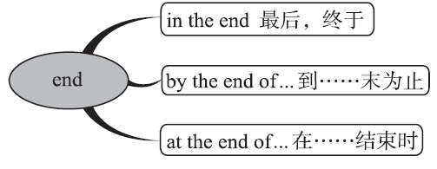
Period 2 Reading
[拓展] end的常用短语：

Slide 28
Period 2 Reading
3. (1)We will have a final exam ________ the term.
A．near the end B．near the end of
C．at the end D．in the end of
B

Slide 29
Period 2 Reading
(2)2017·莱芜 It sounds like a good plan, but you should ________
it with your parents first.
A．keep B．learn
C．discuss D．choose
C
【解析】考查动词的词义辨析。keep意为“保持”；learn意为“学习”；discuss意为“讨论”；choose意为“选择”。根据句意“它听起来像一个好计划，但是你应该首先和你的父母讨论一下”可知，此题考查动词短语discuss sth with sb，意为“和某人讨论某事”。故选C。

Slide 30
Period 2 Reading
●4 Time seems to go faster when we are reading interesting books.当我们阅读有趣的书时，时间似乎过得更快。
[探究] seem 意为“看起来，好像”，常用于下列句型：
(1)主语＋seem(s)/seemed(＋to be)＋____________
(2)主语＋seem(s)/seemed＋____________
(3)It seems/seemed＋____________
名词/形容词
不定式
that从句

Slide 31
Period 2 Reading
4. (1)汤姆看上去是一个诚实的男孩。
Tom _________________________________ boy.
(2)他好像在新学校交了许多朋友。
He __________________ many friends in the new school.
(3)似乎没有人知道发生了什么事。
It _____________________________ what has happened.
(1)seems (to be) an honest
seemed/seems to make
seems that nobody knows

Slide 32
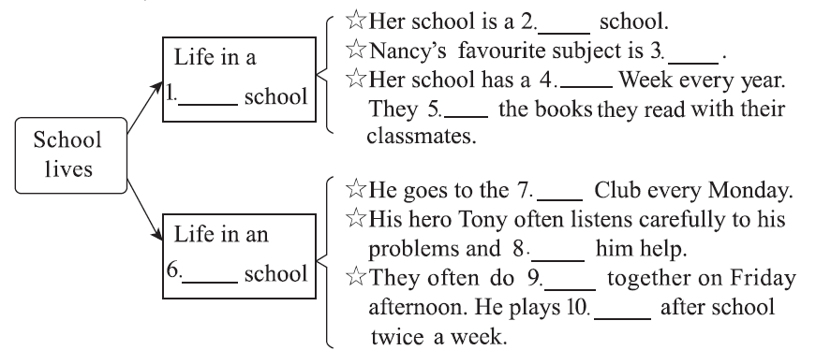
Period 2 Reading
课文回顾
mixed
French
Reading
British
discuss
Buddy
offers
American
sports
baseball

