Slide 1
Unit 3 We should obey the rules.
人教精通版英语五年级下册
WWW.PPT818.COM

Slide 2
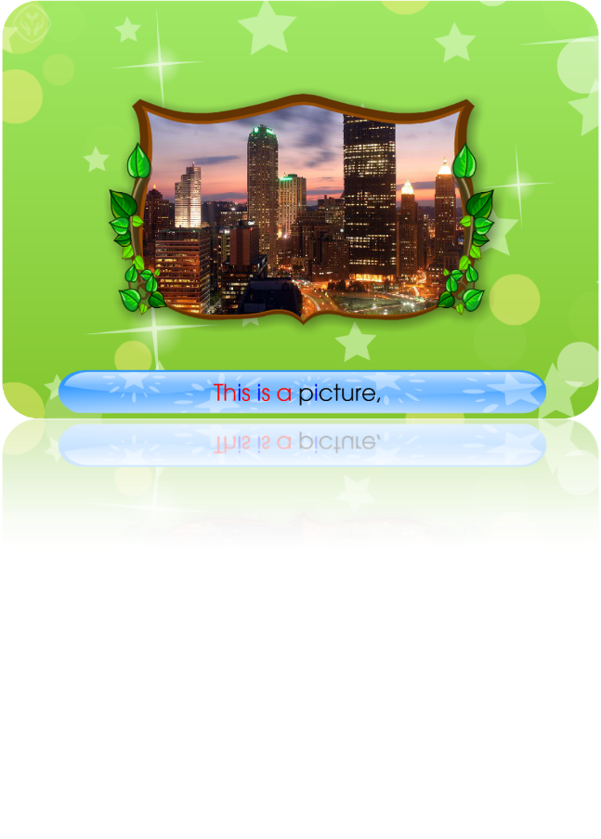
>>Warm-up
Let’s chant

Slide 3
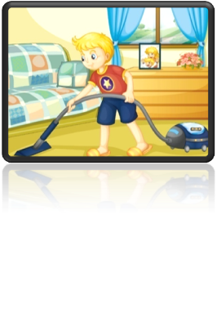
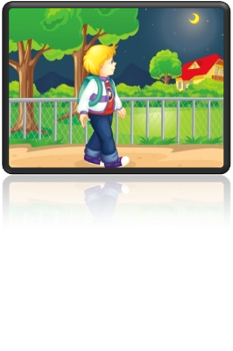
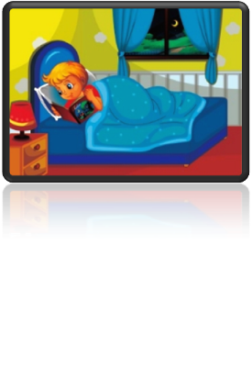
>>Lead-in
Review
You should…/You shouldn’t…

Slide 4
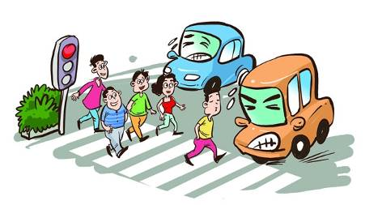
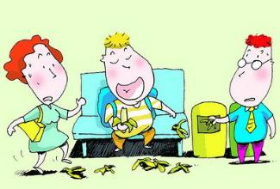
>>Lead-in
What do you think of them?
Do they obey the rules?

Slide 5
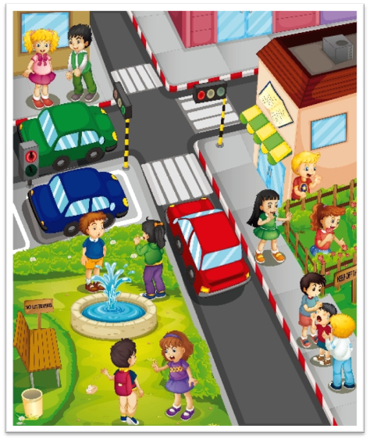
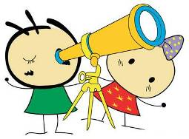
>>Presentation
Look at the picture and discuss.

Slide 6
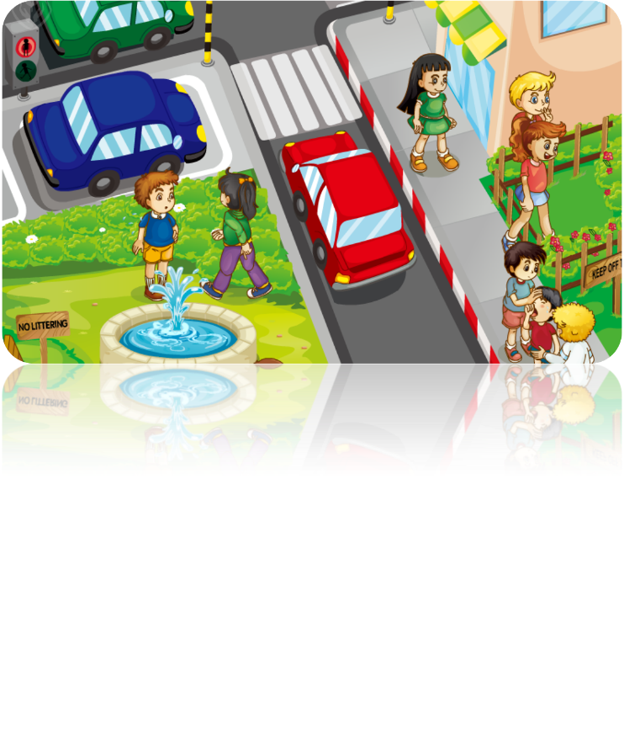
>>Presentation
Just talk

Slide 7
>>Presentation
must
V.原形
mustn’t
must not

Slide 8
>>Presentation
should
shouldn’t
应该
不应该
must
mustn’t
必须
禁止

Slide 9
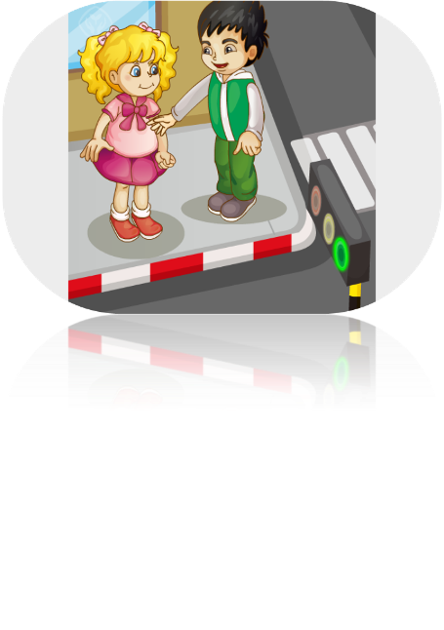
>>Practice
Just talk
You mustn’t ________ the street now.
cross

Slide 10
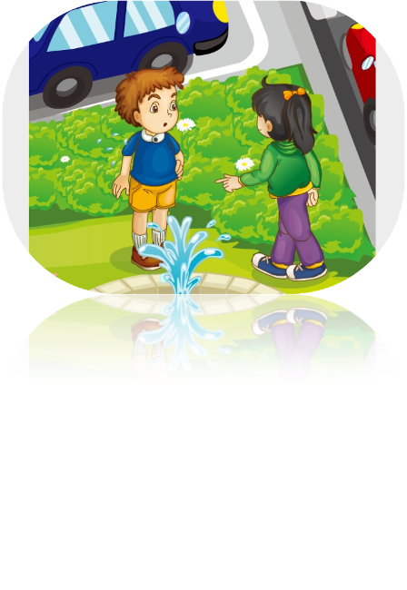
>>Practice
Just talk
You mustn’t ________ on the ground.
spit

Slide 11
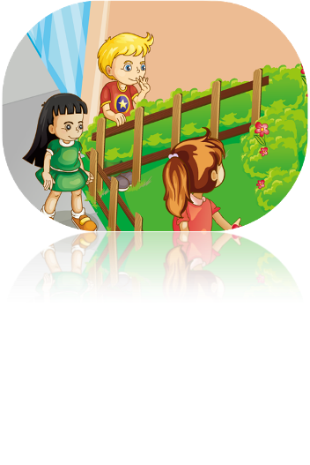
>>Practice
Just talk
You must ____________ the grass.
keep off
You mustn’t ________ the flowers.
pick

Slide 12
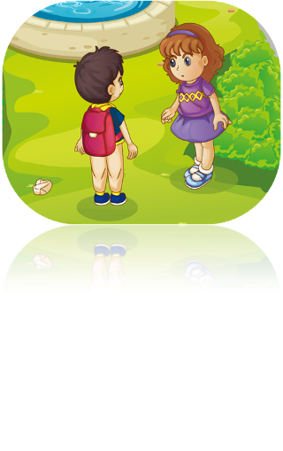
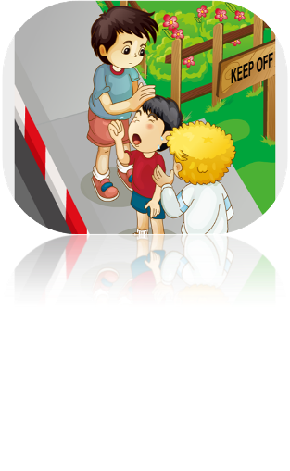
>>Practice
Just talk
You mustn’t _________.
litter
You must _______________ young children.
take good care of

Slide 13
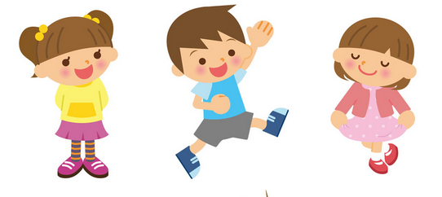
>>Practice
You must keep off the grass.

Slide 14
>>Practice
must
mustn’t
You ________ cross the street now. You ________ wait for the green light.
mustn’t
must
You ________ pick the flowers.
mustn’t
You ________ spit on the ground.
mustn’t
You ________ litter.
mustn’t
You ________ keep off the grass.
must
You ________ take good care of young children.
must

Slide 15
>>Summary
如何表达必须和禁止做某事？
You must/mustn’t…
例如：
You must keep off the grass.
You mustn’t pick the flowers.

Slide 16
>>Homework
1. 观看课文动画，按照正确的语音、语调朗读课文。
2 . 在公共场所必须做和禁止做哪些事情？请列出一个清单。
3 . 预习Lesson18。
close

