Slide 1
Unit 5
At the weekend
WWW.PPT818.COM

Slide 2
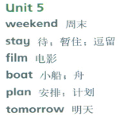
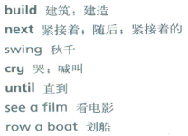
UNIT 5
At the weekend

Slide 3
UNIT 5
At the weekend
What are you going to do this weekend?
这个周末你计划做什么？
be going to的特殊疑问句
What+be+主+going to+其他？
回答：主+be+going to+其他。
PPT模板：www.1ppt.com/moban/ PPT素材：www.1ppt.com/sucai/
PPT背景：www.1ppt.com/beijing/ PPT图表：www.1ppt.com/tubiao/
PPT下载：www.1ppt.com/xiazai/ PPT教程： www.1ppt.com/powerpoint/
资料下载：www.1ppt.com/ziliao/ 范文下载：www.1ppt.com/fanwen/
试卷下载：www.1ppt.com/shiti/ 教案下载：www.1ppt.com/jiaoan/
PPT论坛：www.1ppt.cn PPT课件：www.1ppt.com/kejian/
语文课件：www.1ppt.com/kejian/yuwen/ 数学课件：www.1ppt.com/kejian/shuxue/
英语课件：www.1ppt.com/kejian/yingyu/ 美术课件：www.1ppt.com/kejian/meishu/
科学课件：www.1ppt.com/kejian/kexue/ 物理课件：www.1ppt.com/kejian/wuli/
化学课件：www.1ppt.com/kejian/huaxue/ 生物课件：www.1ppt.com/kejian/shengwu/
地理课件：www.1ppt.com/kejian/dili/ 历史课件：www.1ppt.com/kejian/lishi/

Slide 4
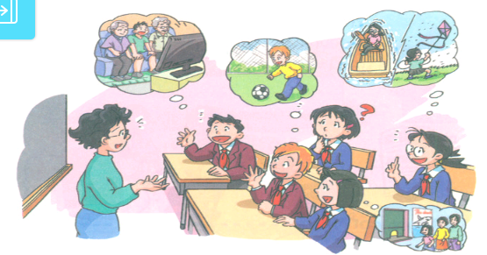
UNIT 5
Listen and say

Slide 5
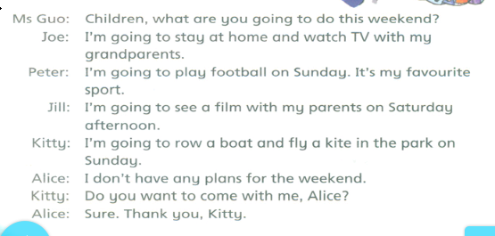
UNIT 5
Listen and say

Slide 6

UNIT 5
Look and learn

Slide 7
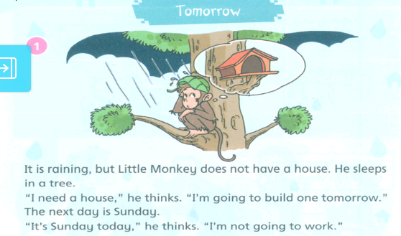
UNIT 5
Read a story

Slide 8
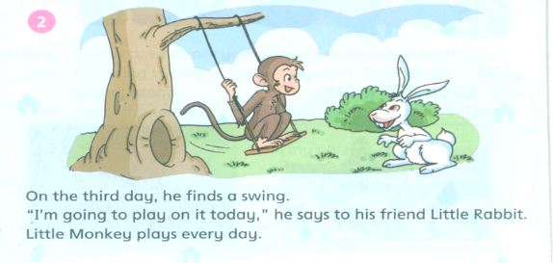
UNIT 5
Read a story

Slide 9
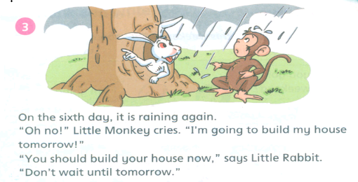
UNIT 5
Read a story

Slide 10
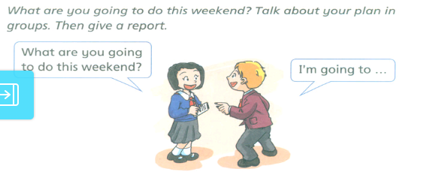
UNIT 5
Do a survey

Slide 11
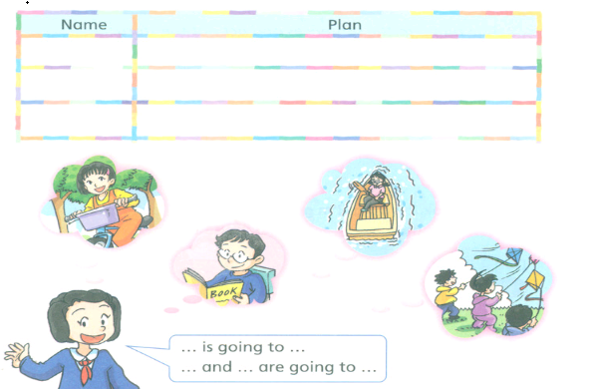
UNIT 5
Do a survey

Slide 12
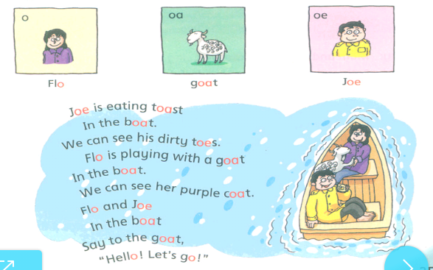
UNIT 5
Learn the sounds

Slide 13
UNIT 5
Learn the sounds
音标学习
o-[əu] oa-[əu] oe-[əu]

Slide 14
THANK
YOU

