Slide 1
Section Ⅰ Listening and Speaking
WWW.PPT818.COM

Slide 2
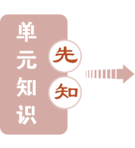
UNIT 4 NATURAL DISASTERS

