Slide 1

Module 5
Look after yourself
Unit 1 We’d better get you
to hospital.
WWW.PPT818.COM

Slide 2

What should you do?
see someone get an electric shock
Use a wooden stick to keep him away from the electricity.

Slide 3
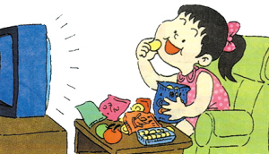
What should you do?
become a couch potato (成天躺着或坐在沙发上看电视的人)
Advise her to eat less and do more exercise.

Slide 4
What should you do if you have an accident?
cut your finger / knee
Cover the wound with a clean cloth.
Try to stop bleeding.
hurt your shoulder
Go to the doctor’s.
break your arm
Don’t move.
Fasten it to a piece of wood.

Slide 5
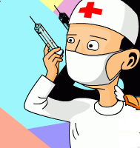
What should you do if you have an accident?
get burnt by hot oil
Wash the wound with running water until the pain stops.
be bitten by a dog
Ask the doctor for help.

Slide 6
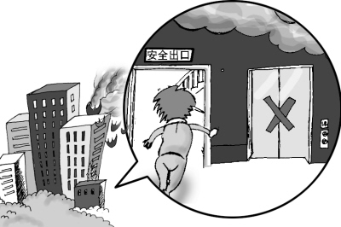
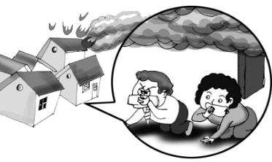
What should you do if you have an accident?
be trapped in a building on fire
Cover the nose and the mouth with a wet handkerchief.
Keep down to the ground.
Don’t use a lift.

Slide 7

1
Look at the picture and answer the questions.
Do you think the person is seriously hurt?
What do you think has happened to him?

Slide 8
Do you think the person is seriously hurt?
What do you think has happened to him?
I think the person is seriously hurt because there is a nurse present./ It looks like a minor graze, so it is not a serious injury.
He fell down and cut his knee.

Slide 9

2
Listen and answer the questions.
1. Has Tony’s dad ever had an accident?
2. How long did it take for the wound to get better after Tony’s dad cut his finger?
Yes, he cut his finger once, and he fell off his bike.
It took a month for the wound to get better.

Slide 10
3. What parts of his body hurt after Tony’s dad fell off his bike?
4. What is Tony reading about for his school trip?
His knee and shoulder hurt after he fell off his bike.
He is reading about personal safety and accidents in the mountains.

Slide 11
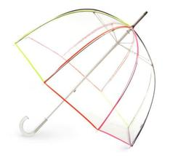
3
Read and answer questions.
1. Where are they?
2. What are they doing?
3. Who has an accident?
They are in the mountains.
They are walking in the mountains.
Daming.

Slide 12
Complete the sentences.
1. Mr. Jackson and Betty have to wait for Tony and Daming because ________________
______________________.
2. As soon as Mr. Jackson decided to look for them, ________________________.
they were walking
more slowly than them
Tony came calling for help

Slide 13
3. The reason why Daming had an accident is
that ______________________________
__________________________________.
4. Daming has got a wound in his leg. However,
Mr. Jackson _______________________.
he fell over when he was running down the steps.
says it is nothing serious

Slide 14
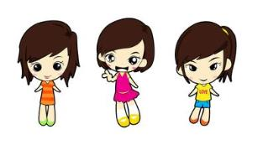
Work in pairs. Try to retell the accident to your partner.

Slide 15
A: Who’s missing today?
B: John. He didn’t feel well and went to
the hospital.
2) A: How do you feel?
B: Cold! I'm very cold!
3) A: I am sorry I can’t go to your birthday
party. My wife has been ill and I’ve got
to take her to the hospital.
B: Very sorry to hear that. I hope it’s
nothing serious.

Slide 16
Pronunciation and speaking
Listen and mark the pauses.
It’s Daming. He’s had an accident. He fell over when he was running down the steps. He’s hit his head and his leg hurts. I think he’s broken his leg.
Now listen and check.

Slide 17
Read aloud. Make sure you pause in the correct places.
Of course you will! It’s nothing serious. Tony, tell everyone we have to call off the walk and go back home.
Now listen and check.

Slide 18
Work in pairs.
Talk about an accident you have had.
where it happened
It happened on my way to school.
what happened
A car stopped in front of me. I fell off my bike.
how you were hurt
I cut my face, and hurt my arms and knees.
how long it took to get better
It was three weeks before I could ride my bike again.

Slide 19
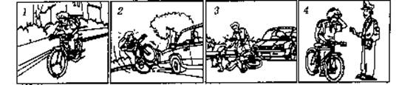
根据以上四幅图和提示词语，写出一篇语法正确、意思连贯、语句通顺、符合逻辑的短文，开头已给出。
要求：1. 叙述要用第三人称。
2. 词数60~80个左右。
3. 要表达自己的看法或想法。
4. 选用下列词语：rush hour, cross, make sure, come over, traffic rules
Last Monday, Tim got up at 7:40 in the morning.

Slide 20
Last Monday, Tim got up at 7:40 in the morning. It was the rush hour. He rode his bike to school very fast. He was crossing the street when a car came at that moment. Tim’s bike hit the car and he fell to the ground heavily. The driver was very kind and stopped to make sure that Tim was all right. Then a policeman came over. He told Tim to ride more slowly next time and it was dangerous. Tim thanked him and went to school. All of us should obey the traffic rules.

Slide 21
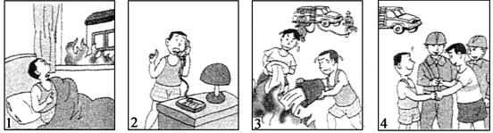
Have a try!
Describe the four pictures and write a short passage about 70 words.

Slide 22
Read and complete the accident report.
Accident report
Where
Who
What happened
How the person was hurt
in the mountains
Daming
He fell over when he was running down the steps.
He hit his head and cut his knee.

Slide 23
Read again and answer the questions.
① Why did Mr. Jackson decide to go and look for Tony and Daming?
② What happened to Daming?
They had an agreement to stick together, and it’s going to rain, so Mr. Jackson decided to go back and look for them.
Daming fell over. He hit his head and hurt his leg.

Slide 24

③ When did the accident happen?
The accident happened about 10 minutes ago./The accident happened when Daming was running down the steps.

Slide 25
Complete the passage with the words
and expressions in the box.
accident agreement blind catch up hurt
We had a(an) _________ to stay together, but Tony and Daming were too slow. We stopped to wait for them to _________. But Daming had a(an) ________ and _________ himself. He was afraid of going _________ because he could not see very well. It was nothing serious, though. However, we had to call off the walk and go home.
agreement
catch up
accident
hurt
blind

Slide 26
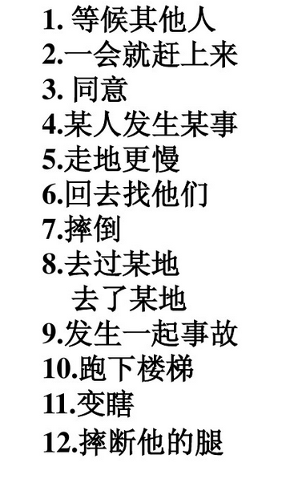
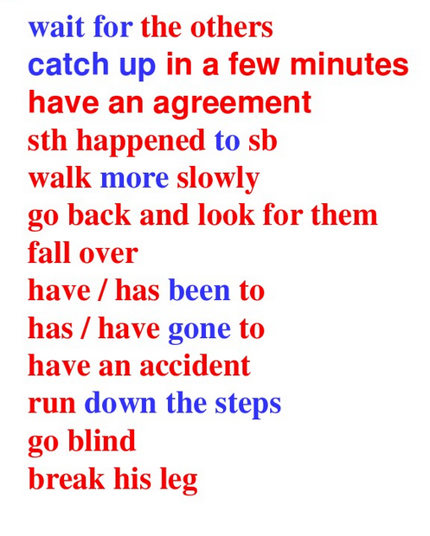

Slide 27
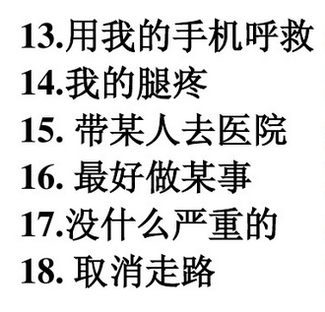
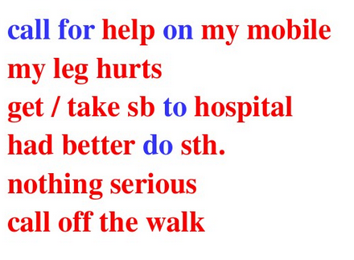

Slide 28
Everyday English
Read and make a dialogue with each one.
Who’s missing?
How do you feel?
It’s nothing serious.

Slide 29
Language points
1. Look after yourself!
look after 照顾，照料
take care of 照顾； 照料

Slide 30
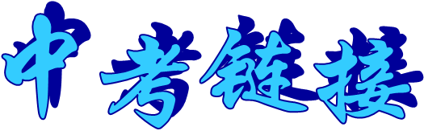

【2012江苏苏州】14. Maggie wanted an evening job that would allow her to ______ her son during the day.
A. look at B. look around
C. look after D. look out

Slide 31
【2012黔西南】20. My sister is ill. I have to _______her at home.
A. look at B. look up
C. look after D. look for

Slide 32
【2013广东】34. Again and again the doctor ______ the crying baby girl, but he couldn’t find out what was wrong with her.
A. looked over B. looked after
C. looked for D. looked out

Slide 33
【2013湖北十堰】30. Here is the book. First _________ it and then tell me what you think of it.
A. look into B. look through
C. look up D. look after

Slide 34

2. They’ll catch up in a few minutes.
catch up 追上，赶上
如果你拉下很多功课，你会很难赶上。
If you miss a lot of lessons, it’s very difficult to catch up.
I’ll help ______ the city parks.
A. catch up B. cheer up C. clean up

Slide 35
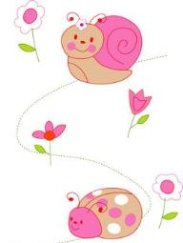
知识链接
catch up with 赶上 / 追上…
keep up with 跟上，不落在……后面
come up with 赶上; 接近，走近想出，提出，提议

Slide 36
【2013黑龙江绥化】— It is too noisy here. I can’t stand it.
— Me, too. We have to________ new ways to solve the problem.
catch up with B. keep up with
C. come up with D. make up with

Slide 37
After discussing, the students ______ some good ideas to work on the project. (2008陕西中考)
A. put up B. set up
C. caught up with D. came up with
In the race Wu Dong ran fastest. No one could _______ him.
A. get on with B. hurry up
C. give up D. catch up with

Slide 38
3. Who’s missing?
谁掉队了？
Miss “错过；遗漏；思念”后跟名词、代词、动名词
他家就在街尾，你会找到的。
His house is at the end of the street. You won’t miss it.

Slide 39
missing “丢失的”
我已经找到丢了的表。
I have found the missing watch.

Slide 40
4. fall over 摔倒;跌倒;倒下
如果他喝酒超过两杯，就会醉倒。
If he drinks more than two glasses of wine he falls over.

Slide 41
5. I’ll call for help on my mobile.
call for 1）去接（某人）；去取（某物）
7点钟我来接你。
I shall be calling for you at seven o'clock.
2）“要求;呼吁 ”
在今天这个日子里，我呼吁大家联合起来。
On this day, I call for a union.

Slide 42
(2009·漳州中考) --- I’m sorry I can’t find the library book.
--- I’m afraid you have to ________ it.
A. send for B. call for
C. pay for D. wait for
【解析】四个选项都含有for，分别意为“派人去请”、“需要；要求；打电话求助”、“为……付款”、“等待”。结合上文I’m sorry I can’t find the library book.可知题意为“我担心你不得不为它赔款”，故排除A、B、D三项，选C。

Slide 43
6. It’s nothing serious.
这里 nothing serious 表示“不很严重， 没什么大事”。如：
他从自行车上摔下来，但是不严重
He came off the bike but 。happened.
nothing serious

Slide 44
I fell like _______ this weekend.
A. doing different something
B. doing something different
C. to do something different
D. to do different something
【解析】feel like doing sth. 是固定用法，意为“想要做某事”，由此可以排除C和 D; 形容词修饰复合不定代词something, anything, nothing等时，通常要放在不定代词的后面，由此可以排除A项。故答案是B。

Slide 45
【2013湖南益阳】29.You have just read the newspaper. Did you find ______ in it?
A. interesting anything
B. anything interesting
C. interesting something.
【解析】考查不定代词的用法。句意：你已经读了这份报纸，你发现有有趣的东西在上面吗？something用于肯定句中，故排除C；形容词修饰不定代词时后置。故选B。

Slide 46
7 . … we have to call off the walk and go back home.
call off 取消；决定终止
由于天气不好，比赛取消了。
The match 。 bad weather.
was called off
because of

Slide 47
知识链接
与call有关的短语还有：
call on 拜访某人；号召
call at 参观某地
call for 喊着叫某人来；邀请，需要
call out 大声呼叫
call in 尤指向工作单位打电话汇报
call sb. in 请某人来帮忙
call up 打电话；召唤

Slide 48
Exercise
Choose the proper phrases in the box.
have been to call for help
catch up with wait for happened to
1. You will have work harder to ____________ the top students in your class.
2. I hear you ________________ Africa as a volunteer.
catch up with
have been to

Slide 49
3. The children can’t ___________ the coming New Year.
4. The young man had to _____________ at once on his mobile phone.
5. The girl is missing. What’s _____________ her?
wait for
call for help
happened to

Slide 50
Fill in the blanks with the right form of the verbs given.
1. An old woman asked him what was _________ (miss).
2. Suddenly, a car stopped in front of him and he __________ (fall) off his bike.
3. It’s getting late. You’d better ________ (take) a taxi to the airport.
missing
fell
take

Slide 51
Translate these sentences.
1. 如果你落下许多课, 就很难追上。
If you _____________ lessons, _____________
___________________.
跑快点, 否则你追不上他。
______________________________________
2.别担心, 没什么大事。
______________________________________
miss lots of
it’s very
difficult to catch up
Run fast, or you can’t catch up with him.
Don’t worry! Nothing serious.

Slide 52
3. 她出差时我将照看她的孩子。
I will ___________ her child when she is on a business trip.
look after
4. 他坐下来要了一些啤酒。
He sat down and __________ some beer.
假如碰到问题，请给我打电话。
Please ______ me if you have problems.
called for
call

