Slide 1
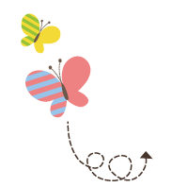
1111111111111111111111111111111111111111111111111111111111111111
Unit 3 Winter in Canada
六年级上册
Lesson 18 The Snowman
WWW.PPT818.COM

Slide 2
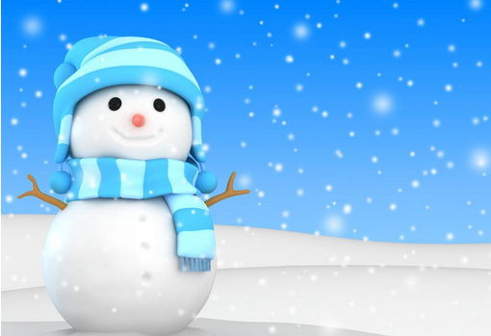

Slide 3
Story Time
One day, John said to his mother, “I am going to play in the snow.”
“Okay,” said his mother. “ Put on your coat.” John put on his coat. “Don’t forget your hat!” said his mother. John put on his hat.
He played in the snow. He made a big snowman.
He said, “ Poor snowman! It’s cold! Put on a hat!” He took off his hat and put it on the snowman.
The snowman opened his eyes! “Hello,” he said. “How are you?”

Slide 4
Story Time
“Yikes!” said John. He took his hat off the snowman. The snowman was a snowman again. He put his hat on the snowman.
“Hello,” said the snowman. “ How are you?”
“You can talk!” said John. “What’ s your name?”
“I don’t think I have a name,” said the snowman. “What a cold, snowy day! Wonderful! What do you want to do?”
“Can you skate?” asked John.
“Skate? I don’t know,” said the snowman.
“Do you want to learn? I can teach you,” said John. “ Let’ s go!”
But the snowman couldn’t go. He had no feet. John said, “Don’t

Slide 5
Story Time
worry! I can help you.” John put his skates under the snowman.
“Can you skate now?” asked John.
Whoosh! The snowman could skate! He could skate very fast!
“This is easy! This is fun!” he said. “Can we always skate?” the snowman asked.
“No. Spring is coming. Then comes summer and autumn,” said John.
“Why can’t we skate in spring, summer and autumn?” asked the snowman.
“Because it is too warm. There is rain. there is wind, but there is

Slide 6
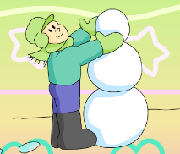
Story Time
no snow and no ice,” said John.
“And no snowmen,” said the snowman sadly.
“No,” said John. “But don’t worry. I can help you.”
At dinner time, John’ s mother opened the fridge.
Hello. Nice to meet you!
Read and talk
·What can the snowman do?
·Why is the snowman sad?
·What did John do for the snowman?

Slide 7
讲解
知识点 1
forget / fəɡet/ v. 忘记
I forgot to close the door. 我忘记关门了。
forgot
remember 记得
例句：
for（为了）+ get（得到）= forget
加法记忆法：
过去式：
对应词：

Slide 8
讲解
知识点 2
easy / iːzi/ adj. 容易的【三会】
This is easy. 这很容易。
字母组合 ea 的发音是 /iː/。
hard（adj.）困苦的；艰难的
difficult（adj.）困难的
easy meat 轻而易举的事
east 东方
例句：
发音：
反义词：
短语：
形近词：

Slide 9
讲解
知识点 3
wind /wɪnd/ n. 风【三会】
There is wind in summer. 夏天有风。
windy（adj.）有风的
kind 友好的 wine 葡萄酒
例句：
win（赢）+ d = wind（风）
加法记忆法：
词形变化：
形近词：

Slide 10
讲解
知识点 4
sadly / sædli/ adv. 悲伤地
The snowman said sadly. 雪人悲伤地说。
sad（adj.）悲伤的
例句：
词形变化：

Slide 11
习题
一、选出下列单词中不同类的一项。
（ ）A. door B. forget C. get
二、根据图片和句意写出所缺单词，补全句子。
The girl is very______ . Because she can’t find her dog.
A
B项与C项均为动词，A项为名词。故选A。
点拨：
sad

Slide 12
习题
三、单项选择。
（1）This is an ______ question.
A. hard B. easy C. funny
B
根据句中的不定冠词an可知选B。easy是以元音音素开头的单词，与an连用。句意为“这是一个简单的问题。”
点拨：

Slide 13
习题
（2）There is _____ in autumn. It’s cool.
A. windy B. wind C. cloudy
B
there be 句型表示“某地有某物”，某物要用名词来表达，A项和C项都是形容词，wind是名词，故选B。
点拨：

Slide 14
这是一个非常有趣的故事。故事中男孩的名字叫作约翰，他堆了一个雪人。雪人戴上他的帽子后就可以说话了，还可以和约翰一起滑冰。他们玩得很开心。因为约翰怕春天来了之后，雪人消失，他把雪人放进了冰箱里。

Slide 15
Thank you!

