Slide 1
Unit6 I like hamburgers.
人教精通版三年级上册
WWW.PPT818.COM

Slide 2
Review
Look and say
Game
What’s missing?

Slide 3
Review
Look and say
Sure! Here you are.
Can I have an apple, please?
Thank you!

Slide 4
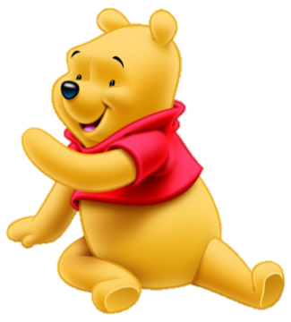
Review
Look and say
Sure! Here you are.
Can I have some milk, please?
Thank you!

Slide 5
Presentation
Just learn
rice

Slide 6
Presentation
Just learn
noodles

Slide 7
Presentation
Just learn
chicken

Slide 8
Practice
Game 1
大小声
rice
noodles
chicken

Slide 9
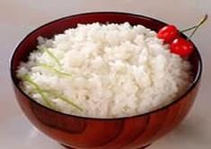
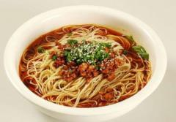
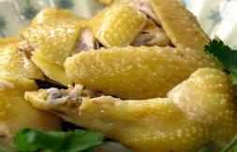
Practice
Game 2
Choose and say
1
2
3

Slide 10
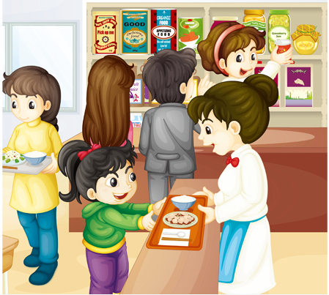
Presentation
Look and say
What are they talking about?

Slide 11
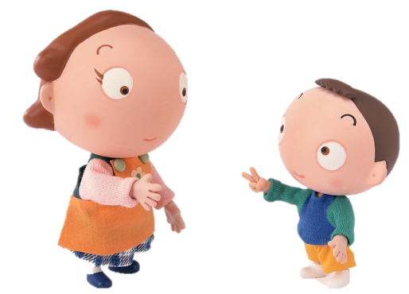
Presentation
Key points
Can I help you?
A cup of water, please.
Here you are.
Thank you!

Slide 12
Presentation
Key points
Can I help you?
Some bananas, please.
Here you are.
Thank you!

Slide 13
Presentation
Listen and imitate
Can I help you?
Some rice, please.
Here you are.
Thank you!

Slide 14
Practice
Let’s read
1
2
3
Read together.
(齐读)
Read in roles.
（分角色读）
Read in groups.
(分组读）

Slide 15
Show time
两人一组试着练习对话并表演，其他同学评价。
 | 模仿录音中的语音语调，有感情地朗读。
 | 可以脱离课本，适当改动其中部分，语音地道。
 | 适当添加内容，意思完整，有创新，表演生动。
Good
Great
Excellent

Slide 16
Practice
Let’s play

Slide 17
Practice
Let’s say
Some noodles, please?
Here you are.
Thank you.
You’re welcome.

Slide 18
Summary
本课学习的食物类单词有:
rice
noodles
chicken

Slide 19
Homework
1.观看或跟读Just talk部分的课文动画或录音，并注意语音、语调。
2.在四线三格中正确抄写本课单词，要求五遍英语一遍汉语。
3.预习Lesson36。
Close

