Slide 1
人教精通版四年级上册
This is my new friend
WWW.PPT818.COM

Slide 2
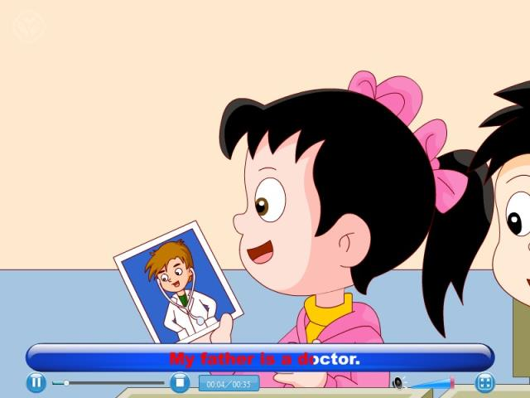
Let’s chant

Slide 3
Today, I will show you a picture of a lady. If you want to know something about her, please ask questions quickly.

Slide 4
大家听一听她是怎么介绍自己的吧！
I’m Yang Ming’s mother. I’m from Beijing, China. I’m a TV reporter.

Slide 5
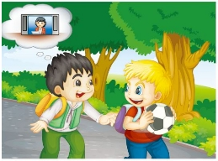
It’s Sunday. Yang Ming and Peter are going to play football together. On the way, Yang Ming tells Peter his mother is a TV reporter.

Slide 6
Peter asks Yang Ming’s father’s job.

Slide 7
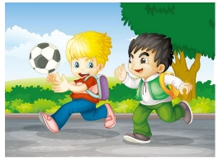
Yang Ming asks Peter to guess. Peter guesses, “Is he a teacher? Is he a doctor?”

Slide 8
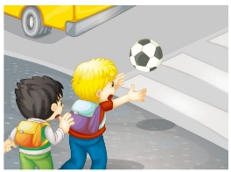
Look at their football.

Slide 9
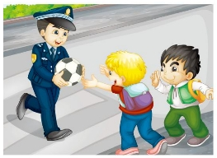
At that time, a policeman comes on and gives the football to them.

Slide 10
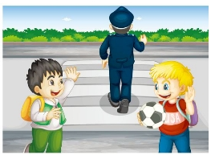
Who’s the policeman?

Slide 11
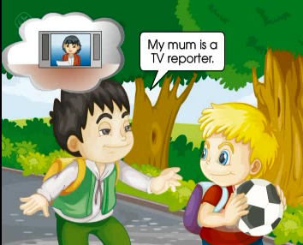
观看动画，回答：Who’s the policeman?

Slide 12
Practice
先跟读课文，模仿录音，再分角色表演Fun story，看谁表演的生动形象!

Slide 13
Practice
快速反应
学生分为男女两队，看图片单词，快速说出单词的一方得分。

Slide 14
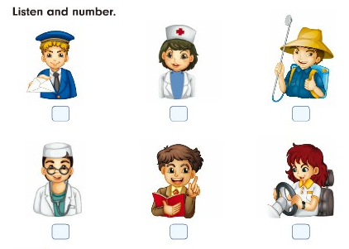
5
4
1
6
3
2

Slide 15
Language use
假设这是一个交流家庭成员信息的会议，大家拿出准备好的家庭图片，谈论家人信息。
例如：
Hello, my name is…I’m from… Look at this photo. This is my father. He’s a… He likes… Look at this woman. She’s my mother. She likes… I have a happy family.

