Slide 1
陕旅版英语六年级上册
Unit8 New Year’s Party
第3课时
WWW.PPT818.COM

Slide 2
教学目标：
1. 能听懂、理解Let’s learn more部分的短文，并能模仿录音中的语音语调流利地朗读课文。
2. 能在实际生活中准确运用一般过去时态描述并谈论有关新年聚会的相关内容；并能根据所学词汇进行替换练习，做到活学活用。
3. 培养学生英语阅读的正确方法和习惯，鼓励小组间的合作学习。

Slide 3
Let’s sing

Slide 4
Play a game
Verbs group
Past tense
verbs group
每组选出一名代表抽取词卡并认读单词
PK

Slide 5
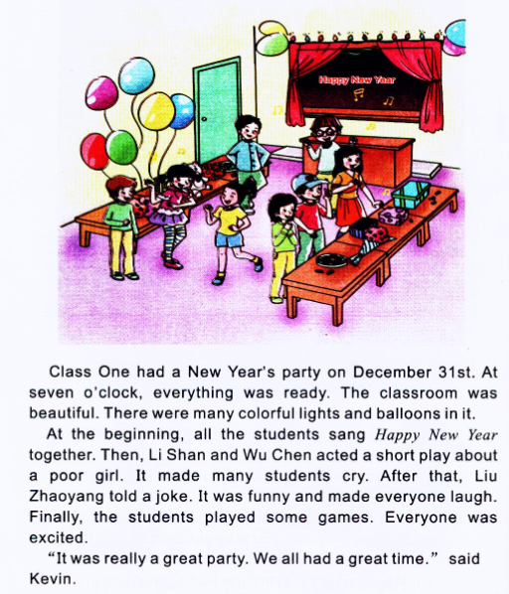
Let’s learn more
Q1: What did Class One do?
Q2: What can you see in the classroom?

Slide 6
Practice—句子接龙
At the beginning,…
Then,…
After that,…

Slide 7
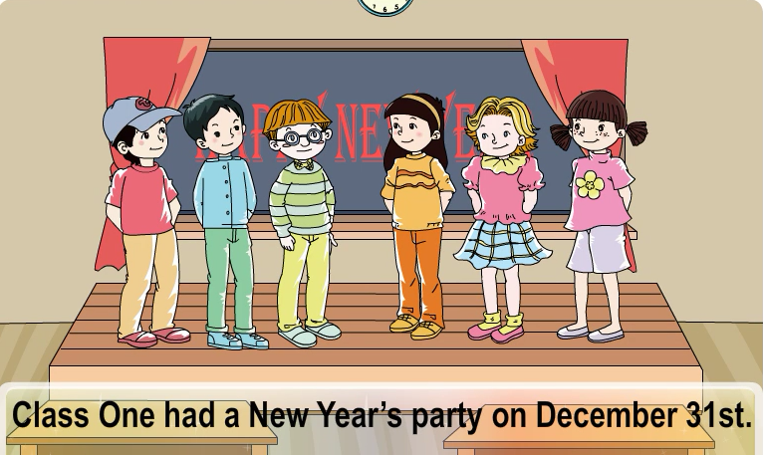
观看课文动画并大声跟读

Slide 9
Yes or No?
( ) Class Three had a New Year's party.
( ) They had the party on October 31 st.
( ) Everything wasn’t ready at seven o’clock.
( ) There were many gifts and colorful lights in the classroom.
( ) Li Shan and Wu Chen acted a short play at the beginning.
( ) Liu Zhaoyang’s joke made everyone laugh.
( ) The students sang Happy New Year finally.
( ) The games made everyone excited.
( ) The party was great.

Slide 10
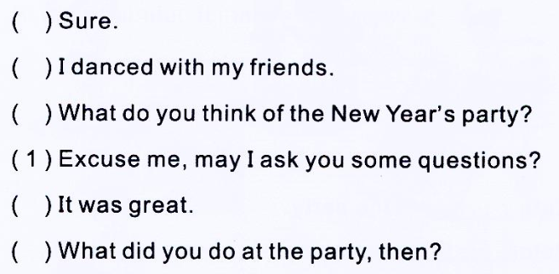
Part C Order and act
2
6
3
4
5

