Slide 1
初中英语外研版八年级下
Module1 Feelings and impressions
Unit1 It smells delicious
WWW.PPT818.COM

Slide 2
内容结构
Warm-up
1
Presentation
2
Language Points
3
Exercise
4

Slide 3
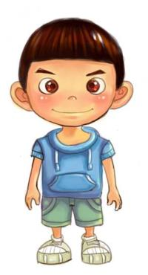
Warm-up
Look and say
 | 视觉 | Eye
 | 嗅觉 | Nose
 | 听觉 | Ear
 | 味觉 | Mouth
 | 触觉 | Hand
look
smell
sound
taste
feel

Slide 4
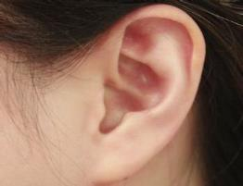
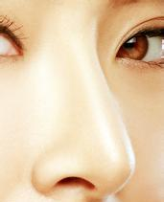
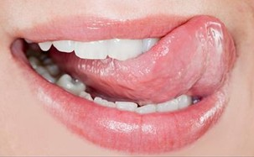
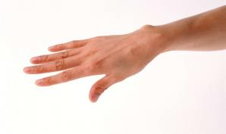
We use our eyes / noses / hands / mouths /
ears to …
Discussion:
look
sound
smell
taste
feel

Slide 5
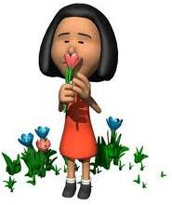
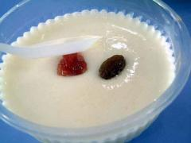
Presentation
Learn some new words
smell v. 闻起来
这花闻起来很香。
The flower smells sweet.
cheese n. 奶酪
fresh adj. 新鲜的
这奶酪闻起来很新鲜。
The cheese smells fresh．

Slide 6
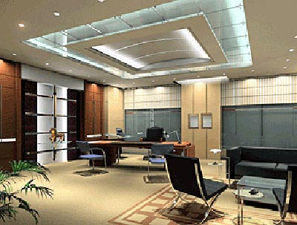
sound v.听起来
办公室听起来很安静。
The office sounds quiet.

Slide 7
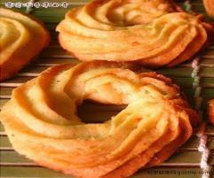
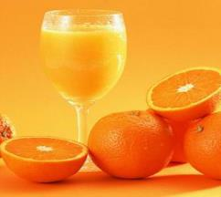
cookie n. 小甜饼
taste v. 尝起来
这小甜饼尝起来很美味。
The cookies taste delicious.
sour adj. 酸的
这橙汁尝起来很酸。
The orange juice tastes sour.

Slide 8
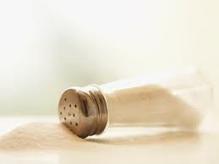
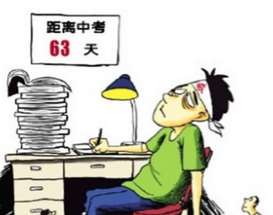
salt n. 食盐
这盐尝起来很咸。
The salt tastes salty.
nervous adj. 紧张的
考试让我很紧张。
The exam makes me nervous.

Slide 9
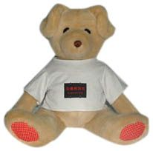
soft adj. 软的
这玩具摸起来很软。
The toy feels soft.

Slide 10
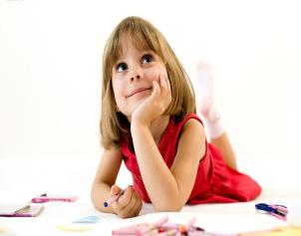
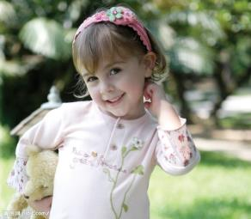
pretty adj.可爱的
这小女孩看起来很漂亮。
The little girl looks pretty.
同义词
lovely adj. 可爱的
这女孩看起来很可爱。
The girl looks lovely.

Slide 11
感官动词
quiet 安静的
salty 咸的
sour 酸的
fresh 新鲜的
pretty 漂亮的
lovely 可爱的
soft 柔软的
smell (smelled, smelt;
smelled, smelt)
闻，嗅；闻起来
feel (felt, felt)
摸起来；感觉
taste 尝起来
look 看起来
sound 听起来
+ adj.
The cheese smells fresh.

Slide 12
1
Listen and number the pictures.
2
1
3
4

Slide 13
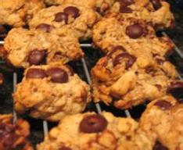
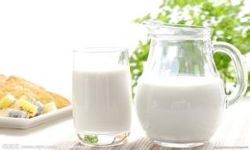
2
Listen again and complete the sentences.
1. The cookie tastes sweet.
2. The milk ________________.
3. This bed _________________.
4. Tom ____________________.
smells sour
feels a bit soft
looks very strong

Slide 14
3
Listen and read.
Tony: Mm... What a delicious smell! Your
pizza looks so nice.
Betty: Thanks! Would you like to try some?
Tony: Yes, please. It looks lovely, it smells
delicious, and mm, it tastes good.
Daming: What’s that on top?
Betty: Oh, that’s cheese. Do you want to try
a piece?

Slide 15
Darning: Ugh! No, thanks. I’m afraid I don’t
like cheese. It doesn’t smell fresh. It
smells too strong and it tastes a bit sour.
Betty: Well, my chocolate cookies are done
now. Have a try!
Darning: Thanks! They taste really sweet and
they feel soft in the middle.
Tony: Are you cooking lots of different
things? You look very busy!

Slide 16
Betty: Yes, I am! There’s some pizza and
some cookies, and now I’m making
an apple pie and a cake.
Darning: Apple pie sounds nice. I have a sweet
tooth, you know. Shall I get the sugar?
Betty: Yes, please. Oh, are you sure that’s
sugar? Taste it first. It might be salt!

Slide 17
Darning: No, it’s OK. It tastes sweet. It’s sugar.
Tony: What’s this? It tastes sweet too.
Betty: That’s strawberry jam, for the cake.
Darning: Good, everything tastes so sweet!
It’s my lucky day!

Slide 18
Now check (√) what Betty is making.
√
√
√
√

Slide 19
4
Complete the sentences with the words in the box.
lovely soft sour strong sugar sweet
1. I bought a large chocolate cake, because I
love _______ food.
2. Dried fish has a ________ taste. You don’t
need much of it in the dish.
sweet
strong

Slide 20
3. She does not put ________ in tea because
she does not like sweet tea.
4. The milk has gone _________ overnight, so
we cannot drink it.
5. The bed feels ________ and comfortable.
6. Apple pie sounds _________. It is my
favourite.
sugar
sour
soft
lovely

Slide 21
5
Complete the table with the words in the boxes in Activities 1 and 4.
Ear | sound | quiet…
Eye
Hand
Mouth
Nose
look
lovely; strong; soft
feel
lovely; soft; strong
taste
sour; strong; sweet; lovely
smell
sour; strong; sweet; lovely

Slide 22
Pronunciation and speaking
6
Listen and underline the words the speaker stresses.
1. It smells too strong and it tastes a bit sour.
2. They taste really sweet and they feel soft in
the middle.

Slide 23
Free talk
You and your friends are at a party. There is a lot to see, to eat and to drink. And there is also beautiful music. Talk about your feelings and impressions about it. Make a dialogues with your friends.
Let’s make dialogues like this:

Slide 24
A: Do you like …?
B: Yes, I do. / No, I don’t. It looks /
tastes / smells / feels / sounds …
They look / taste / smell / feel / sound …
Do you like …?
A: …
Key words:
classical music; flowers;
ice cream; sea;
your bed; jeans;
roast duck; jazz;

Slide 25
Language points
Well, my chocolate cookies are done now.
句中的be done表示“做好了，完成了”。
例如：
I am nearly done. 我差不多做完了。
Are you done with that pen? 那支笔你用完了吗？
The beds are done. 床铺都整理好了。

Slide 26
2. Shall I get the sugar?
当说话人主动提出要做某事，尤其是主动提出帮助时，我们常用Shall I …?
例如：
Shall I get some water for you?
我去给你弄点儿水喝吧？
我们还可以用Shall we…?来提出建议。例如：
Shall we buy Betty a cake?
我们给贝蒂买个蛋糕吧？

Slide 27
3. …are you sure that’s sugar?
……你确信那是糖吗？
be sure后面接句子，表示“确信，相信”。例如：
I’m sure tomorrow is Betty’s birthday. 我确定明天是贝蒂的生日。
I’m sure we will find each other.
我相信我们能找到对方。

Slide 28
Exercise
一、用 feel; look; smell; sound; taste 填空：
1. The milk ________ strong.
2. My sweater ________ soft.
3. The room ________ quiet.
4. These flowers ________ beautiful!
5. This pizza _______ delicious.
smells
feels
sound
look
tastes

Slide 29
二、根据首字母填空。
1. The food will taste too salty if there is too much s_______ in it.
2. When we talk, we should think of other’s f_________.
3. Many people spend their holiday in the countryside. The enjoy the f______ air there.
4. I want some more cookie. It t_______ really good.
salt
feelings
fresh
tastes

Slide 30
三、完成句子。
1. 丝绸摸起来很柔软。
Silk ___________________.
2. 洋葱不好吃，气味太浓了。
The onion doesn’t taste good, it ______________.
3. 汤姆看起来不开心。
Tom _____________________.
4. 别不好意思，试一试。
Don’t be shy, just _______________.
feels very soft
smells too strong
looks very unhappy
have a try

Slide 31
Homework:
Try to use “taste, feel, look, smell, sound” to make sentences.

