Slide 1
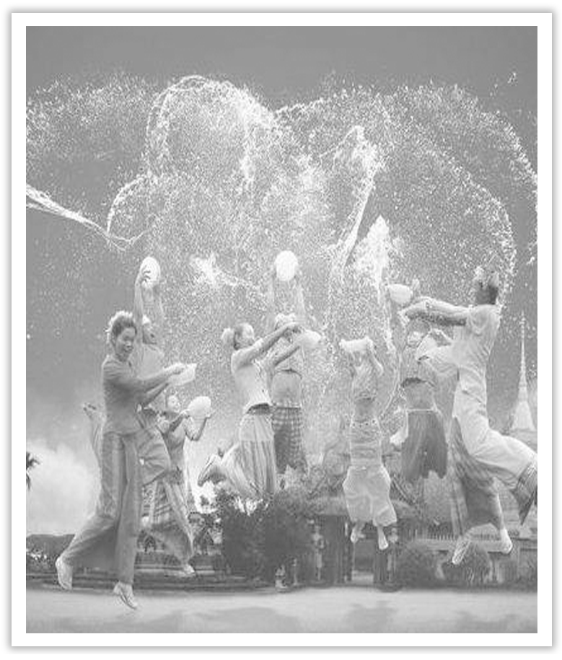
Unit 3 Diverse Cultures
Section Ⅰ Listening and Speaking
WWW.PPT818.COM

Slide 2
主题语境——人与社会之文化习俗
【语境概说】 本单元的主题语境为人与社会中的文化习俗，该主题语境主要包括与文化习俗相关的跨文化沟通、跨文化包容 、跨文化合作、文化遗产等。该主题与学生生活密切相关，在此主题意义的引领下，有助于整合多元文化方面的学习内容，促进学生语言能力、文化意识、思维品质和学习能力的整合发展。

Slide 4
The value of culture is its effect on character.Its use is for life.Its aim is not beauty but goodness.文化的价值在于它对人类品性的影响。文化的作用在于裨益人生，它的目标不是美，而是善。
Knowledge about diverse cultures opens up people’s mind and enables them to perceive things from different angles.对于不同文化的了解，使人们的胸襟更加开阔，并从不同的角度去理解事物。

Slide 5
1.Translate the following words and phrases.
①diverse adj. ____________________
②diversity n. __________________
③fortune n. ____________
④fortune cookie ____________
不同的；多种多样的
差异(性)；不同(点)
机会；运气
幸运曲奇

Slide 6
⑤gumbo n. ____________
⑥nachos n. _____________________
⑦cheese n. ____________
⑧spicy adj. ____________________
⑨chip n. ______________________________________
⑩ethnic adj. _____________________________________________
秋葵汤
墨西哥辣味乳酪玉米片
干酪；奶酪
加有香料的；辛辣的
(英)炸土豆条；(美)炸薯片；芯片；碎片
具有民族特色的；异国风味的；民族的；种族的

Slide 7
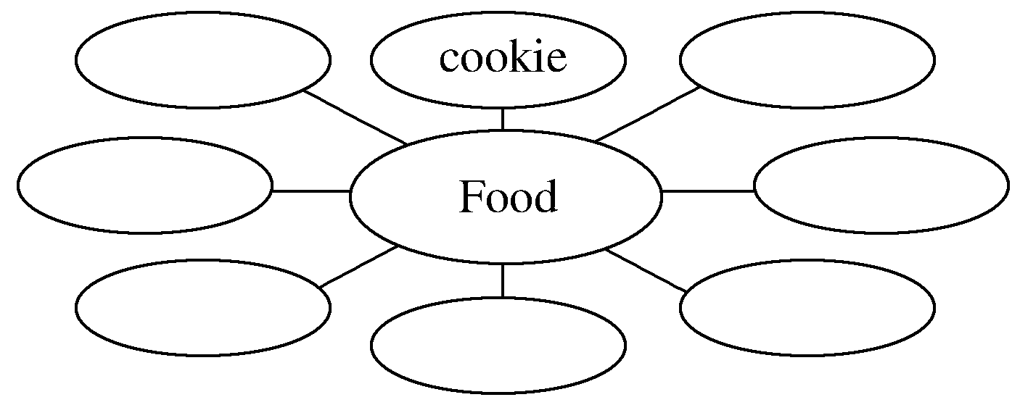
2.Brainstorming：What kind of food do you like?
beef，steak，roast，pork，ham，bacon，sausage，chicken，fish，vegetables，chips，noodles，milk，cheese，bread，egg
________________________________________________________________________
________________________________________________________________________

Slide 8
3.Look at the picture on Page 26 and tell your classmates what kind of food each of them is.
_____________________________________________________________________
4.Finish Ex.1 on Page 26.
nachos，fortune cookie，gumbo，hamburger

Slide 9
5.Try to translate the sentence in various ways.
我订的饭菜怎么样？
①______________________________________________________
②______________________________________________________
③______________________________________________________
④______________________________________________________
⑤______________________________________________________
⑥______________________________________________________
How about the food I ordered?
What about the food I ordered?
What do you think of the food I ordered?
What do you think about the food I ordered?
How do you like the food I ordered?
How do you find the food I ordered?

Slide 10
1.Finish Ex.2 on Page 26.
2.Finish Ex.3 on Page 26.
3.Finish Ex.4 on Page 27.

Slide 11
1.Speaking—Finish Ex.5 on Page 27 by following the example.
A：I have heard that you are invited to a potluck dinner at an American friend’s house.What special dish will you take?
B：Fortune cookie.
A：How is the food special?
B：It is a biscuit containing a message，usually about the future.
A：Sounds very interesting.

Slide 12
2.Pronunciation
The pauses in the sentences.
(1)Miss Jennifer Honey︱was a mild and quiet person︱who never raised her voice︱and was seldom seen to smile，︱but there is no doubt︱she possessed that rare gift︱for being adored︱by every small child︱under her care.
(2)Before 1949，︱I used to live in Shanghai︱with my mom.

Slide 13
语言知识积累
询问信息的常用表达
1.What food would you like，Chinese food or Western food?
想吃点什么？中餐还是西餐？
2.What snack do you like best?
你最喜欢什么点心？
3.What kind of Chinese snack do you like?
你喜欢哪种中国快餐/点心？

Slide 14
4.How about the food and service here?
您觉得这里的食品和服务怎么样？
5.How is the food prepared and what is it made of?
这种食物是怎么做的，是用什么做的？
6.How is this food special?
这种食物有什么特别之处吗？

Slide 15
文化知识习得
中西方饮食文化差异有哪些？
中国的传统饮食特点：
1.重食：古人就有“民以食为天”之说。见面常问“吃了没有”，可见饮食文化的地位。
2.重养：以“五谷”养“六脏”，饮食中重视人体养生保健。
3.重味：中国的饮食最注重食物的味，讲究“色、香、味、型”。

Slide 16
4.重理：中国的饮食提倡健康优美、奋发向上的文化情调，追求一种高尚的情操。
西式餐饮的主要特点是：
一是生，如牛排带血丝。
二是冷，如凡是饮料都加冰块。
三是甜，无甜不餐，无餐不甜。

Slide 17
学习策略形成
1.学会用不同句式表达询问信息。
2.学会英语朗读中的停顿现象，并能灵活掌握。
句子中意群的停顿
意群就是指句子中按意思或语法结构划分出的各个成分，每一个成分即称为一个意群。同一意群中的词与词的关系紧密相关，密不可分，否则就会引起误解。每一个意群内部不停顿；但是意群和意群之间则需要停顿。

Slide 18
fortune n.机会；运气 fortunate adj.幸运的；侥幸的(＝lucky) fortunately adv.幸运地(＝luckily)
fortune cookie (教材P₂₆)幸运曲奇
[合作探究] 体会fortune的用法和意义
①They envy his good fortune.
他们羡慕他的____________。
②People who love laugh will not have bad fortune.
爱笑的人不会有____________。
好运气
坏运气

Slide 19
③I have the good fortune to have a good friend like you.
我很幸运能有你这样一位好朋友。
[自主发现]
④____________ fortune 好运气
⑤____________ fortune 坏运气
⑥have the good fortune ____________... 有幸做某事
good
bad
to do

Slide 20
[词块积累]
seek one’s fortune 找出路；碰运气
make a fortune 发财
try one’s fortune 碰运气
by good fortune 幸好；由于幸运
[巩固内化] 单句语法填空
①She was ____________(fortune) enough to find a job as soon as she graduated from the university.
②I have the good fortune ____________(work) in our department office.
fortunate
to work

