Slide 1
Unit 3 What subject do you like best?
WWW.PPT818.COM

Slide 2
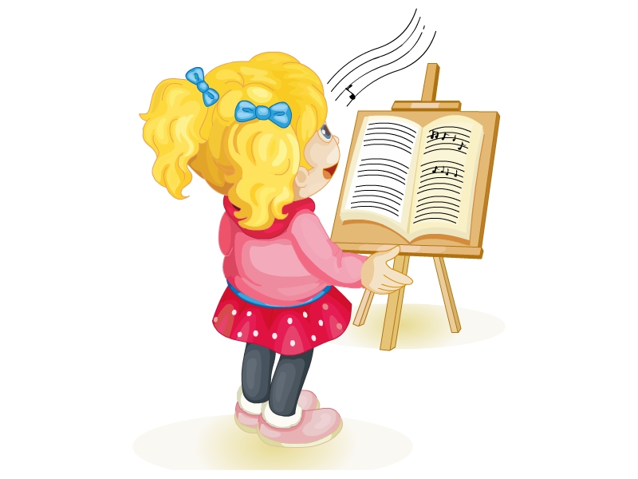
music

Slide 3
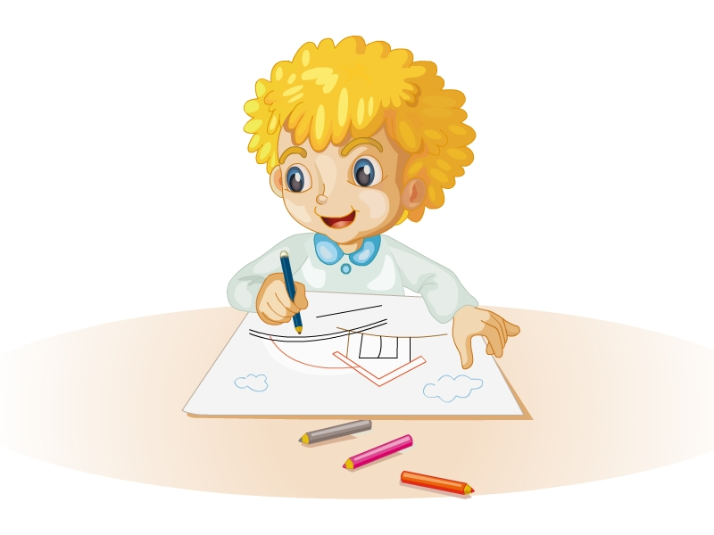
art

Slide 4
How many lessons do you have in the afternoon?
I have four.

Slide 5
Do you like music?
Yes, I do. I like it very much.

Slide 6
Do you like Chinese?
No, I am not.

Slide 7
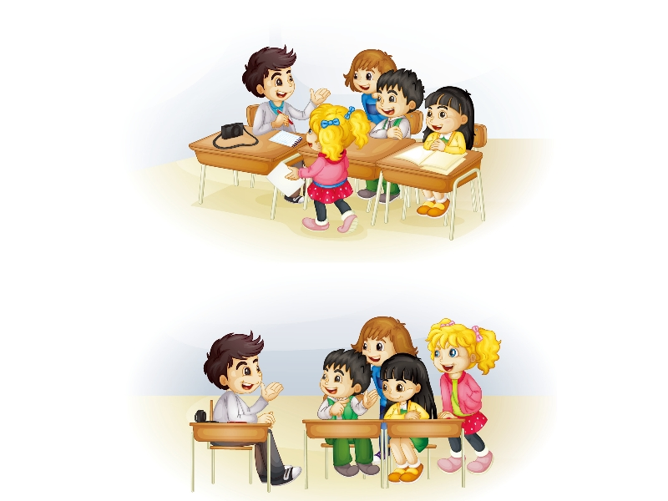

Slide 8
重点句型
How many lessons do you have in the afternoon?
I have four.
你下午有多少门课？
我有四门课。

Slide 9
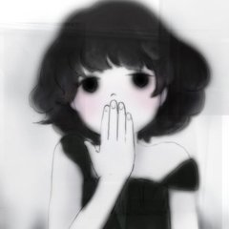
新单词
art 艺术
music 音乐

Slide 10
小练习
选择填空。
( )1.—Do you like English?
—________
A．Yes, I don't. B．No, I do. C．No, I don't.
( )2.What ________ they?
A．do B．are C．is

Slide 11
小练习
( )3.I like it ________．
A．very many B．much C．very much
( )4.How many ________ do you have today?
A．class B．lessons C．student

Slide 12
答案
1.C 2.B 3.C 4.B

Slide 13
Goodbye!

