Slide 1
Module
5
Shopping
Unit 2
You can buy everything on the
Internet.
WWW.PPT818.COM

Slide 2
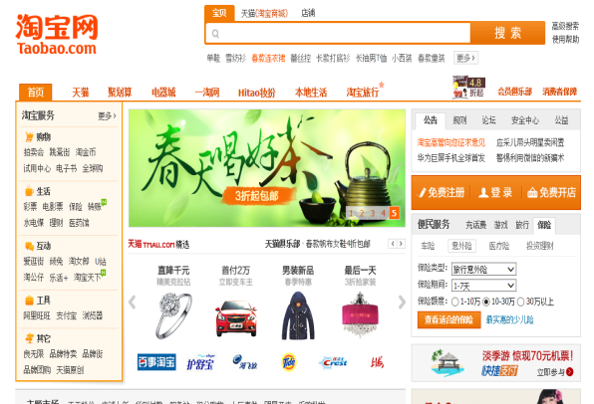
Online shopping

Slide 3
TV shopping

Slide 4
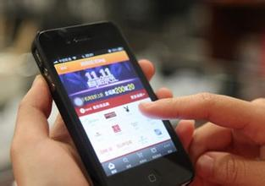
Telephone shopping

Slide 5
There are many ways of shopping.
Online shopping is one of them.

Slide 6
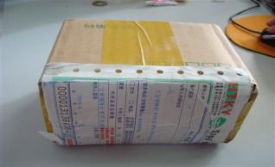
1. What can I buy on the Internet?
You can buy everything on the Internet.
receive it by post =

Slide 7
2. How can I pay for it?
Pay over the Internet =
3. Do you like online shopping? Why?
compare the prices

Slide 8
2 Fast reading. Read the passage and check true or false .
1. Online shopping is a new way of shopping.
2. You pay for online shopping before you receive it.
3. Online shopping is very difficult.
4. It’s very safe to shop over the Internet.
5. Our way of life is changing because of online shopping.
√
√
×
×
√

Slide 9
Pair-work: find out the main idea of each paragraph
Intensive reading: Online shopping
Part 1 (1)
You can buy everything on the Internet / How to buy things on the Internet.
P1:
P2:
P3:
P4:
Online shopping has several advantages.
Part2 (2&3): Advantages and disadvantages of shopping online
Some people don’t like shopping on the Internet. = disadvantages
Part3 (4)
Online shopping is changing our way of life.

Slide 10
Part 1 (1):
How can we buy things on the Internet?
First, …
Second, …
At last, …

Slide 11
Part2 (2&3):
4 Work in pairs. Complete the table.
Shopping online
advantages | disadvantages
Shopping online has many advantages. First, …Second, … Third, …. But many people don’t like online shopping, because…

Slide 12
Part3 (4):
How is our life changing?
We won’t go out any more.
We can buy at any time.
We can receive it anywhere.

Slide 13
3 Complete the passage with the following words.
later out pay before
Internet shopping is easy. You buy something online,
you (1) ___________ for it, then a few days (2)
___________you (3) ___________ it by post. But
going (4) ___________ and shopping with friends is
much more fun!
pay
later
receive
out

Slide 14
Match time: Boys & Girls

Slide 15
Brain-storm: Is online shopping good or bad?
Good ,but we should use it correctly.
Don’t spent too much time shopping online. It’s bad for our eyes.
Don’t buy anything we won’t need, even though it’s cheap. Only buy something we need.
Buy something for our family.

Slide 16
Writing : supermarket shopping
advantages | disadvantages

Slide 17
6 Write a paragraph about shopping at a supermarket.
Homework
Begin like this: Supermarket shopping is not difficult. First, …
List the advantages and disadvantages.
Finish like this: Shopping at a supermarket is fun.

