Slide 1
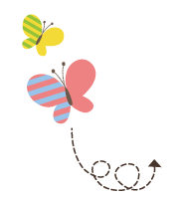
1111111111111111111111111111111111111111111111111111111111111111
Unit 2 School in Canada
六年级上册
Lesson 11 Always Do Your Homework!
WWW.PPT818.COM

Slide 2
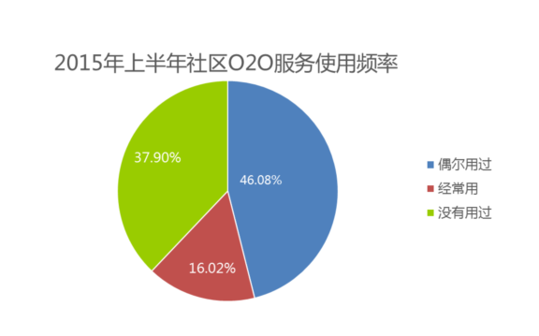

Slide 3
1. Look at the blackboard.
Mr. Wood: Class, let’s get to work. Li Ming, do you do your homework？
Li Ming: Yes, always！
Mr. Wood: Good ! Let’s put an A for always.
Mr. Wood: Jenny, do you help your mother？
Jenny: Yes. I often clean the floor.
Mr. Wood: Let’s put an O for often.
Mr. Wood: Steven, do you walk to school？
Steven: Yes, sometimes. But sometimes I ride my bike.
Mr. Wood: Let’s put an S for sometimes.
Mr. Wood: Danny, do you wear dresses？
Danny: No!! I never wear dresses!
Mr. Wood: Okay. Let’s put an N for never.

Slide 4
讲解
知识点 1
always /ɔːlweɪz/ adv. 总是；永远
I always go to work by car. 我经常乘轿车去工作。
例句：
表示动作重复、状态继续，中间没有间断。
用法：
never（adv.）从不
反义词：

Slide 5
讲解
知识点 2
put ... for... 用……代表……
例句：
Let’s put a line for a river. 让我们用线条代表河流。
拓展
含有 put 的常用短语：
（1）put on 穿上
例句：You can put on your dress.
你可以穿上你的连衣裙。
（2）put ... on... 把……放在……上
例句： Please put it on the table.
请把它放在桌子上。
（3）put ... in ... 把……放在……里
例句： She puts the pen in the box.
她把钢笔放在盒子里

Slide 6
讲解
知识点 3
sometimes /sʌmtaɪmz/ adv.有时；间或
例句：
Sometimes I walk to the park.
有时我步行去公园。
用法：
表示动作偶尔发生，间隔较大，可以用在句首、句中或句末。
加法记忆法：
some（一些）+ times（次，回）=sometimes
sometime（adv./adj.）在某时 / 一度的
反义词：

Slide 7
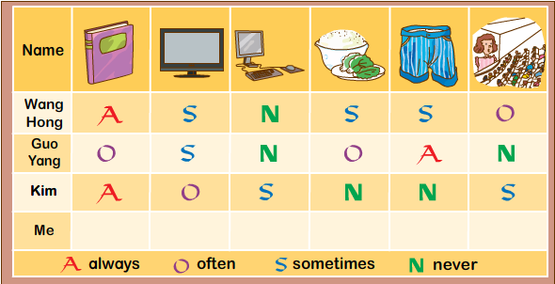
2. Let’s do it!
Look and write.

Slide 8
2. Let’s do it!
1. Wang Hong __________ reads books.
Wang Hong __________watches TV.
2. Guo Yang __________ plays computer games.
Guo Yang __________has lunch at school.
3. Kim __________wears shorts.
Kim__________ goes to the cinema.
4. I _________________________________________.
I _________________________________________.
always
sometimes
never
often
never
sometimes
never play computer games
sometimes go to the cinema.(答案不唯一)

Slide 9
3. Listen and repeat.
Would you 'like some soup ？
'No, thanks.
Are you okay ？
'No, I’m sick.
Is it a duck ？
'Yes, it is.

Slide 10
习题
一、单项选择。
I put an apple ________ the right answer.
A. from B. of C. for
C
put… for…表达“用……代表……”，这里表示用苹果代表正确答案。
点拨：

Slide 11
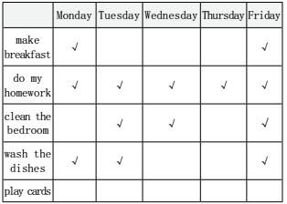
习题
二、我的日常。看表格，用“always，often，sometimes，never”填空。
（1）I __________ make breakfast in
the morning.
（2）I ___________do my homework.
（3）I ___________clean the bedroom.
（4）I ___________wash the dishes at
home.
（5）I ___________ play cards with my friends.
sometimes
always
often
often
never

Slide 12
本节课我们学习了以下知识，请同学们一定加强巩固，以便能和同学们进行灵活交流哦！
重点单词：always, sometimes, often, never
重点短语：put…for…
重点句式：I often clean the door.
But sometimes I ride my bike.

Slide 13
Thank you!

