Slide 1
Unit 6 An old man tried to move the mountains.
Section A 3a —4c
WWW.PPT818.COM

Slide 2
3a Read the passage and answer the questions.
Which book is talked about?
Who is the main character?
What is he like?
Journey to the West.
The Monkey King or Sun Wukong.
He can make 72 changes and help the weak.

Slide 3
3b Read the passage and answer the questions.
What he can do
What he cannot do
He can make 72 changes to his shape and size, turning himself into different animals and objects.
He can not turn himself into a person unless he can hide his tail.

Slide 4
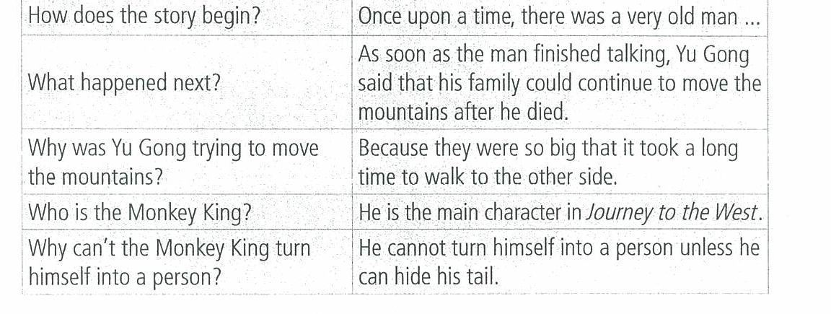
Grammar Focus

Slide 5
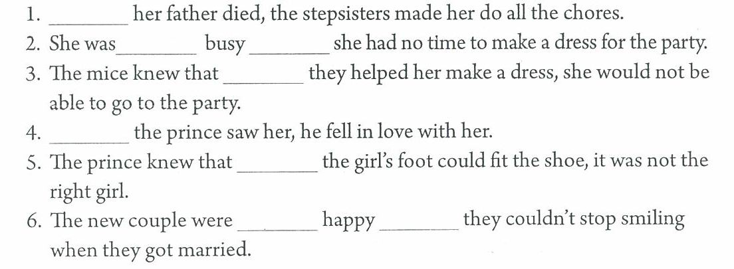
4a Fill in the blanks with unless, as soon as or so…that.
As soon as
so
that
unless
As soon as
unless
so
that

Slide 6
Key points
1. “unless” 如果不，除非
eg: He can not play basketball unless he finishes his homework.
除非他完成作业，否则他不能去打篮球。
eg: Tony can not get up on time unless his mom reminds him.
如果他的妈妈不提醒他，托尼就不能按时起床。
2. “as soon as” 一……就…… ；尽快
as soon as 可以引导时间状语从句，在含有时间状语从句的主从复合句中，若主句的谓语动词是一般将来时，则从句的谓语动词常用一般现在时表示将来。如果主句是过去时，从句也用过去时。
eg: He will watch TV as soon as his mom goes out.
他的妈妈一出去，他就会看电视。
eg: Tina met her friend as soon as she went to the library.
蒂娜一去图书馆就遇到了她的朋友。

Slide 7
3. “so…that” 如此……以至于
so + adj./adv. + that 引导的结果状语从句。
eg: Tom is so young that he can’t go to school by himself.
汤姆太小不能自已去上学。
eg: She was so happy that she couldn’t stop laughing.
她太开心了忍不住的笑。
4. “turn…into” 变成
eg: Could you turn the cloth into clothes?
你能把布料变成衣服吗？
5. “Western” 西方的
eg: Many Western countries are developed countries.
许多西方国家都是发达国家。 Northern
表示方位的图示：
Eastern Western
Southern

Slide 8
4c Tell your partner about your favorite story.
My favorite story is…
It is interesting because…

Slide 9
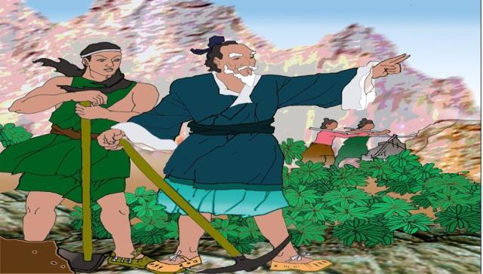
Homework
Tell your partner about your favorite story.(4c)
My favorite story is…
It is interesting because…

