Slide 1
Unit6 I like hamburgers.
人教精通版三年级上册
WWW.PPT818.COM

Slide 2
Review
Let’s play

Slide 3
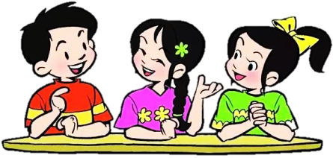
Lead-in
Free talk
What food do you like?
What drink do you like?
I like …

Slide 4
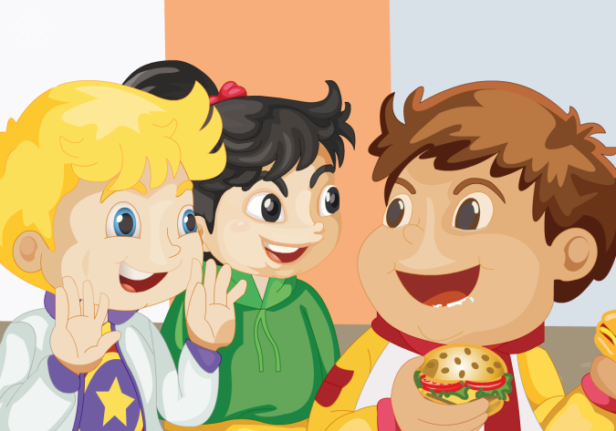
Presentation
Fun story
Read and act.

Slide 5
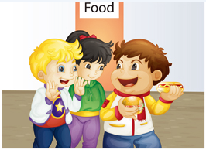
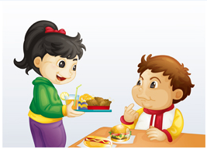
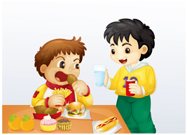
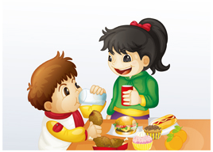
Presentation
Listen and repeat
Hi, I’m Big Bob. I like hamburgers, hot dogs, Coke …
Bob, here’s some chicken for you.
Thanks!
Can I have some water, please?
Here you are.
Here’s a Coke for you.
Thank you.

Slide 6
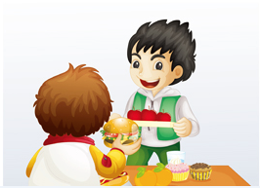
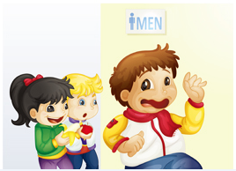
Presentation
Listen and repeat
Have some apples.
Thanks!
Anything else?
No, no, no. Thanks!

Slide 7
Practice
Let’s read
1
2
3
Read together.
(齐读)
Read in roles.
（分角色读）
Read in groups.
(分组读）

Slide 8
Show time
小组合作，试着练习对话并表演，其他同学评价。
 | 模仿录音中的语音语调，有感情地朗读。
 | 可以脱离课本，适当改动其中部分，语音地道。
 | 适当添加内容，意思完整，有创新，表演生动。
Good
Great
Excellent

Slide 9
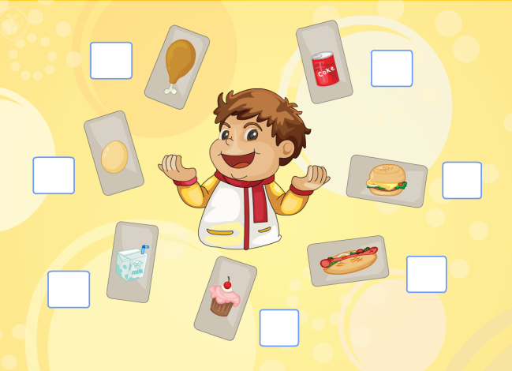
Presentation
Let’s check
Listen and number.

Slide 10
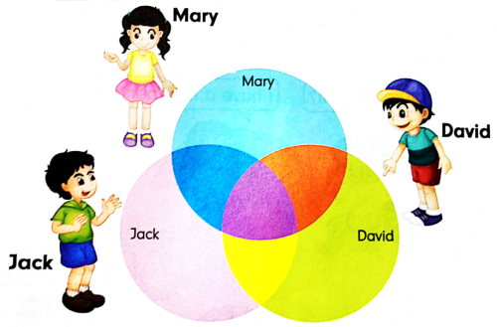
Presentation
Let’s think
Look, say and write.
I like noodles, cakes, eggs, pears, milk and Coke.
I like hamburgers, cakes, bananas, eggs and Coke.
I like hot dogs, cakes, eggs, milk and apples.

Slide 11
Practice
Game
Choose and say
1
2
Coke
milk
3
4
juice
water
5
6
7
8
egg
rice
chicken
noodles
9
10
11
12
pear
cake
hot dog
hamburger

Slide 12
Consolidation
Listen and number the pictures.
4
2
5
6
3
1

Slide 13
Homework
1. 观看或跟读Fun story部分的课文动画或录音，并注意语音、语调。
2.复习本单元所有的单词，并读给你的父母听。
3. 做一做与本课相关的练习。
Close

