Slide 1
Unit 2 Topic 2
I must ask him to give up smoking.
Section D
WWW.PPT818.COM

Slide 2
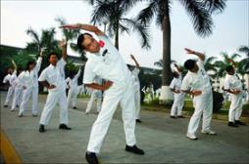

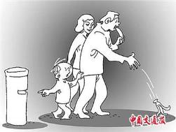
What healthy living habits should we have?
We should do morning exercises.
We should wash our hands before meals.
We must not throw litter about.

Slide 3

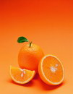
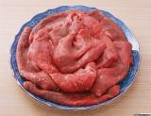



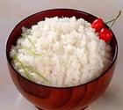
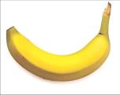
apples
oranges
meat
chocolate
ice cream
chicken
banana
hamburger
rice

Slide 4

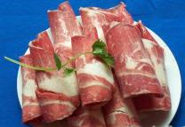


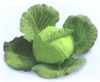
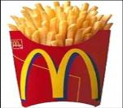

strawberry
watermelon
beef
tomatoes
sausage
sandwiches
cabbage
potato chips
eggplant

Slide 5
What should we eat or drink every day?
Meal | Food | Drink
Breakfast
Lunch
Supper
bread, eggs
milk
vegetables, fish, meat, rice
orange juice,
water
noodles, fruit, vegetables
hot water,
milk

Slide 6

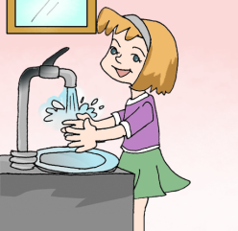
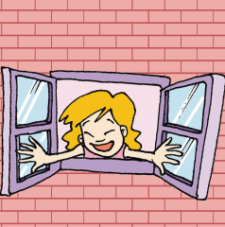
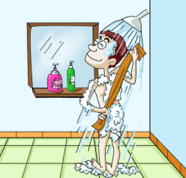
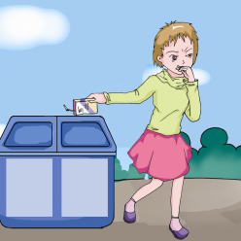
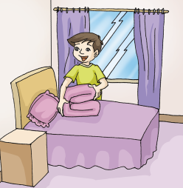
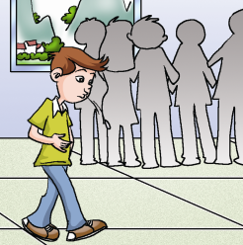
What should we do to keep healthy?
1 Listen and number the following pictures.
5
3
1
2
4
6

Slide 7


1 Make sentences with the structures in the box.
should / shouldn’t…
We
must / mustn’t…
We should take showers often.
We should wash the hands before meals.

Slide 8

1 Make sentences with the structures in the box.
We should often open the window to keep the air fresh.
We mustn’t drink sour milk.

Slide 9


1 Make sentences with the structures in the box.
We should tidy our rooms and often sweep the floor.
We mustn’t spit in public.

Slide 10
Group work
Work in groups, write down the good habits and bad habits around you.
Good habit | Bad habit
Drink a glass of milk every day. | Spit everywhere.
… | …

Slide 11

Good habits
1. Taking a walk after meals.
2. Going to bed early and getting up early.
3. Drinking enough water every day.
4. Washing hands before meals.

Slide 12
Bad habits
1. Eating too much meat.
2. Going to bed late and getting up late.
3. Throwing litter around.
4. Going to school without breakfast.

Slide 13
Can you give more suggestions on keeping healthy?
1. We must have enough food to keep healthy.
2. We must have the right kinds of food.
3. We should have different food.
4. We shouldn’t eat too little or too much.

Slide 14
2 Complete the passage with the correct words.
Some people think that smoking ________ ( must/can) help him relax. In fact, smoking is really __________ (healthy/unhealthy). Do you know that there ______ (is/are) over 4000 chemicals in cigarettes? These chemicals are _______ (good/bad) for our bodies. They _____ (must/can) cause cancer and other diseases.
The smoke from cigarettes harms ____________ (only/ not only) smokers but also other people. It’s called “second-hand smoke” and it ______ (can/can’t) be more dangerous and has higher risks. Smokers shouldn’t use smoking to help them relax. They ______ (must/mustn’t) give up smoking as soon as possible.
can
unhealthy
are
bad
can
not only
can
must

Slide 15
Project
1. Choose the answer to each question according to your lifestyle.
( )1.How often do you walk to school?
A. Never. B. Sometimes. C. Always.
( )2.How often do you eat candy?
A. Often. B. Seldom. C. Never.
( )3.How long do you usually sleep at night?
A. Less than 7 hours. B. More than 10 hours. C. 7-10 hours.
( )4.How often do you exercise?
A. Less than three times a week. B. Three to six times a week.
C. Every day.
( )5.How often do you eat fruit and vegetables?
A. Never. B. Seldom. C. Often.
( )6.How long do you watch TV every day?
A. More than 4 hours. B. 2-4 hours. C. Less than 2 hours.

Slide 16
Project
Testing How Healthy You Are
Scores: A = 1 point B = 2 points C = 3 points
Total score: _________
Conclusion | What you should do to keep healthy.
(6-9) Unhealthy
(10-13) Just so-so
(14-18) Healthy

Slide 17
summary
Grammar
Modal Verbs (Ⅱ): must/mustn’t; may; can
You _________ throw litter around. He thinks smoking ______ help him relax.
It _____ even cause cancer. I _____ ask him to give up smoking.
_______ I borrow your newspaper and show it to my father?
mustn’t
can
can
must
May

Slide 18
summary
Functions
_______ up late is bad for your health.
How terrible! It’s ______ for your health.
Don’t read ____ the sun. It will keep you ______ during the day.
Staying
good
in
active

Slide 19
语法精讲
mustn’t 是must not 的缩写形式, 其意思是“禁止, 不许, 不准, 一定不要, 一定不许”。
e.g. You mustn’t drink the water. 你不许喝这水。
注意: 不用mustn’t 来回答由must（必
须、一定要）开头的问句, 而应用
needn’t (don’t have to)。

Slide 20
e.g. Must he clean the room before class? 他一定要在课前打扫教室吗？
肯定回答: Yes, he must.
是的, 一定要。
否定回答: No, he needn’t .
/ No, he doesn’t have to.
不，不必。

Slide 21
考点探究
1. — Must I stay at home and take care of her?
— No, you ___. (济南·2007)
A. mustn’t B. won’t
C. can’t D. needn’t
D
解析: 表示“不必”用needn’t；mustn’t 意为“不许，禁止”，故正确答案 D。

Slide 22
2. You’d better ____ smoking, ____ you will get ill. (成都·2007)
A. go on; so B. give up; and
C. give up; or
C
解析：give up 放弃，or 否则，故正确答案C。

Slide 23
3. – Must we get up at 4:00 in the morning?
– No, you ___.
A. must B. mustn’t
C. don’t D. needn’t
D

Slide 24
改错
Wash hands before meals is good to you.
【指点】wash hands 是动词短语，不能
直接作主语，应改为动名词短语 washing
hands或不定式短语to wash hands。动名
词短语作主语，谓语动词用第三人称形
式。be good to…对某人和善，应改为be
good for…对某人有好处。

Slide 25

Exercises
选择正确答案。
1.— Watching TV too much _______ bad for your eyes.
— I’ll go to bed right away.
A. is B. are C. was D. be
2.— If you feel _______, you should go to school.
A. bad B. worse C. better D. good
3.— I can’t keep myself active during the day.
— You _______ take more exercise.
A. must not B. must be C. need to D. may be
4. —You had better ask your brother _______ playing
computer games. It’s bad for him.
A. to give up B. not to give up
C. to give it up D. not give it up

Slide 26
选择方框中的句子完成对话。
A：Which is more important, wealth or health?
B：In my opinion (观点), _____ .
A：I agree with you. But how can we keep healthy?
B：I think ___ especially (尤其) green vegetables and fruit.
A：Can we eat too much meat?
B：No, I think ____ .
A：What else should we do?
B：We should ______ . But remember not to do sports soon
after meals.
A：I see. _____?
B：It is good.
C
D
A
E
B
A. that is bad for our health B. Is going to bed early good or bad for our health C. health is more important than wealth D. we should eat healthy food E. do some sports every day

Slide 27

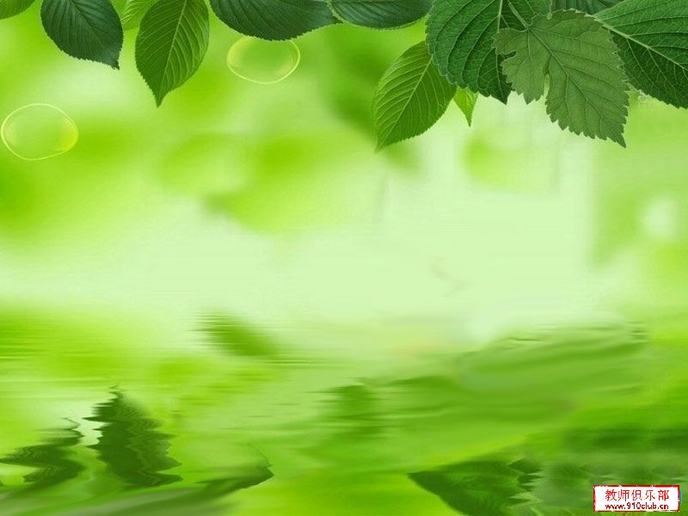
Homework
What should we do to keep healthy?
Please write a passage about it. The
following questions may help you.
How long do you usually sleep every night?
How often do you exercise?
How often do you eat fruit and vegetables?

