Slide 1
Unit 4 Topic 2
How can we protect ourselves from the earthquake?
Section D
WWW.PPT818.COM

Slide 2
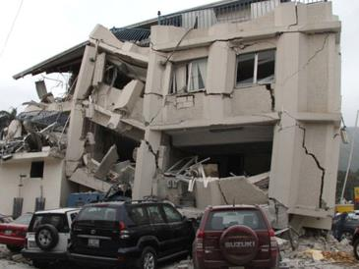
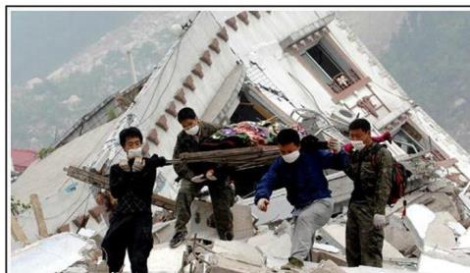
We all know the Wenchuan earthquake made a lot of buildings fall down and lots of people lose their homes.
Look at some photos about Wenchuan in the earthquake in 2008.

Slide 3
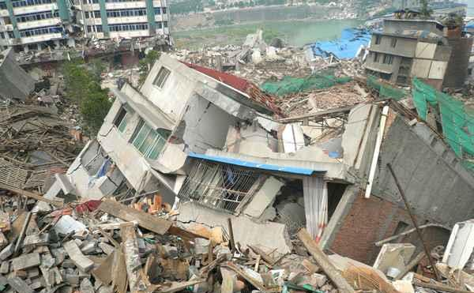
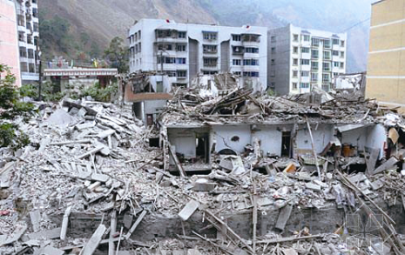

Slide 4
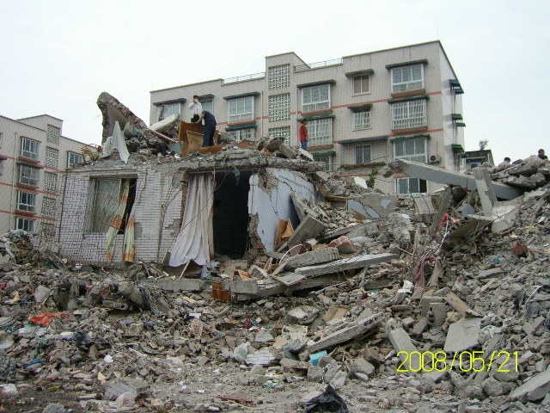
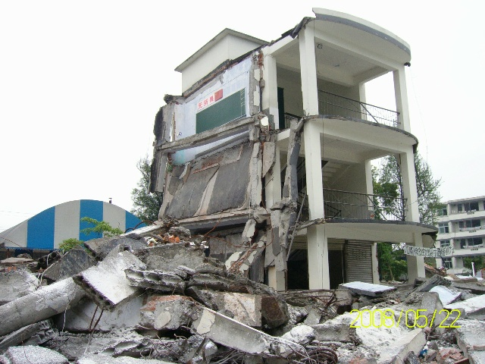
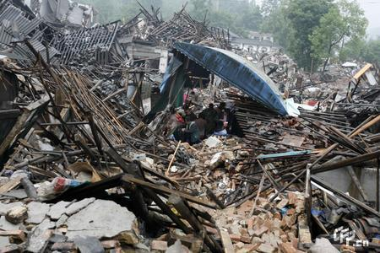

Slide 6
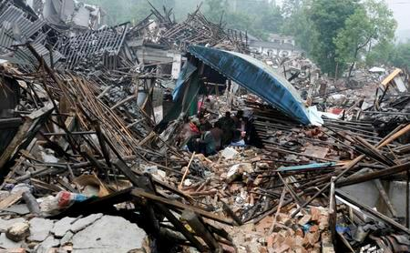

Slide 7
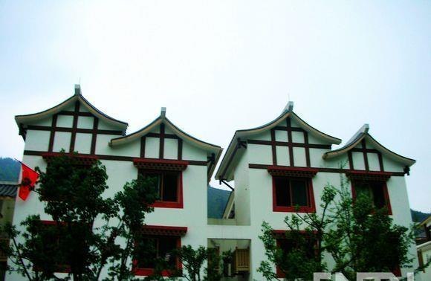
Do you want to know how the people’ life in Wenchuan is now ?
Enjoy some photos about the new Wenchuan.

Slide 8
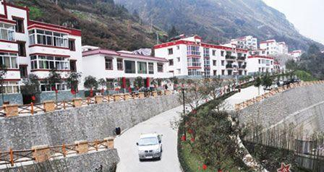
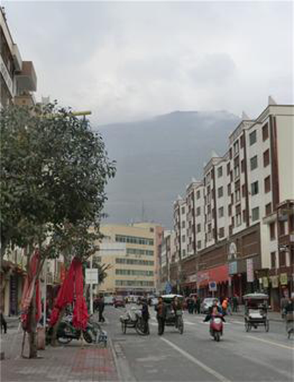

Slide 9
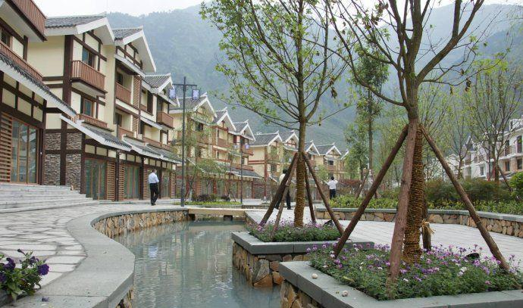

Slide 10
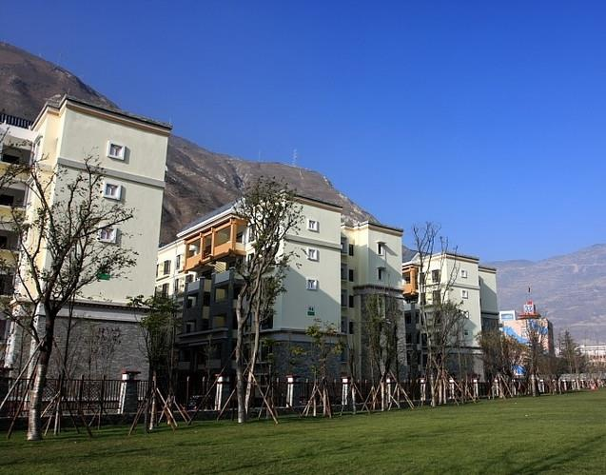

Slide 11
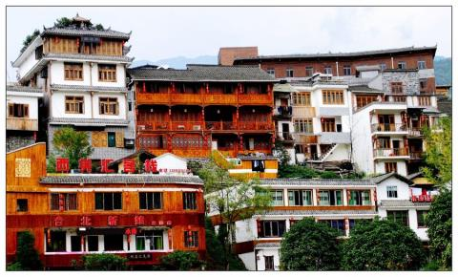
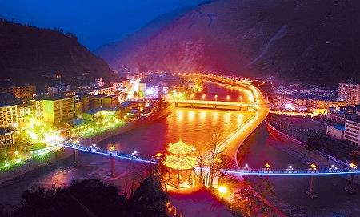
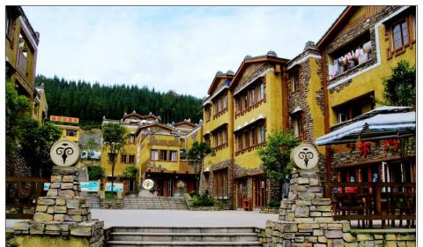

Slide 12
1
Read the passage and complete the table on Page 96.
Time
Place
Event
Result
Measure
Present situation
At 2:28 in the afternoon, on May 12, 2008
Wenchuan County in Sichuan Province
There was a terrible earthquake.
More than 69 000 people lost their lives and five million people lost their homes.
With the help of the whole nation, people in Wenchuan are building their homes.
People are returning to normal life. The children are able to study in safe, new schools.

Slide 13

Watch the flash and read 1, then find out the phrases in the passage .
1. five million
2. with the help of …
3. the whole nation
4. rebuild their home
5. return to normal life
五百万
在……的帮助下
全国
重建他们的家园
恢复正常的生活

Slide 14

Key points
Five million people lost their homes.
基数词修饰million, hundred, thousand时，只能用单数形式（表示确数）。
two hundred
three thousand
seven million
当hundred, thousand, million 与of连用时，一定要用复数（表示概数）。
hundreds of 数百，数以百计
thousands of 数千，成千上万 millions of 数百万
两百
三千
七百万

Slide 15
2.But with the help of the whole nation …
with the help of sb. / sth.
= with one’s help
Eg:在警察的帮助下，他终于找到了他的小狗。
____________________________________, he found his little dog at last.
在电脑的帮助下，他知道了很多的东西。
_________________the computer, he knows a lot of things.
在……的帮助下
With the help of the police/With the police’s help
With the help of

Slide 16
Write a piece of news about the Tangshan earthquake with the help of the following information. Pay attention to the elements in news.
2
Time | early morning July 28,1976
Place | near Tangshan, Hebei
Event | Earthquake struck Tangshan
Result | 240 000 died , more than 160 000 injured
Measure | sent the army to help; provided food and water; rebuilt their homes

Slide 17
You can write like this :
On the early morning of July 28, 1976, a
terrible earthquake hit Tangshan in Hebei province, China. 240 000 people died and more than 160 000 people were injured. Luckily, the government sent the army to help them and provided food and water. With the help of the whole nation, people in Tangshan rebuilt their homes. Now, a more beautiful new Tangshan has appeared.

Slide 18
Project
Caring About the Children From Disaster Areas
Ask your friends how they feel about children from disaster areas.
1)What do you want to do for the children from
disaster areas?
2)What do you want to say to children from
disaster areas?
3)What do you think people in disaster areas
should do?

Slide 19
2. Make a short report to your class about your
survey.
3. Write a letter to the children in disaster
areas. Give your comfort, concern and best
wishes to them.

Slide 20
Summary
Read through Sections A-C carefully and complete each sentence
below.
Grammar
Comparative and superlative degrees of adjectives (Ⅱ)
The Wenchuan earthquake in 2008 was __________ than this one, but the Tangshan earthquake in 1976 was_____________.
I think the mobile phone is _____________ than the telephone. Yes, but the computer is ______________ of all.
Running out can be ___________ .
Remember, _________________ thing is to stay calm.
__________ place is under a strong table or desk.
more serious
the most serious
more useful
the most useful
dangerous
the most important
The safest

Slide 21
Functions
A terrible earthquake _____ Qinghai. Was it serious ?
I’m very sorry to ________ that .
______ can we protect ourselves _______ the earthquake?
hit
hear
How
from

Slide 22
Homework
1.认真复习 Topic 2。
2.继续收集应对灾害的方法，在班里与同学交流。

