Slide 1
Unit 2 I’m Healthy
第1课时
WWW.PPT818.COM

Slide 2
>>Warming-up
Let’s chant
I am hungry. Eat some cake, eat, eat.
Can I have more?
There is no more, no more.
I am thirsty. Drink some milk, drink, drink.
Can I have more?
There is no more, no more.

Slide 3
>>Lead-in
Think and write
Can you write more?
Fruit | Vegetable | Food | Drink | Sport
apple | tomato | rice | milk | play basketball

Slide 4
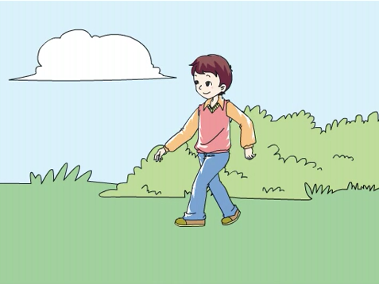
>>Presentation
Let’s learn
take a walk

Slide 5
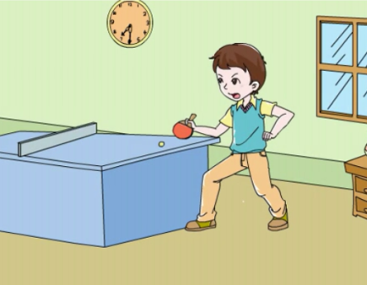
>>Presentation
Let’s learn
play ping-pong

Slide 6
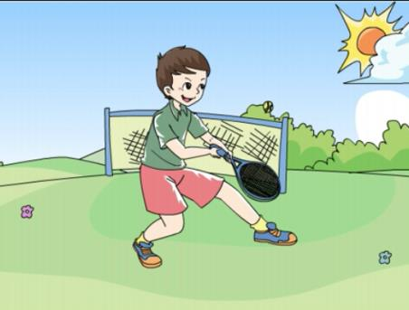
>>Presentation
Let’s learn
play tennis

Slide 7
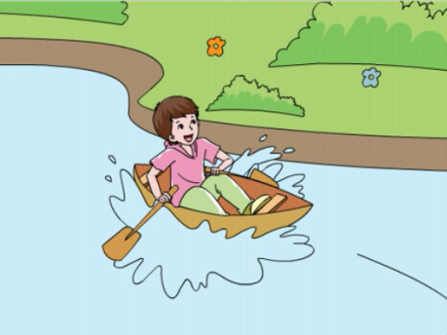
>>Presentation
Let’s learn
go boating
Let’s go boating!

Slide 8
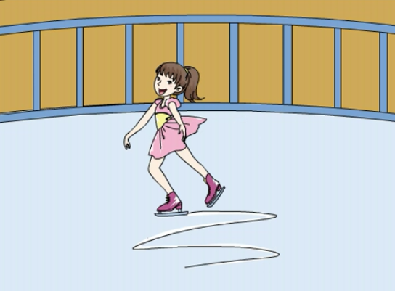
>>Presentation
Let’s learn
go skating

Slide 9
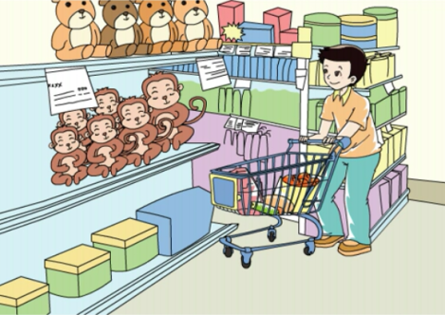
>>Presentation
Let’s learn
go shopping

Slide 10
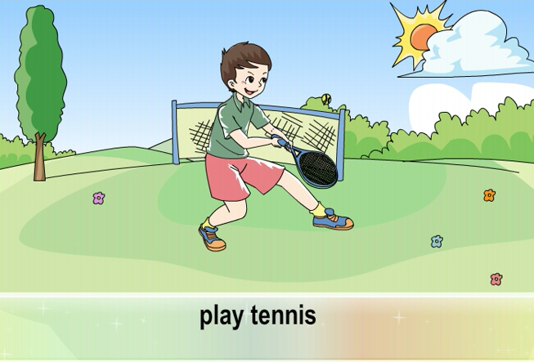
>>Presentation
Watch and read

Slide 11
>>Practice
Which is missing?
go skating
go shopping
go boating
take a walk
play ping-pong
play tennis

Slide 12
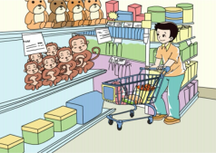
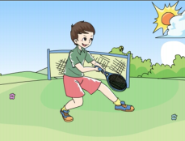
>>Presentation
Quick response

Slide 13
>>Presentation
Let’s learn
动词go + 动词-ing，表示“去做某事”
go swimming
去游泳
go dancing
去跳舞
go fishing
去钓鱼
go skating
去滑冰

Slide 14
>>Presentation
Summary
动词加-ing
1
直接加-ing
fish — fishing
boat — boating
2
去e加-ing
dance — dancing
skate — skating
3
双写尾字母加-ing
swim — swimming
run— running

Slide 15
>>Summary
本课所学动词短语有哪些？
take a walk
play ping-pong

Slide 16
>>Summary
本课所学动词短语有哪些？
play tennis
go boating

Slide 17
>>Summary
本课所学动词短语有哪些？
go skating
go shopping

Slide 18
>>Homework
1.观看课文动画，按照正确的语音、语调朗读课文对话。
2.抄写本课所学动词短语每个5遍。
3.预习“Let’s talk”。
close

