Slide 1
Module 10 The weather
Unit 2
The weather is fine all year round .
WWW.PPT818.COM

Slide 2
Teaching aims
Key words :
mile round northwest southeast
2. key structure:
Take your swimming clothes because you might
want to go swimming in the sea, even in December.
In Alaska the days are long and warm in summer,
but may be cool in the evening.
3. Ability:
To extract specific information from the reading passage.

Slide 3
Words and expressions
/maIl/
/raund /
/nɔ:θ'west /
/sauθ'i:st/
from time to time
英里 n.
mile
围绕地 adv.
round
西北 n.
西北的；朝西北的 adj.
northwest
东南 n.
东南的;朝东南的 adj.
southeast
有时;间或

Slide 4
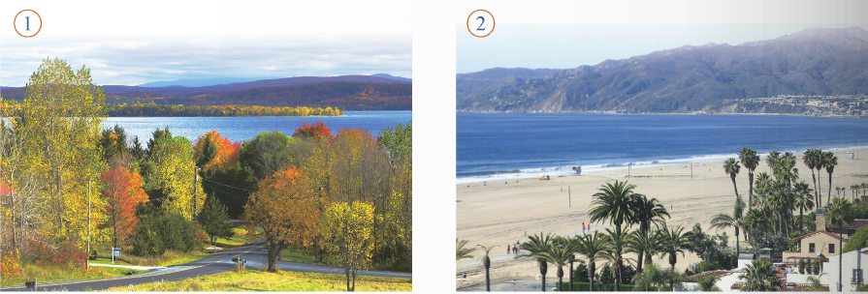
Please describe the pictures!
What you can see in the picture?

Slide 5
1. Then talk about the picture.
For example: Where is it?
What’s the weather like?
What season is it?

Slide 6
2.Read the passage and find out the best time to visit the US.
When is the best time to visit the US?
The US is a very big country. It is about 3,000 miles from
the east coast to the west coast, so choose carefully the places
to see and the time to go. Bring a map because you may want
to travel around.
New York and Washington D.C are good places to visit in
May or October, but in winter there is a lot of snow.
The best time to visit New England is in September. The
weather gets cooler, and the green leaves start to turn photos
gold, then brown. Bring your camera so you can take photos
of the autumn trees.

Slide 7
California is on the Pacific coast, and the weather is fine all
year round. Take your swimming clothes because you might
want to go swimming in the sea, even in December.
In Seattle, in the northwest, it is not very cold but it rains a lot,
so bring an umbrella. In Alaska, the days are long and warm in
summer, but may be cool in the evening. In winter, Alaska can
be very very cold. If you want to visit Alaska, you had better go
in summer. Do not forget to bring a warm sweater with you.
In Texas and the southeast, it is usually very hot and sunny
compared to other places. There are storms from time to time
in summer and autumn.
So when is the best time to visit the US? Any time you like!

Slide 8
3 Complete the table.
Place | Weather | Best time to visit
New York | Winter:
New England
California
Alaska | Summer： Winter：
A lot of snow
In May or October
It gets cooler in September
In September
Fine all year round
All year
Warm day, cool night
In summer
Very cold

Slide 9
4. Complete the sentences with the
correct form of the words from the box.
brown mile storm sweater umbrella
brown
1 In autumn the leaves turn gold and then ______ .
2 It is about 3,000 ______ from the east coast to the west
coast.
3 You might need a(n) ______ in the evening.
4 Sometimes there are ______ in summer and autumn on
the southeast coast.
5 You will need a(n) ____________ in Seattle because it
rains a lot.
miles
sweater
storms
umbrella

Slide 10
Language points
1. the best time to do sth
干某事的最好时候
e.g. Spring is the best time to plant trees.
2. Take photos of … 给……拍照
e.g. I took a photo of Linda.
She took a lot of photos of kids.

Slide 11
3. compared to/with 和……比较
表达这一意思也可以用compared with
e.g. Compared to our small house, Bill’s house seems like a palace.
4. from time to time 有时，间或
e.g. They are now living in different cities, but they still talk on the phone from time to time.

Slide 12
May的用法
1.“may”表达许可
如：May I come in? 我可以进来吗？
2. “may”表达可能性
如：The news may be true.
或许这消息是真的。
另外，“may…”表达“可能性”时其意思等于
“maybe”或“perhaps”，即“或许；也许” 。
3. “may”表达目的
如：He studies hard （in order） to get passed in the exam.
为了要考试及格他努力在用功。

Slide 13
4. “may”表达祈愿句型
如：May you succeed.
=I hope [wish] you'll succeed.（祝你成功。）
5. “May”的惯用表达句式
句型 may well +V…
如：You may well say so.
=There is good reason for you to say so.
你很有理由这么说。——难怪你这么说。
句型 may/might as well +V…=had better +V…
例：We may [might] as well start at once.
=We had better start at once.
我们最好立刻动身吧。
（本句式常用于表达提议或劝告。）

Slide 14
may与might
may , might 或许，可能，可以 （might可以看作是
may的过去式，这两个词除了时态不相同外，在表
达意思的许多方面是相近的。当然may 和might又
都有一些各自不同的独特用法。）
1）表可能性
I may be busy from tomorrow on .
从明天起我可能会忙起来。
You may catch sight of the sunrise from here when
you get up before 5 in the morning .
你在早晨五点钟以前起来，或许能从这儿看到日出。

Slide 15
2）表示允许
I’d like to have a smoke here if I may .
如果可以的话我想在这儿抽一支烟。
The librarian told her that she might return the
book to the library in three days .
图书馆理员告诉她说，她可以在三天后还那本书
3) might也常用于表示目的等状语从句中:
They left off earlier on that day so that they might
catch the first train .
那天，他们为了赶上头班车动身早一些。
One error in calculation might ruin the whole project .
计算中出一点错就可能毁掉整个工程。

Slide 16
经典试题
1.I thought you___ like something to read, so I have brought you some books.
A. may B. might C. could D. must
2.Peter ___ come with us tonight, but he isn’t very sure yet.
A. must B. can C. may D. will
3.Yesterday Jane walked away from the discussion. Otherwise, she___ something she would regret later.
A. had said B. said
C. might say D. might have said
B
C
D

Slide 17
4. ----Could I call you by your first name?
---- Yes, you ___.
A. will B. could C. may D. might
5.Sorry, I’m late. I____ have turned off the alarm clock and gone back to sleep again.
A. might B. should C. can D. will
6.---- Are you coming to Jeff’s party?
----I’m not sure. I___ go to the concert instead.
A. must B. would C. should D. might
C
A
D

Slide 18
5. Match the two parts of the sentences.
1 You can come any
time you like, but…
2 It often rains in
spring, so…
3 Bring a coat
because…
4 Our plan is to walk in
the countryside, so…
5 Sydney is a big city,
but…
6 Let’s stay for a long
time because…
a) …it will soon become cold.
b) …there are lots of things to see.
c) … the best time to visit England is in
spring.
d) …it is a good idea to bring an umbrella.
e) …wear comfortable shoes.
f) …we will find our way with a good map.

Slide 19
6.Write some advice for visiting your hometown and give reasons. Use because, so and but.
The best time to visit my hometown is in…because the weather is…

Slide 20
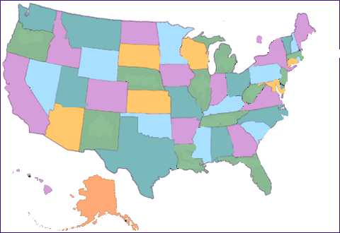
Give your friend some advice about traveling to the USA.
What should you do
Reason
 | bring your umbrella | Because it might rain
 | bring a swimsuit | You might want to swim in the sea
 | wear warm clothes | Because it might be cool in the evening
 | buy a good map | Because you want to travel around
Place
You
should

Slide 21
Task
Different groups are different travel agents of the USA. Discuss in groups to decide:
1) Your travel agent’s name
2) To sell the travel of the USA to attract (吸引) the tourist.

Slide 22
练一练
1.The car don’t move at all. There ____ be
something wrong with it.
A. maybe B. possible C. may
2. -_____________? - It’s sunny and hot.
A. What is the weather like?
B. How is the weather like?
C. What is the weather?
3. It’s interesting ______ games with the children.
A. play B. to playing C. to play

Slide 23
Complete the sentences.
1. 他有时给我发电子邮件。
from time to time
He sends me emails _______________.
2. 照些动物的相是一个好主意。
It’s a good idea to _____________
animals.
take photos of
3. 比起其它城市，住在珠海很舒适。
It’s pleasant to live in Zhuhai ___________ other cities.
compared to

Slide 24
Homework
Finish the exercises in the workbook

