Slide 1

Unit 1 Topic 3
What class are you in?
Section A
WWW.PPT818.COM

Slide 2
Read the numbers you have learned.
one
three
ten
zero
two
eight
five
six
seven
nine
four

Slide 3
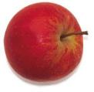
______ apples
eleven

Slide 4

Twelve
______ peaches

Slide 5
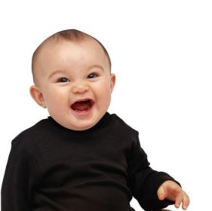

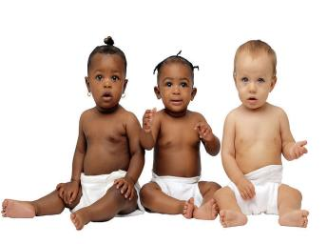
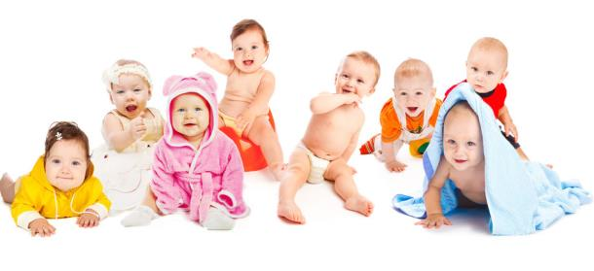
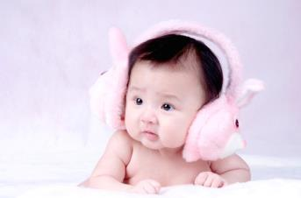
fourteen
_____ babies

Slide 6


________ oranges
fifteen

Slide 7
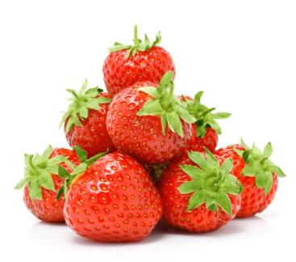

________strawberries
sixteen

Slide 8

__________ strawberries
seventeen

Slide 9
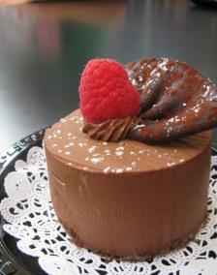
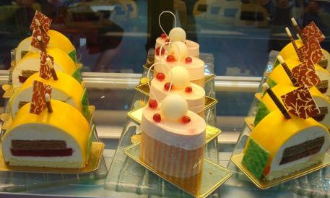
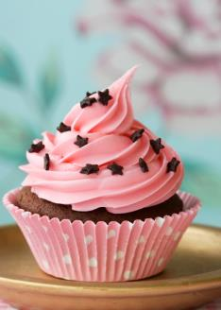
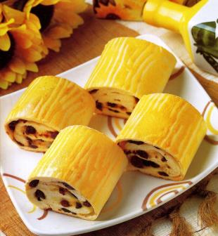
eighteen cakes

Slide 10
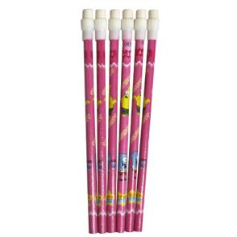

_________pencils
nineteen

Slide 11
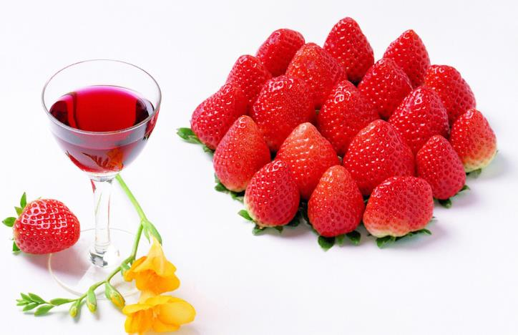
_________ strawberries
twenty

Slide 12


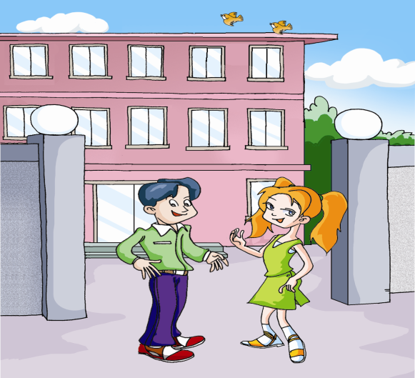


2a Look, listen and say
I am twelve years old.
How old are you?
I’m twelve, too.

Slide 13

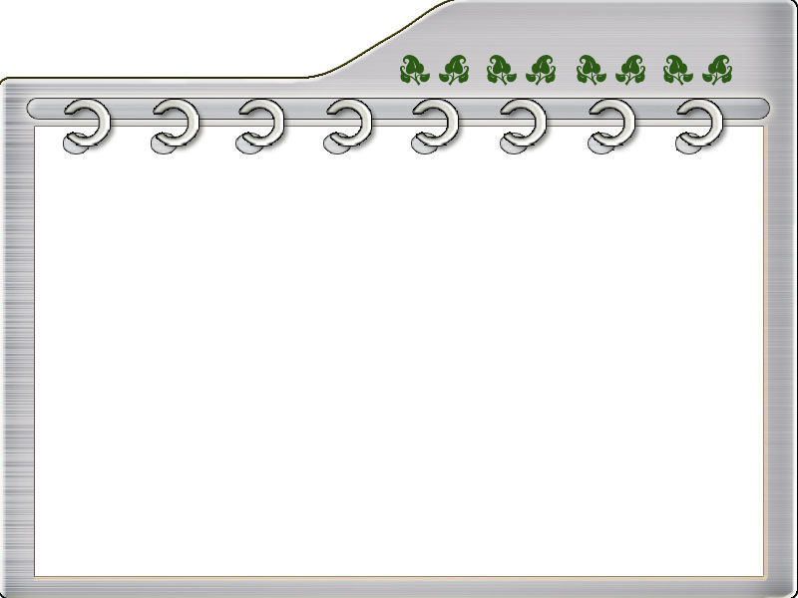

2b Help Li Ming complete Sally's name card.
Sally
Name:________________
Age:__________________
Class:_________________
Grade:________________
12
4
7

Slide 14
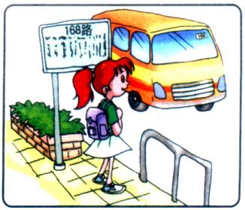
Make conversations.
Name: Jane
Age: 13
Tel : 0307435
From: Canada
What’s her name?
Her name is Jane.
How old is she?
She is 13.
What’s her phone number?
It is 0307435.
Where is she from?
She is from Canada.

Slide 15
Name: Yukio
Age: 17
Tel: 8259379
From: Japan

Slide 16

3 Listen and match
Nancy fifteen Class 16, Grade 9
Mark twelve Class 3, Grade 7
Dick thirteen Class 5, Grade 7
Julia fourteen Class 11, Grade 8

Slide 17

4b Pair work
Act out the conversations above with your partner. Then make your own ones.
A: Hello! ...What grade are you in?
B: I’m in …
Are you in …?
A: Yes/No, …
A: Who’s that?
B: That’s …
A: How old …?
B: He/She is …
A: What class is he/she in?
B: He/She …

Slide 18
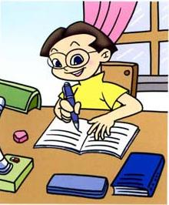
Name: Kang Jun
Age: 13
Class: Class 12,Grade 8
Who’s that?
That is Kang Jun.
How old is he?
He is 13.
What class is he in?
He is in Class 12.

Slide 19

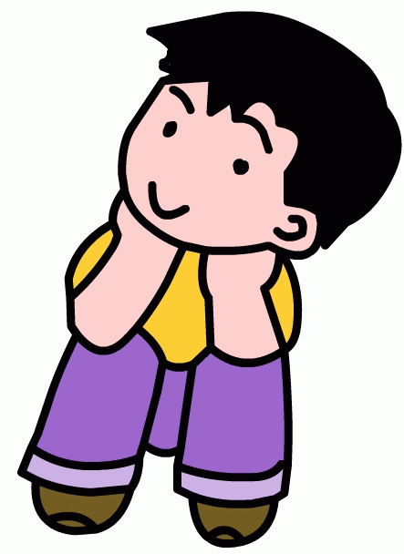
Name: Jack
Age: 12
Class: Class 20, Grade 7
Name: Xiao Lijia
Age: 11
Class: Class 18, Grade 7

Slide 20
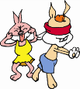
Class activity
Play a bingo game.
1. Choose nine numbers from 1 to 20 and put them into a table like this:
13 | 4 | 11
16 | 19 | 5
7 | 10 | 18

Slide 21
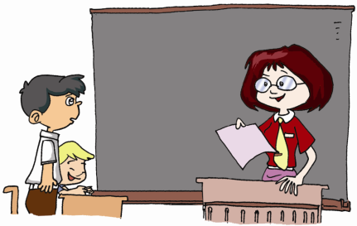

13 | 4 | 11
16 | 19 | 5
7 | 10 | 18
19,7,11 ...
2. Listen to the teacher and cross out (×) the numbers you hear.
3. Say “Bingo!” when you have crossed out any three numbers in a line.

Slide 22
Sum up
(1) 学习数字 11--20。
(2) 学习询问他人的年龄、班级和年级。
(3) 重点句型：What class are you in?
I am in Class 3, Grade 7.
Who’s that ? That’s …

Slide 23

Homework
去结交几个新朋友吧，问问他们在哪个年级，哪个班。别忘记介
绍你自己哦！
Notes:
23

