Slide 1
Unit 5 Do you have a soccer ball?
单元同步作文导练
WWW.PPT818.COM

Slide 2
本单元围绕“和朋友一起欢度时光”这一话题安排了三个任务：一是列举所学的运动项目，从中挑出各自喜欢的体育项目，并说明原因；二是让学生互相询问所爱好的运动，并根据情况发出邀请，学会用have对物品所属进行提问与回答。最后，根据以上两个任务写一篇有关运动的短文。
教材中出现的常用句型：
①I have…我有……
②He has/doesn't have…他有/他没有……
③Do you have…？你有……？
④Let's play basketball.咱们一起打篮球。

Slide 3
⑤…is interesting/fun/relaxing/boring/difficult.……有趣味/有乐趣/令人放松的/无聊的/难的。
⑥It's easy for me.对于我来说很容易。
⑦I like….我喜欢……。
拓展常用相关句型：
①We can…我们能……
②It's good for…对……有好处
③I think…我认为……

Slide 4
_____________________________________________________
_____________________________________________________

Slide 6
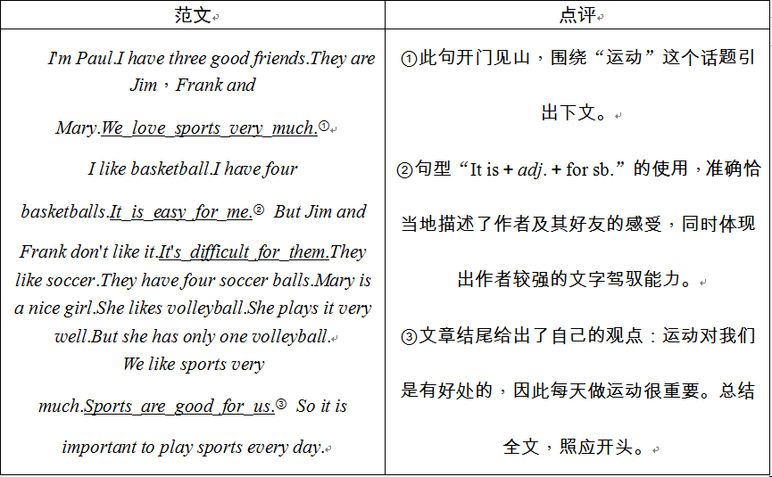

Slide 7
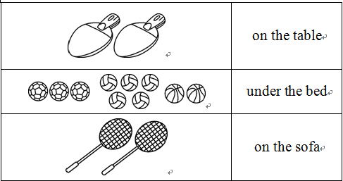

Slide 8
Dear Tom，
I love sports.Some balls and bats are in my room.I have two ping­pong bats.They're on the table.Three soccer balls，five volleyballs and two basketballs are under the bed.And I have two baseball bats.They are on the sofa.I play ping­pong with my classmates after class.I think it's fun.I like soccer.I play it at school with my friends.It's relaxing.Volleyball is difficult for me.I don't play it.
Yours，
Liu Rui

