Slide 1
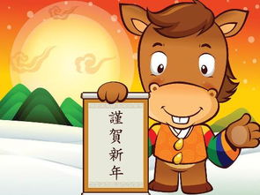
Unit 8
Chinese New Year
第二课时
WWW.PPT818.COM

Slide 2
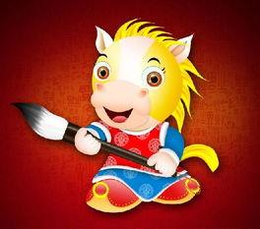
Introduce
Answer questions：
What are you going to do at Chinese New Year?
I am going to have a big dinner with my parents.

Slide 3
Words
pick
/pɪk/
动词,表示“挑选、选择” ;
第三人称单数picks ;过去分词picked;现在进行时picking
常用短语：pick up 拿起
eg ： I pick up a book on the road.
我在路上捡起一本书。
小练习：（ ）She came over to pick ______her things.
A. in B. out C. up
C

Slide 4
Expressions
1. be going to 结构表将来
固定结构,用于将来时态,表示“将要······”。
用来表示按计划或安排要发生的动作,有时也可以表示推测将要或肯定会发生的动作,有“准备、打算”的意思。
eg ： I am going to buy something tomorrow morning.
明天早上我要去买一些东西。
She is going to see Mr. Wang this afternoon.
她打算今天下午去看望王先生。

Slide 5
Expressions
1. be going to 结构表将来
小练习 : 1.（ ） It is going to be Chinese New Year____.
A. next week B. last week C. now
A
2.（ ） My family and I___ going to visit my grandpa.
A. are B. am C. is
A
3. （ ）He is going to___ a kite.
A. making B. made C. make
C

Slide 6
Expressions
2. What +be动词+主语+going to do?
主语+be动词+主语+going to +动词原形
询问某人打算做什么事的句型及其答语的固定句型
“What +be动词+主语+going to do?”的意思是“主语打算做什么？ ”
用来询问别人打算做什么事情的特殊疑问句型。
Be动词在人称与数上和主语一致。

Slide 7
Expressions
eg : —What are going to do this afternoon?
今天下午你打算做什么？
—I am going to learn to play the piano.
我打算学钢琴。
小练习 : 1. are, buy, We, to, some, going, gifts(.)
______________________________________
2. do, going, we, tomorrow, are, to, What (?)
______________________________________
We are going to buy some gifts.
What are we going to do tomorrow?

Slide 8
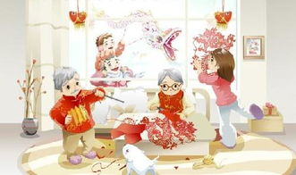
Dialogues
Make sentences using the general future tense.

Slide 9
Expand
精彩英文广告词
1. Good to the last drop. （麦斯威尔咖啡）
滴滴香浓，意犹未尽。
2.Obey your thirst. （雪碧）
服从你的渴望
3.The new digital era. （索尼影碟机）
数码新时代

Slide 10
Expand
精彩英文广告词
4.just do it. (耐克运动鞋)
只管去做。
5.The taste is great. (雀巢咖啡)
味道好极了。
6.Feel the new space. (三星电子)
感受新境界。

Slide 11
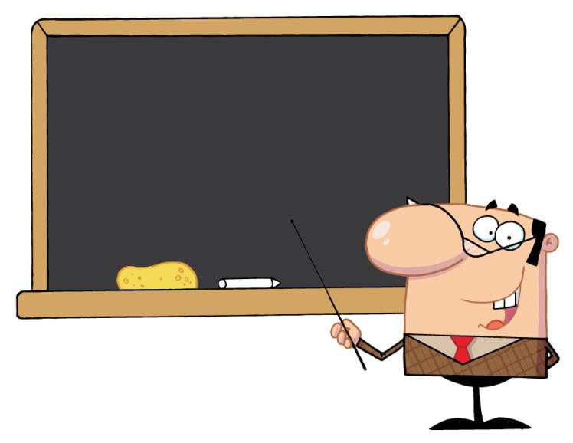
Summary
pick be going to…
What +be+主语+going to do?
主语+be+主语+going to +do？

Slide 12
Exercise
( )1.I a football match tomorrow.
A. watch B. We’re C. am going to
( )2. going to have a big dinner this evening.
A. We B. We’re C. His
C
B

Slide 13
Exercise
( )3.Wang Dong Xi’an next Sunday .
A.Christmas B.Mother’s Day C.Chinese New Year’s Day
( )4.Chinese people usually make tang yuan on .
A.Christmas day B.Mother’s day C.Chinese New Year’s Day
C
C

Slide 14
Exercise
( )5. are going to Beijing next week.
A. Nancy and I B. I and Nancy C. Nancy and me
( )6.It’s the 29th of December. New Year is .
A. going B. coming C. come
A
B

Slide 15
Exercise
( )7.I have got a new bike .I’m very .
A. excite B. coming C. excited
( )8.--Where are you going,Liu Feng?-- .
A. I’m going to the library. B. I’m going to go the library. C. I’m go to the library.
C
A

Slide 16
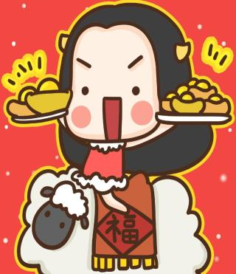
Homework
Write a small dialogue combining with the grammatical structure you learned.

