Slide 1
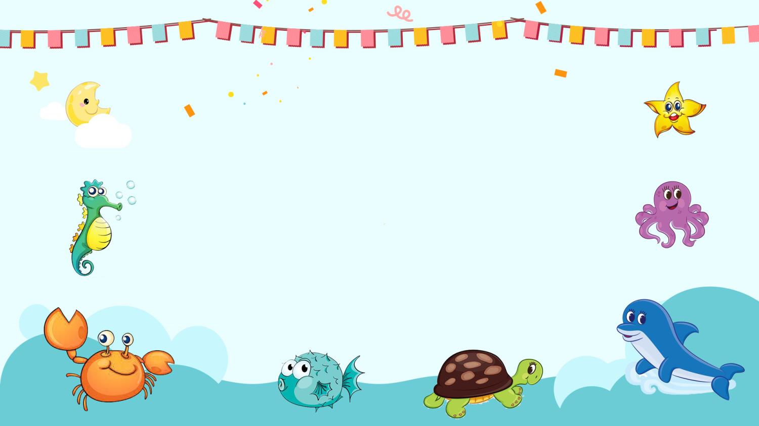
精通版四年级下册
Unit6
Would you like to take a trip?
WWW.PPT818.COM

Slide 2
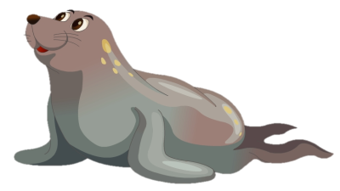
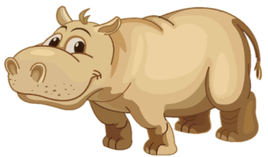
Review:
—What’s that in English?
—It’s a …
seal
dolphin
hippo

Slide 3
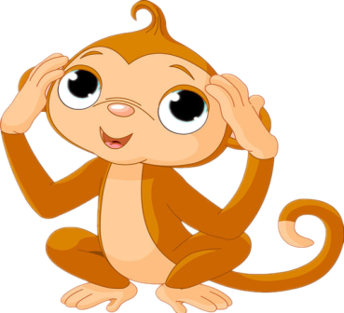
Guessing game:
What’s this in English?
It’s a monkey.

Slide 4
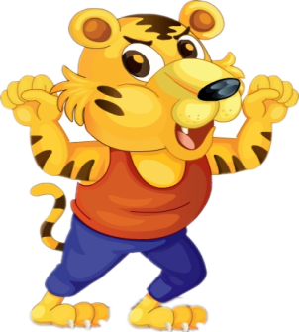
Guessing game:
What’s this in English?
It’s a tiger.

Slide 5
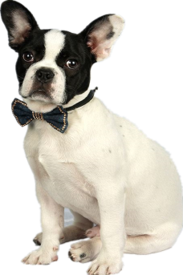
Guessing game:
What’s this in English?
It’s a dog.

Slide 6
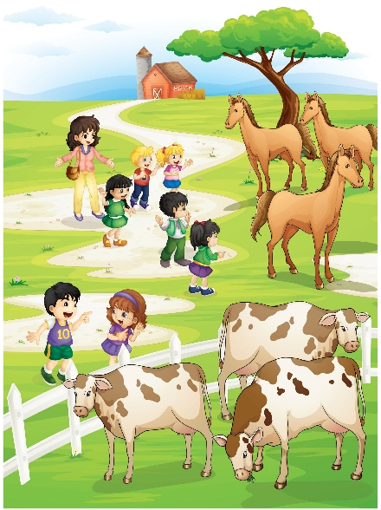
Lead-in:
Here’s the Happy Farm.
What a big farm!
Do you like them?
What animals can you see
in the farm?

Slide 7
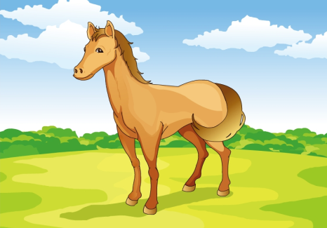
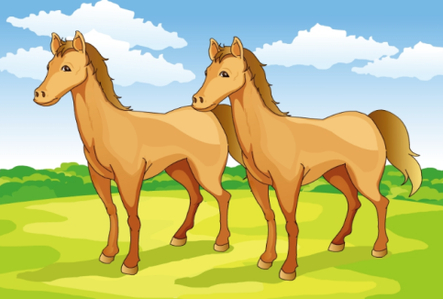
Let’s learn.
a horse
horses

Slide 8
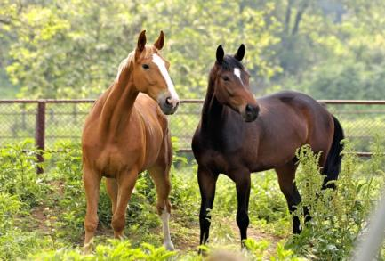
A: What’re these in English?
B: They’re horses.

Slide 9
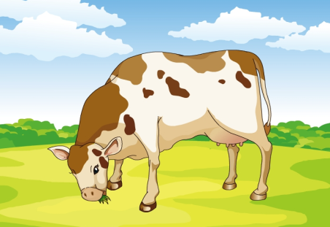
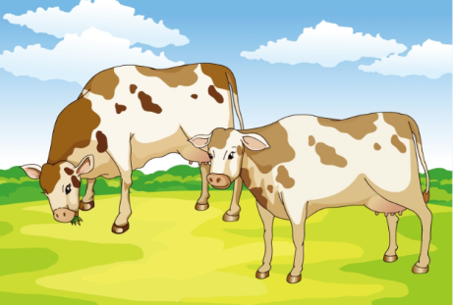
Let’s learn.
a cow
cows

Slide 10
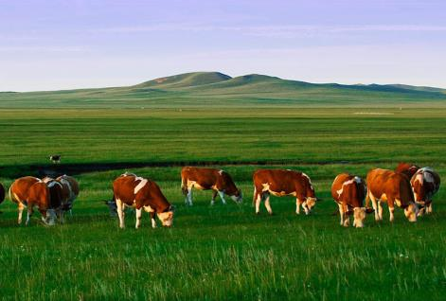
A: What’re these in English?
B: They’re cows.

Slide 11
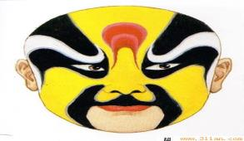
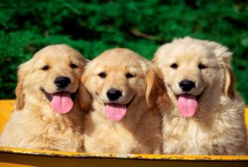
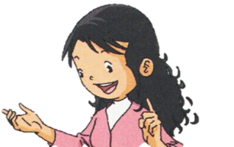
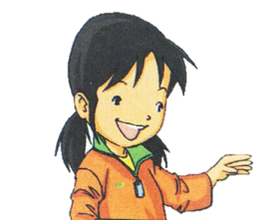
Look and say
What’re these in English?
They’re dogs.

Slide 12
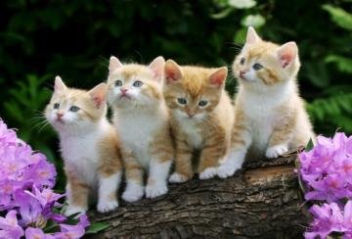
Look and say
What’re these in English?
They’re cats.

Slide 13
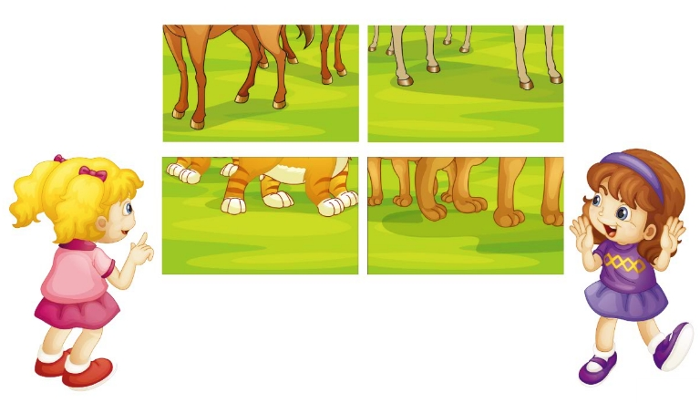
Guess the animals.
Let’s play
What are these in English?
They’re cats.

Slide 14
Practice
Listen and say.
What are they talking about?

Slide 15
Practice
1
Here’s the farm, boys and girls!
2
Oh! What a big farm!
Oh! What a big farm!
3
Look here! What are these in English?
5
What are these in English?
4
They’re horses.
6
They’re cows.

Slide 16
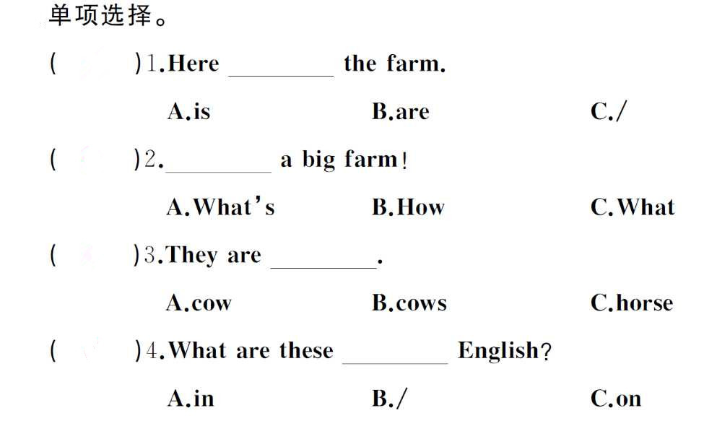
A
C
B
A

Slide 17
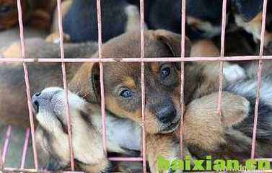
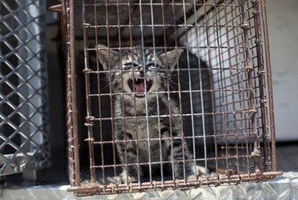
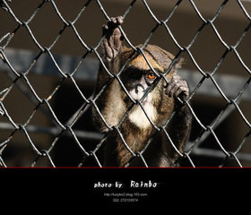
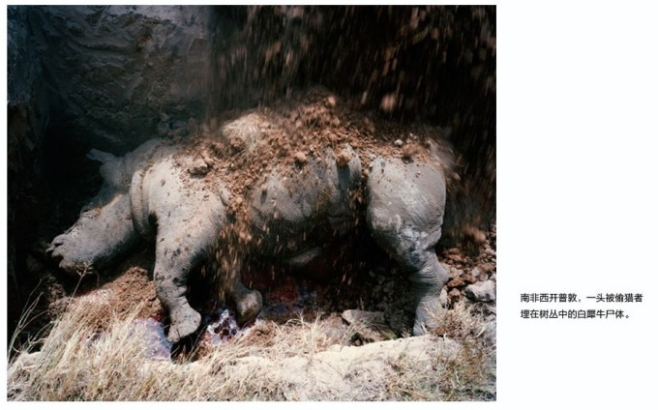
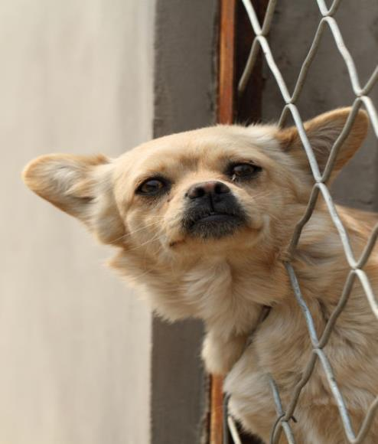
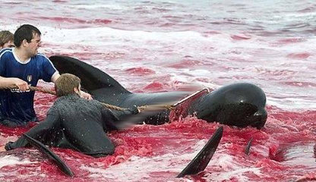
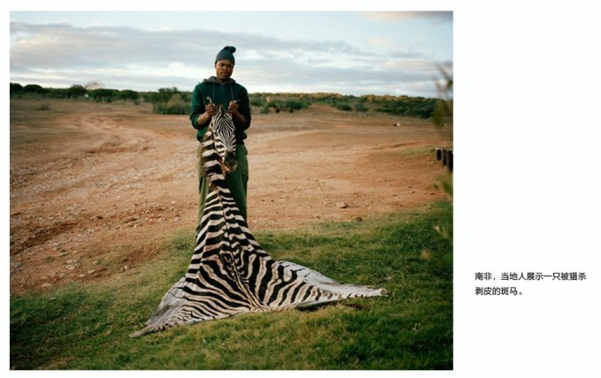
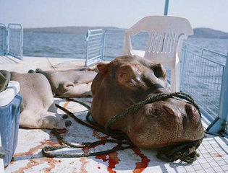
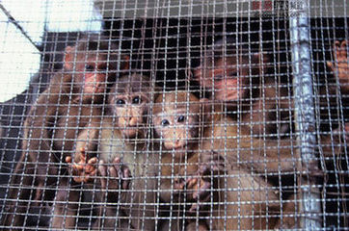

Slide 18
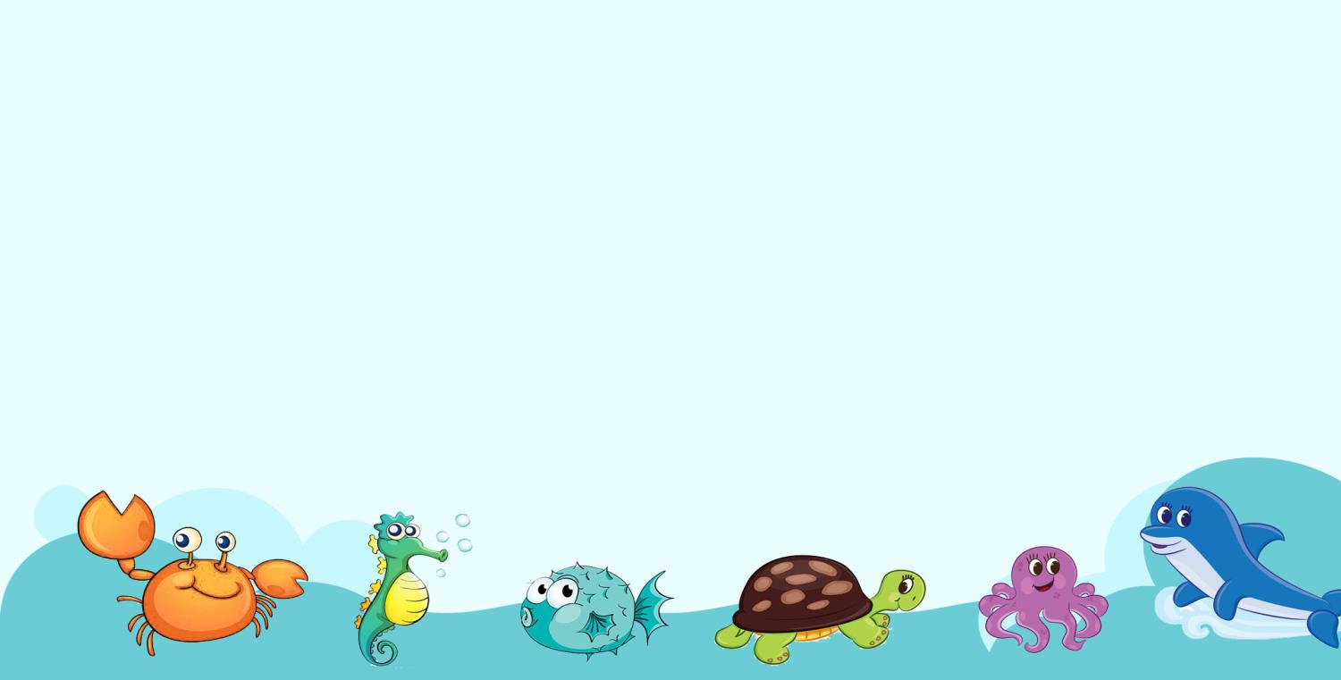
Protect animal duty of everyone.
保护动物 人人有责

Slide 19
Homework:
1.Listen and read the dialogue after class.（必做）
2. Recite the key words and key sentences twice.（选做）
3. Draw a farm picture, and write down the words in the different . （选做）
4.Do exercise-book of this lesson.（必做）

Slide 20
Thank you !
Good bye!

