Slide 1
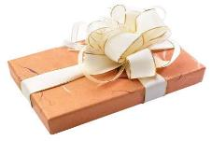
Unit 11
What’s the weather like today!
WWW.PPT818.COM

Slide 2
January, February
March, April
May and June
July, August ,September
October，November，December.

Slide 3
Watch the video

Slide 4
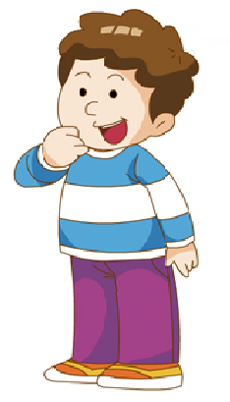
Who’s the boy？
Peter

Slide 5

Where is he from？
England

Slide 6
Peter give us some tips (提示)in England.
In England, it is usually very sunny and warm in April. And it is very dry, too. So we like to play outdoors.

Slide 7
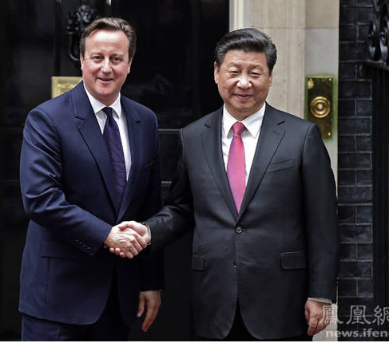
Mr Big
Maybe some day, he will come to China, so Today, we will make some tips(提示) for him in China.

Slide 8
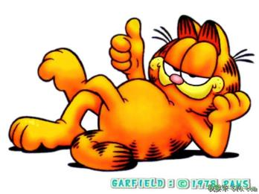
weather

Slide 9
What can you see in the picture?

Slide 10

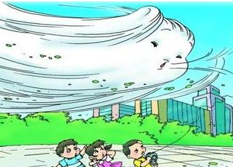
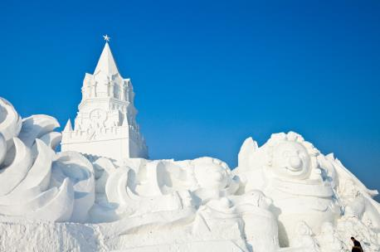
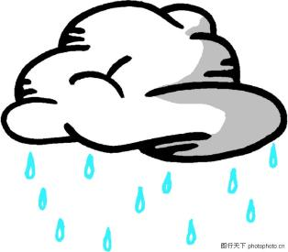
5

Slide 11

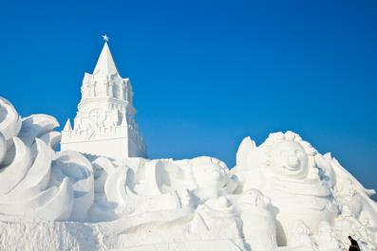
s
snow
c
cloudy
w
wind
s
snow
r
rain

Slide 12
sun
sunny
It’s ________

Slide 13
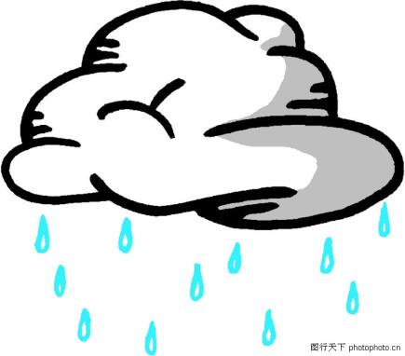
rain
rainy
It’s ________

Slide 14
wind
windy
It’s ________

Slide 15

cloud
cloudy
It’s ________

Slide 16

snow
snowy
It’s ________

Slide 17
It’s wet

Slide 18
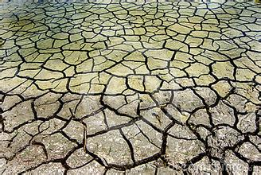
It’s dry

Slide 19

It’s cool

Slide 20
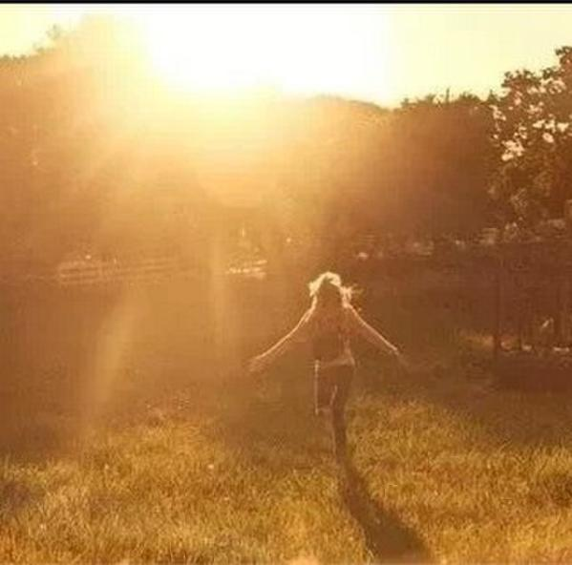
It’s warm

Slide 21

It’s hot

Slide 22

It’s cold

Slide 23
Game 1
What’s the weather like?

Slide 24
We like to_________ .

Slide 25

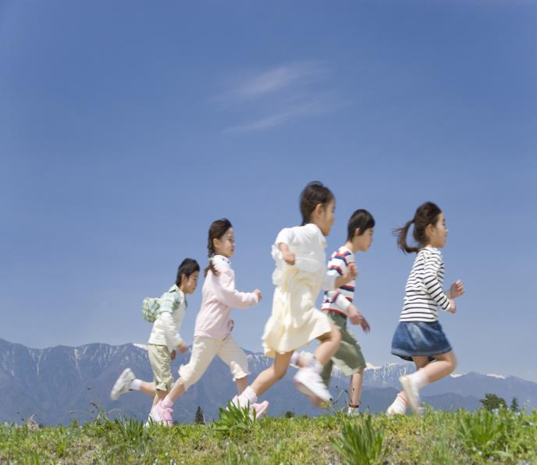
In May, we like to play outdoors.
January
February
March
April
May
June
July
August
September
October
November
December

Slide 26
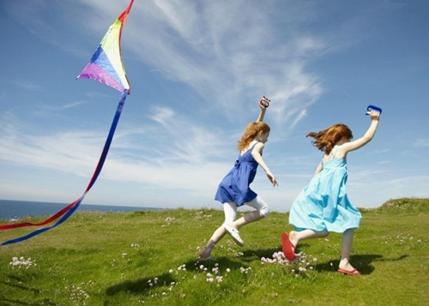
In _____, we like to ________.
January
February
March
April
May
June
July
August
September
October
November
December

Slide 27
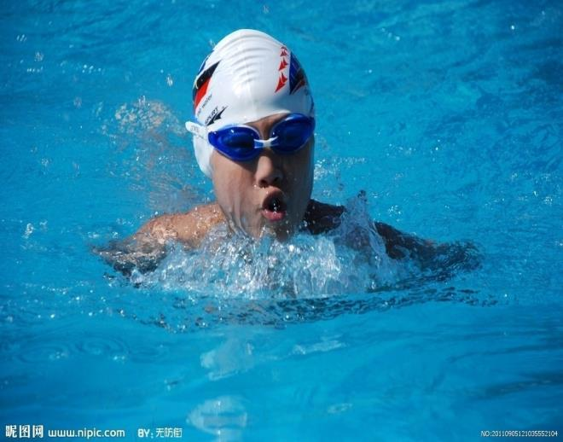
In _______, we like to __________.
January
February
March
April
May
June
July
August
September
October
November
December

Slide 28
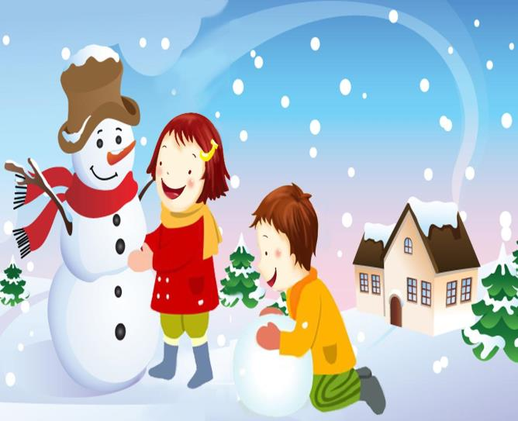
In _______, we like to __________.
January
February
March
April
May
June
July
August
September
October
November
December
Make a snowman

Slide 29
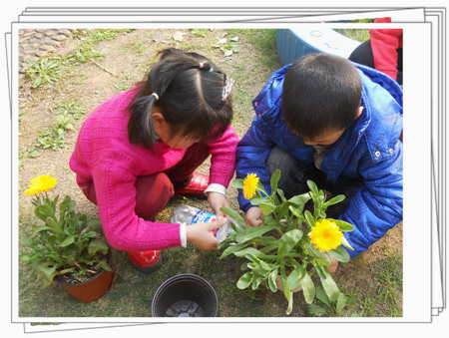
In _______, we like to __________.
January
February
March
April
May
June
July
August
September
October
November
December

Slide 30
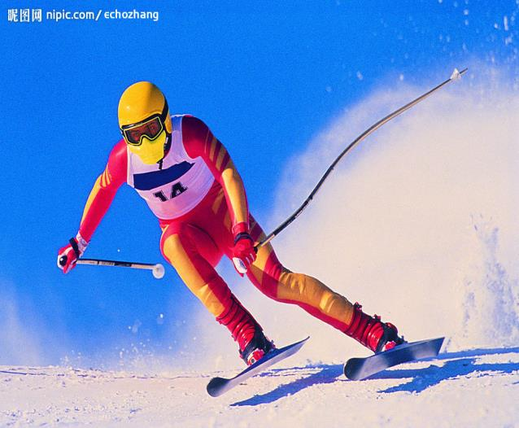
In _______, we like to __________.
January
February
March
April
May
June
July
August
September
October
November
December
ski

Slide 31
In _______, we like to __________.
January
February
March
April
May
June
July
August
September
October
November
December
?

Slide 32
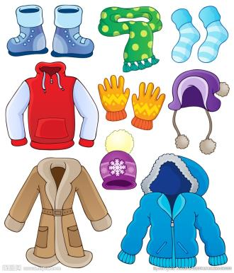
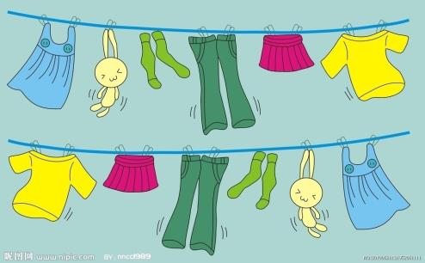
In May, we like to wear T-shirt.
January
February
March
April
May
June
July
August
September
October
November
December

Slide 33
In ________, we like to wear________
?
January
February
March
April
May
June
July
August
September
October
November
December

Slide 34
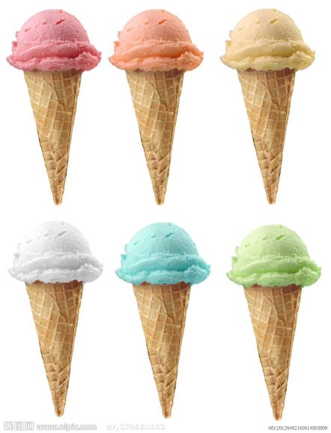
In ______, we like to eat_______
January
February
March
April
May
June
July
August
September
October
November
December

Slide 35
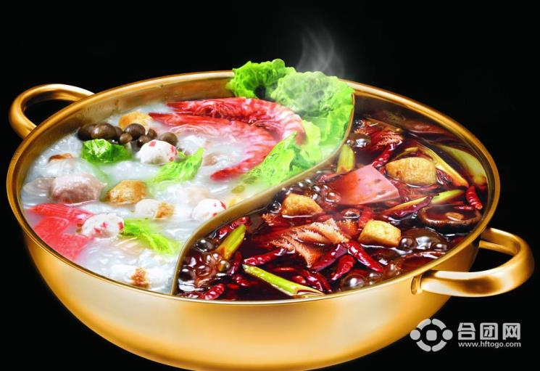
In ______, we like to eat_______
January
February
March
April
May
June
July
August
September
October
November
December

Slide 36
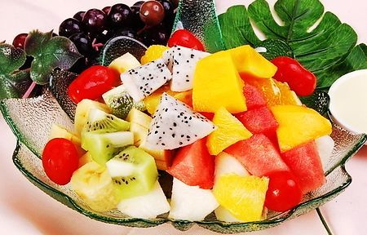
In ______, we like to eat_______
January
February
March
April
May
June
July
August
September
October
November
December
Hot pot

Slide 37
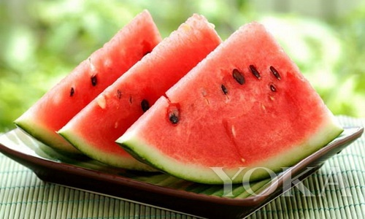
In ______, we like to eat_______
January
February
March
April
May
June
July
August
September
October
November
December

Slide 38
In ______, we like to eat_______
January
February
March
April
May
June
July
August
September
October
November
December
?

Slide 39
In ______,
we like to _______
Eat\do\wear

Slide 40
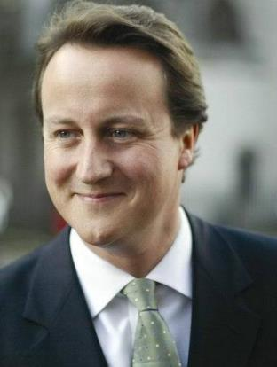
Hey! Mr Big!
Welcome to China.
In August,
it’s hot and sunny.
We usually go swimming
And eat ice cream.

Slide 41
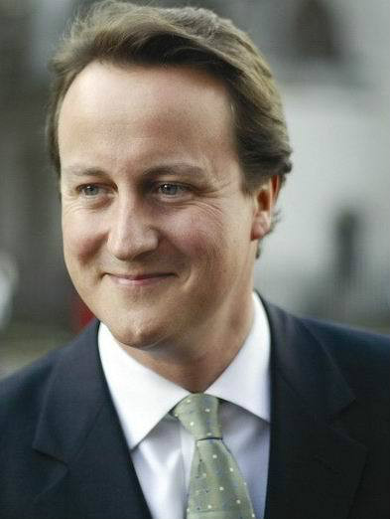
Draw and say
Hey! Mr Big!
Welcome to China.
In _______,
it’s ______.
We usually _______.
…
…
…

Slide 42
Listen and draw
Hey! Mr Big!
Welcome to China.
In _______,
it’s ______.
We usually _______.
…
…
…

Slide 43
Read the dialogue

