Slide 1
Unit 5 Weather
It's snowing.
WWW.PPT818.COM

Slide 2
Let's chant
Sunny, sunny, It's sunny.
Cloudy, cloudy, It's cloudy.
Windy, windy, It's windy.

Slide 3
Aims （学习目标）
1. 学会听、说、认读单词
snow, weather, rain, sorry, dad, raincoat.
2.学会运用句型
How's the weather in ...?
It's ...来谈论天气。

Slide 4
snow
rain

Slide 5
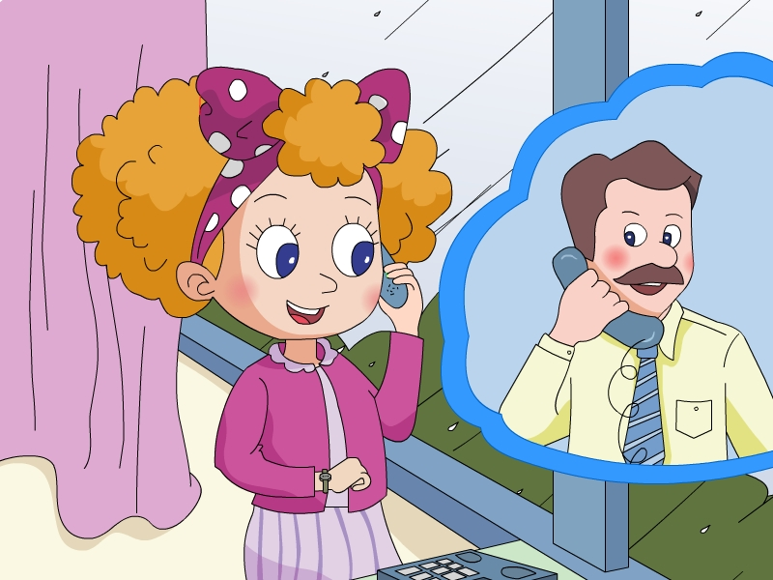

Slide 6
Listen and answer（回答问题）
When Jenny’s dad want to know the weather in Beijing, what does he ask?
How’s the weather in Beijing, Jenny?
It’s raining.

Slide 7
Listen and choose（选择）
How's the weather in Harbin?
A. It’s snowing. B. It's raining.

Slide 8
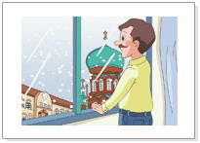
Listen and repeat （跟读）
Oh, it's snowing.

Slide 9
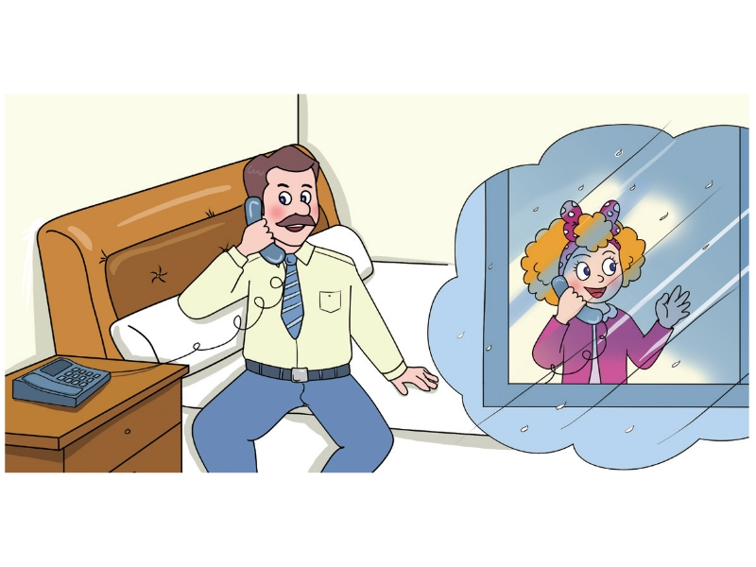
How's the weather
in Beijing, Jenny?
It's raining.

Slide 10
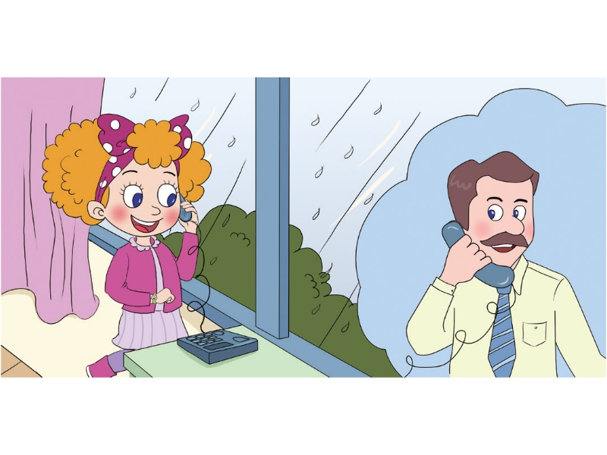
Sorry, dad.It's
time for school.
Put on your
raincoat.
OK. Bye!

Slide 11
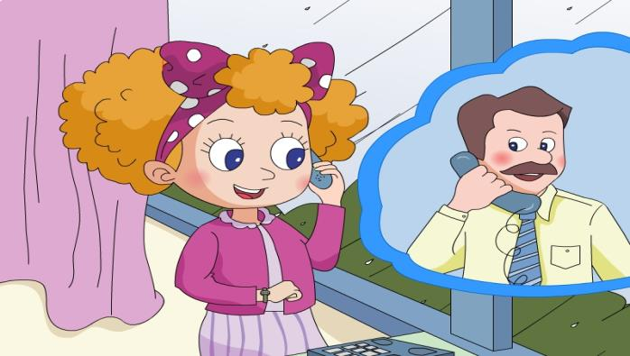
Role play

Slide 12
Let's talk
Shanghai
Harbin

Slide 13
Beijing
Hainan
Tibet

Slide 14
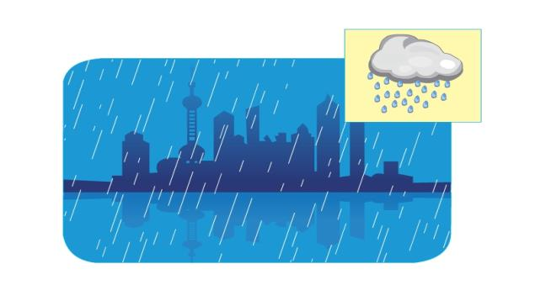
How's the weather in Shanghai?
It's raining.

Slide 15
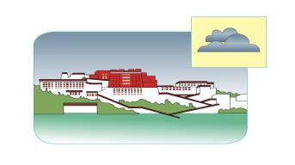
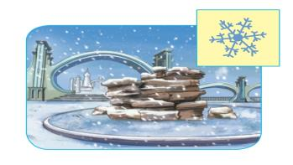
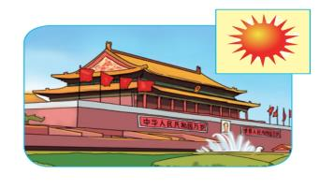

Slide 16
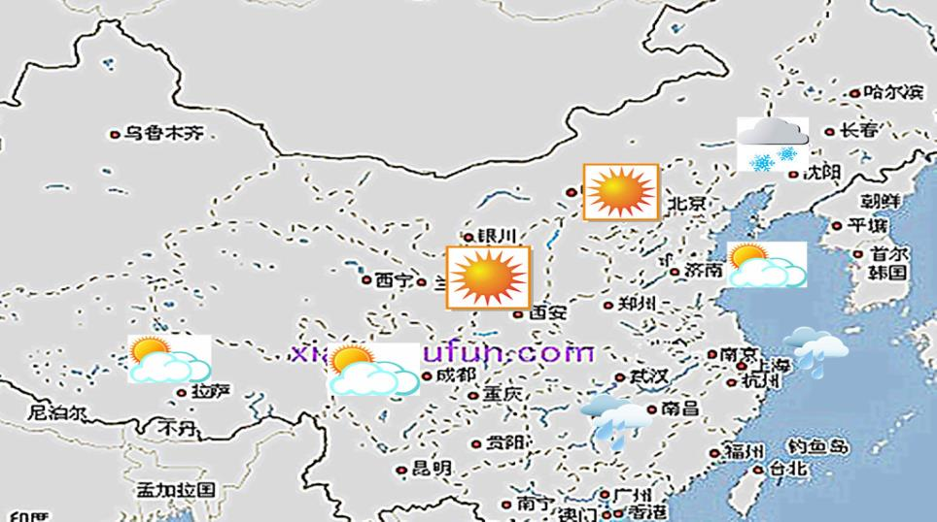
How's the weather in Beijing today?
It's sunny.

Slide 17
Summary
1. Can you read these words?
snow weather rain
sorry dad raincoat
2. Can you read these sentences?
How's the weather in Beijing?
It's raining.

